Slide 1
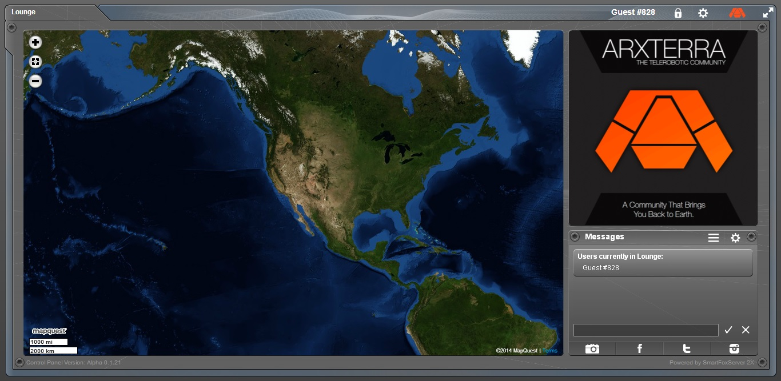
Arxterra: Understanding the Communication Between Arduino and Phone
Tommy Sanchez - EE400D
Connection Type:
How Connect Phone To Arduino
Communication from Phone to Arduino
Communication from Arduino to Phone

Slide 2
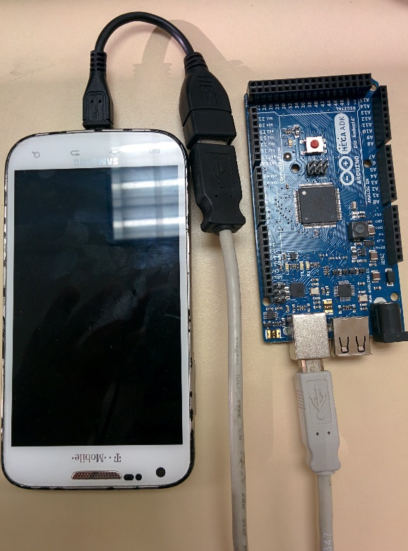
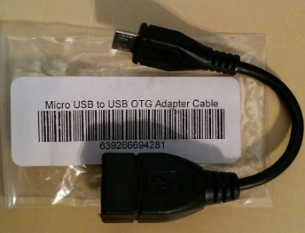
Connection Type: How to Connect Phone to Arduino
There are two ways to connect your phone. Connection Type 1: OTG and Connection Type 2: ADB
Connection Type 1:
OTG
This method allows USB devices (such as a phone) to act as a host. In this method you use a USB to OTG adapter. This method works on both
Arduino Uno or Mega ADK. The type B USB input is used.

Slide 3
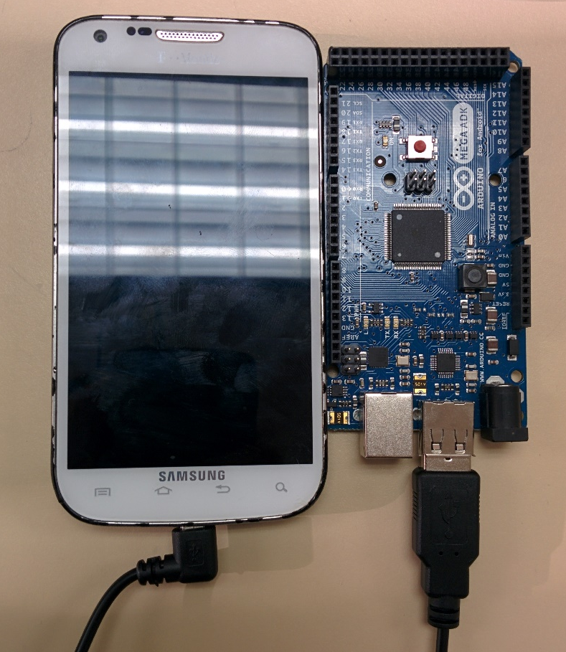
Connection Type: How to Connect Phone to Arduino
Connection Type 2:
ADB (Android Debug Bridge) In our implementation it’s called Microbridge. This method allows communication from the type A input of an Arduino Mega ADK. In other words no adapter is required here.

Slide 4
Connection Type: Which Method Should You Choose
Connection Type 1: OTG
Any phone compatible with the Arxterra App and Arduino Uno Communicator App can connect using this method.
Connection Type 2: ADB For this method your phone must be compatible with the Arxterra App and you must also have USB debugging enabled on your phone(See your phone manual). You must also have the ArduinoADB library(link provided on next slide). If your phone does not communicate even with debugging enabled then use Connection Type 1.

Slide 5
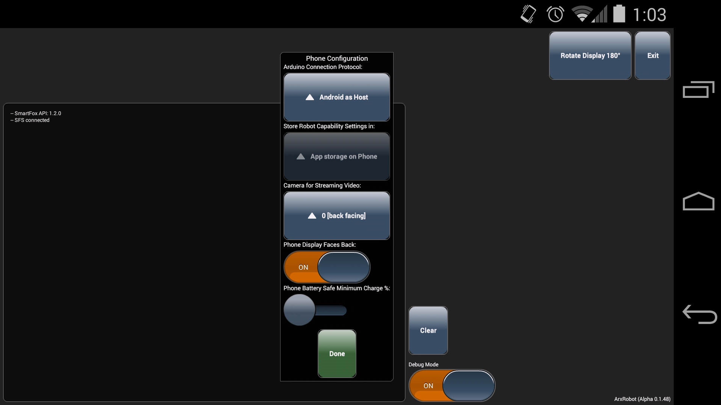
On The App: Choosing Arduino Connection Protocol Base On Connection Type
Depending on whether the OTG or ADB connection type is being used, the Arduino Connection Protocol must be changed accordingly.
If using ADB choose Microbridge.
If using OTG choose Android as Host

Slide 6
The Code:
There are two other sketch’s available if desired, one specifically for Rosco (OTG) and one for Pathfinder(ADB) that only work for that connection type.
https://github.com/arxterra
Note: A hybrid code of these two is covered in this PowerPoint.
In order to simplify communication there is one Arduino sketch that accounts for both connection types. It can be found by going to the link shown below along with the necessary libraries:
https://drive.google.com/folderview?id=0BzOzV5VEB-CjY05SQ3lkMDR6VHM&usp=sharing
The following slides will talk about how the
communication works and where to add your
code using this Arduino sketch.

Slide 7
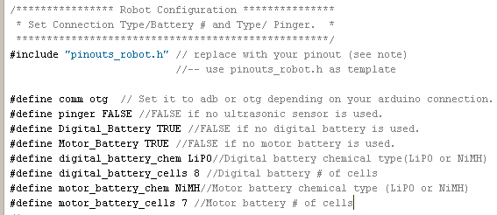
Communication: Quick Robot Configuration
Robot Configuration
In this section at the top of the sketch you configure your connection type, battery types and if using an ultrasonic sensor. Reading the comments here will help you get started with how you should configure each option.

Slide 8
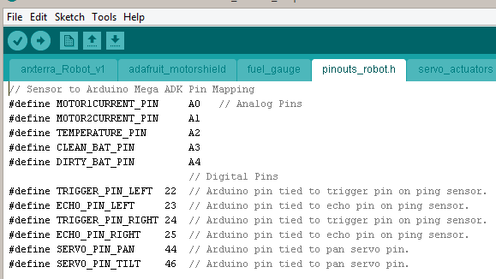
Communication: Quick Robot Configuration
Robot Configuration pinouts_robot.h
The “pinouts_robot.h” tab is where you assign your specific pin configuration for the predefined identifiers. For example, Clean_BAT_PIN, a pin designated for your clean power, is defined to be pin A3.

Slide 9
Communication: Phone to Arduino Commands
Command | Command ID
Move | 0x01
Camera Move | 0x02
Camera Move Home | 0x04
Camera Move Reset | 0x05
Read EEPROM | 0x06
Write EEPROM | 0x07
Safe Rover | 0x08
Sleep | 0x0A
Wakeup | 0x0B
Custom Command | 0x40 to 0x5F
Command ID: The Arxterra
Control Panel is set up for
the following Phone to Arduino Commands
These are also all defined in the Arduino Sketch.
With the exception of custom commands which are determined by you.

Slide 10
Communication: Phone to Arduino
Command | Command ID
Move | 0x01
Command ID and Associated Bytes:
[byte array index] descripton
[0] = 0x01 (MOVE)
[1] = left run (FORWARD, BACKWARD, BRAKE, RELEASE)
[2] = left speed 0 to 255
[3] = right run (FORWARD, BACKWARD, BRAKE, RELEASE)
[4] = right speed 0 to 255

Slide 11
Communication: Phone to Arduino
Command | Command ID
Camera Move | 0x02
Command ID and Associated Bytes:
[byte array index] descripton
[0] = 0x02 (CAMERA_MOVE)
[1] = pan degrees (Most Significant Byte) 0 for most servos
[2] = pan degrees (0 to 180 for most servos)
[3] = tilt degrees (Most Significant Byte) 0 for most servos
[4] = tilt degress (0 to 180 for most servos)

Slide 12
Communication: Phone to Arduino
Command | Command ID
Camera Move Home | 0x04
Camera Move Reset | 0x05
Command ID
[byte array index] descripton
[0] = 0x04 (CAMERA_HOME)
In these two cases there
are no associated bytes
Command ID
[byte array index] descripton
[0] = 0x05 (CAMERA_RESET)

Slide 13
Communication: Phone to Arduino
Command | Command ID
Read EEPROM | 0x06
Write EEPROM | 0x07
Command ID and Associated Bytes:
Read
Write
[byte array index] descripton
[0] = 0x06 (EEPROM_READ)
[1] = Address High
[2] = Address Low
[3] = Number Bytes
[byte array index] descripton
[0] = 0x07 (EEPROM_WRITE)
[1] = Address High
[2] = Address Low
[3] = Number Bytes
[4] = Data (Most Significant Byte)
[5] = ...
[N] = Data (Least Significant Byte) N

Slide 14
Communication: Phone to Arduino
Command | Command ID
Safe Rover | 0x08
Sleep | 0x0A
Wakeup | 0x0B
Command ID
Command ID
[byte array index] descripton
[0] = 0x08 SAFE_ROVER)
[byte array index] descripton
[0] = 0x0B (WAKEUP)
Command ID
[byte array index] descripton
[0] = 0x0A (SLEEP)
In all cases there
are no associated bytes

Slide 15
Communication: Phone to Arduino
Command | Command ID
Custom Command | 0x40 to 0x5F
Command ID and Associated Bytes:
[byte array index] descripton
[0] = command ID in range of 0x40 to 0x5F (64 to 95)
[1 to ?] = Data as dictated by data type user configured
Take a look at the Custom Commands Tutorial for examples:
http://arxterra.com/creating-custom-commands-with-the-arxterra-application/

Slide 16
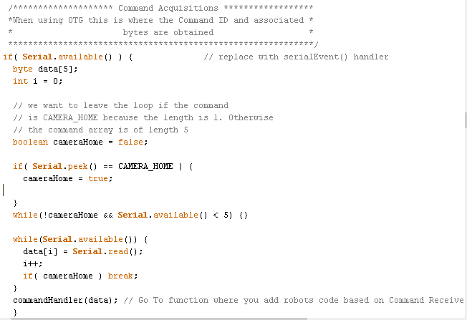
Communication: Phone to Arduino How It Receives Commands
OTG
With OTG type the following is executed to obtain the Command ID and it’s associated bytes. They are put into an array called data[]. The function commandHandler() uses this data array.

Slide 17
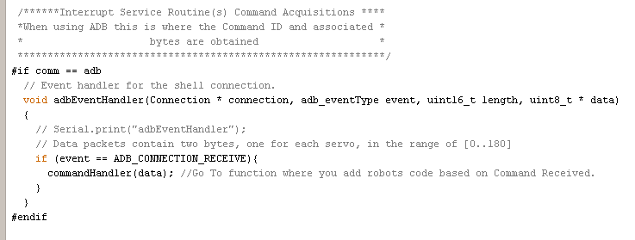
Communication: Phone to Arduino How It Receives Commands
ADB
With adb type the following Interrupt is executed to obtain the Command ID and it’s associated bytes. They are put into an array called data[]. The function commandHandler() uses this data array.

Slide 18
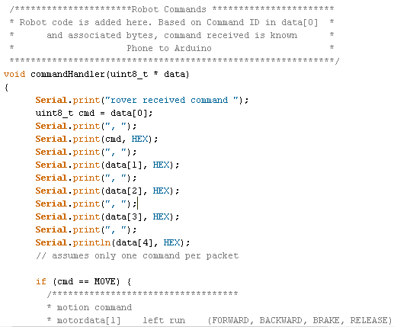
Communication: Phone to Arduino commandHandler()
commandHandler() : This function is where you will decide what your robot does based on the command received.
cmd is set equal to the Command ID which is in data[0]

Slide 19
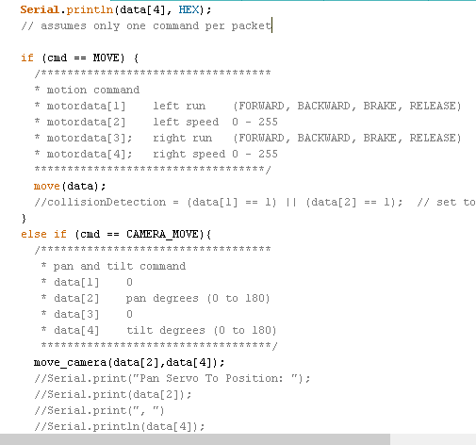
Communication: Phone to Arduino commandHandler()
commandHandler() :
As an example if your command ID(data[0]) is 0x01, that means you received a Move command. You would then be in the “if (cmd == MOVE)” section. Here would be your code for Movement. The kind of movement can be decided based on the associated bytes(i.e data[1]-data[4]).

Slide 20
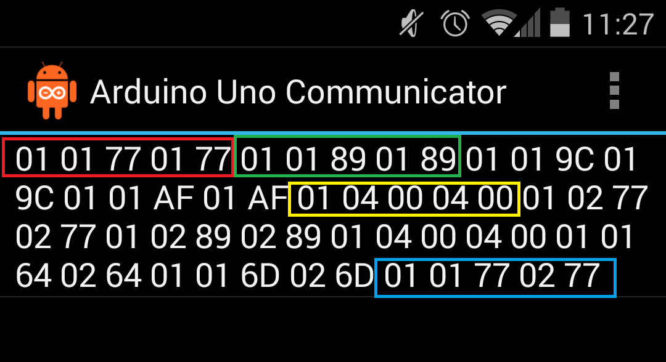
Communication: Phone to Arduino commandHandler()
commandHandler() :
When using OTG connection. The Communicator app will show the data coming in. All the ones shown to the right are Move instructions with its associated 4 bytes. Only a few have been highlighted for illustrative purposes. You can decide what the associated bytes mean for your application
Recall: [byte array index] descripton
[0] = 0x01 (MOVE)
[1] = left run (FORWARD(1), BACKWARD(2), BRAKE(4), RELEASE)
[2] = left speed 0 to 255
[3] = right run (FORWARD(1), BACKWARD(2), BRAKE(4), RELEASE)
[4] = right speed 0 to 255

Slide 21
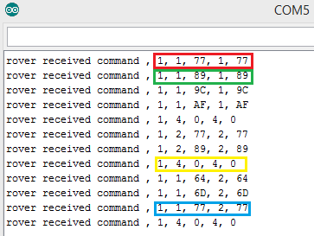
Communication: Phone to Arduino commandHandler()
commandHandler() :
When using ADB connection you can view incoming data from the Arduino Serial Monitor. All the ones shown to the right are Move instructions with its associated 4 bytes. This is the same idea as in the previous slide.

Slide 22
Communication: Phone to Arduino commandHandler()
commandHandler() :
On the Arxterra app with the debug switch to enable you should also be able to see what kind of data you are receiving on the window space with either connection type(OTG or ADB).

Slide 23
Communication: Phone to Arduino commandHandler()
Byte array index
[0] [1] [2] [3] [4]
Move forward Slowly
commandHandler() :
In order to help you better understand how you can translate the associated bytes using the convention at the bottom right, the byte arrays highlighted are illustrated in a structured manner.
Move forward faster
Stop
Turn Right Slowly
Recall: [byte array index] descripton
[0] = 0x01 (MOVE)
[1] = left run (FORWARD(1), BACKWARD(2), BRAKE(4), RELEASE)
[2] = left speed 0 to 255
[3] = right run (FORWARD(1), BACKWARD(2), BRAKE(4), RELEASE)
[4] = right speed 0 to 255

Slide 24
Communication: Phone to Arduino commandHandler()
commandHandler() :
Back in our example the MOVE section called a move() function. This function handles what kind of move to do (left, right, forward, backward) based on the data while leaving that section uncluttered. Again, the associated bytes can be used to help you decide direction.

Slide 25
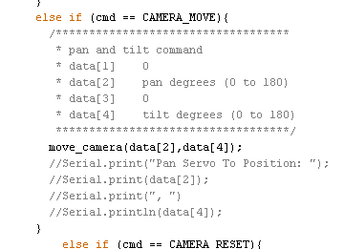
Communication: Phone to Arduino commandHandler()
commandHandler() :
You’ll notice that in the commandHandler function, all the Phone to Arduino Commands are checked. On the right is the check for the CAMERA_MOVE command ID. If 0x02 is the command received it calls a move_camera function.
(used for pan and tilt)
Recall:
[byte array index] descripton
[0] = 0x02 (CAMERA_MOVE)
[1] = pan degrees (Most Significant Byte) 0 for most servos
[2] = pan degrees (0 to 180 for most servos)
[3] = tilt degrees (Most Significant Byte) 0 for most servos
[4] = tilt degress (0 to 180 for most servos)

Slide 26
Communication: Phone to Arduino commandHandler()
commandHandler() : CUSTOM COMMANDS
If you have a custom command
you will have to add your own elseif check and be aware of
What your associated bytes if any are. Naming convention for the command would be up to you. Be sure to look at the
PowerPoint on custom commands.
Recall:
[byte array index] descripton
[0] = command ID in range of 0x40 to 0x5F (64 to 95)
[1 to ?] = Data as dictated by data type user configured

Slide 27
Communication: Arduino to Phone
Telemetry | ID
Motor 1 Current | 0x01
Motor 2 Current | 0x02
Body Temperature | 0x03
Ultrasonic Ranger Left | 0x04
Ultrasonic Ranger Right | 0x05
Digital Battery | 0x06
Motor Battery | 0x07
Pan | 0x08
Tilt | 0x09
EEPROM Read Results | 0x0A
Custom Command Status | 0x40 to 0x5F
To send telemetry information from the arduino to phone the following ID’s are used.
These are also all defined in the Arduino Sketch.
With the exception of custom commands which are determined by you.

Slide 28
Communication: Arduino to Phone
Telemetry | ID
EEPROM Read Results | 0x0A
Custom Command Status | 0x40 to 0x5F
Telemetry ID and Associated Bytes:
Custom
EEPROM
[byte array index] descripton
[0] = command ID in range of 0x40 to 0x5F (64 to 95)
[1 to ?] = Data as dictated by data type user configured
[byte array index] descripton
[0] = 0x07 (EEPROM_WRITE)
[1] = Address High
[2] = Address Low
[3] = Number Bytes
[4] = Data (Most Significant Byte)
[5] = ...
[N] = Data (Least Significant Byte) N

Slide 29
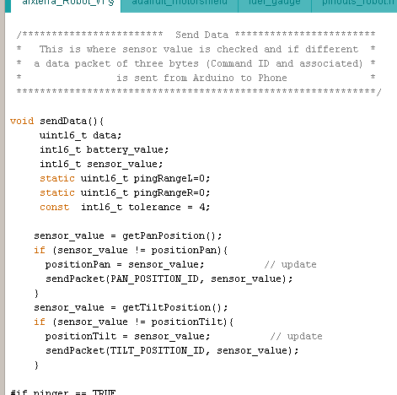
Communication: Arduino to Phone sendData()
Send Data:
The sendData function is used to check whether there has been a change in anything from the telemetry table on the previous slides. The two if statements on the right check if a new pan or tilt position was detected and if so go to the sendPacket function with this information.

Slide 30
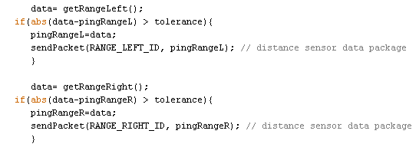
Communication: Arduino to Phone sendData()
Send Data:
For the Ultrasonic sensor, telemetry is only sent to the phone if the difference from a previous ping to the new ping is greater than the tolerance. Again if this is true, the information is used by the sendPacket function.

Slide 31
Communication: Arduino to Phone sendData()
Send Data:
The other telemetry checks in this function work much the same way of detecting a change. If custom commands are used this is where you would add a telemetry check based on your robot needs. The
Example on the right could be used as a template.

Slide 32
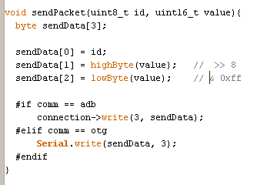
Communication: Arduino to Phone sendPacket()
sendPacket:
If any change is detected in sendData that information is taken over to the sendPacket function. This function contains the ID for the telemetry and its associated values. Depending on if you’re using OTG or ADB connection type the information is sent to the phone accordingly.

Slide 33
Extra Resources/Information
Setting Up the Code For The Arduino ADK:
Tutorial Provided by Ryan Fiske (Fall 2013)
http://www.arxterra.com/wp-content/uploads/2013/10/ArxterraCodeSetup.pdf
USB to USB OTG cable to connect to
Android phone using the OTG connection Type
Tutorial on logging in to control panel and applications http://www.arxterra.com/get-up-and-running-with-the-arxterra-control-panel-android-applications/
Tutorial on Custom Commands on the Arxterra Control Panel/App http://www.arxterra.com/creating-custom-commands-with-the-arxterra-application/

