Slide 1
Github & Arduino
How To: Post On Github How To: Download from Github How To: Upload Code Downloaded from Github to Arduino
Tommy Sanchez
EE400D Spring 2014

Slide 2
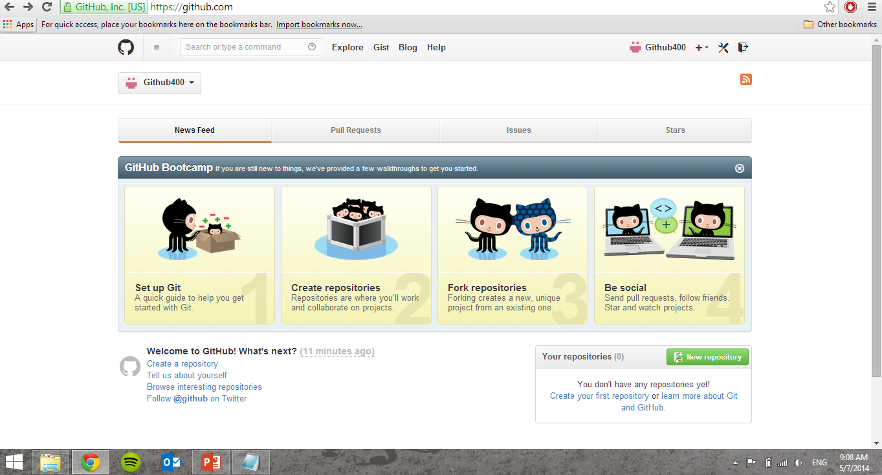
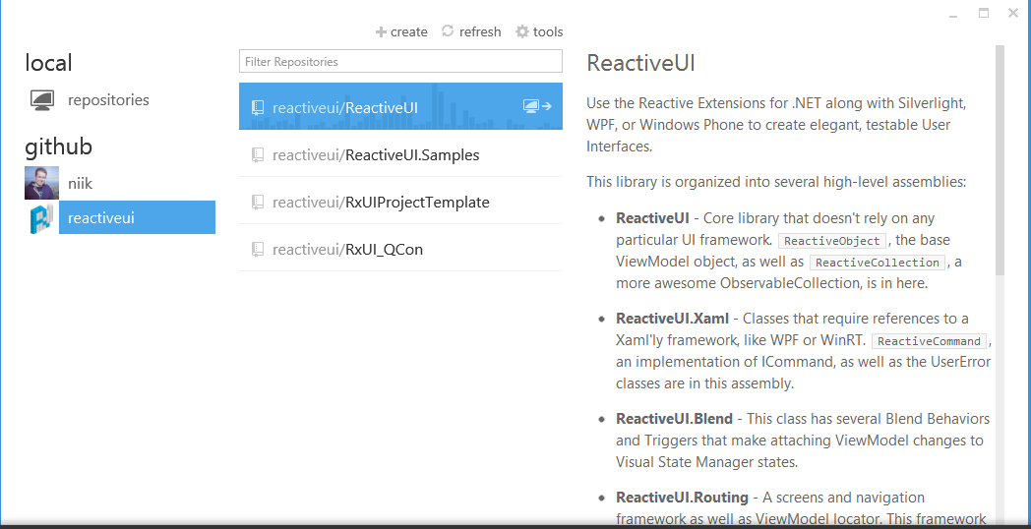
The Web Interface & The Program Interface
There are two interfaces to add files to Github. The slides will cover both. (The program method is best/easiest for multiple files)

Slide 3
Account
Visit www.github.com and create an account if you don’t have one.

Slide 4
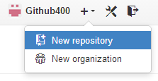
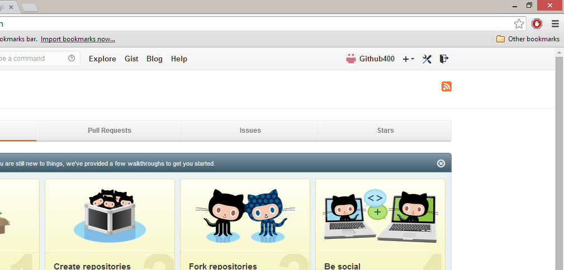
The Web Interface
In order to upload any files you need to create what is called a repository.
To create one, click on the + sign at the top right of the Github page.
Once the drop menu show click “New repository”.

Slide 5
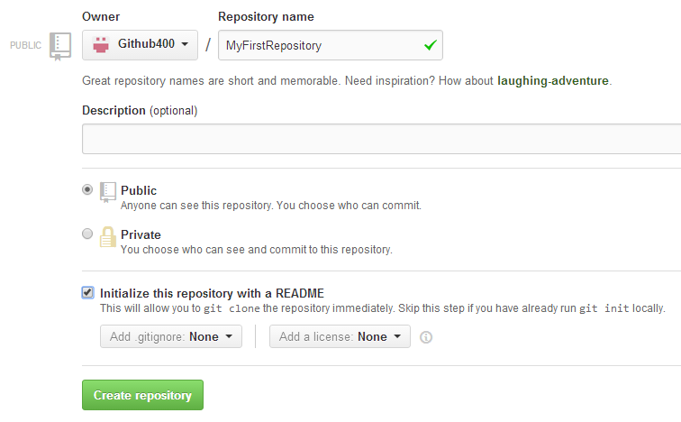
The Web Interface
On the New repository page give it a name, choose public or private, initialize a Readme file if desired, and click “Create repository”.

Slide 6
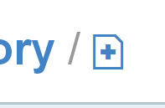
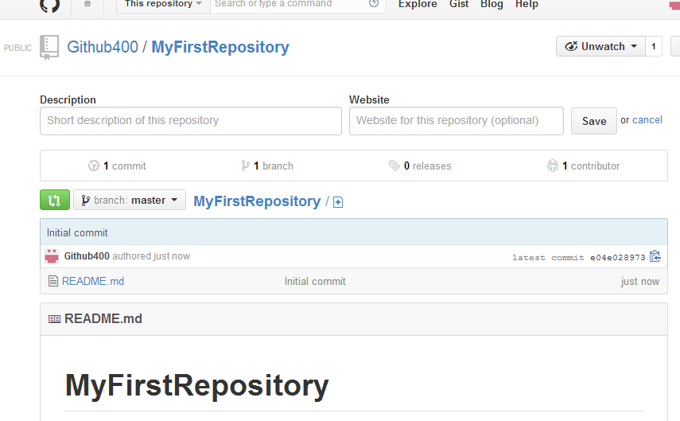
The Web Interface
To add a file to your new repository click + icon.

Slide 7
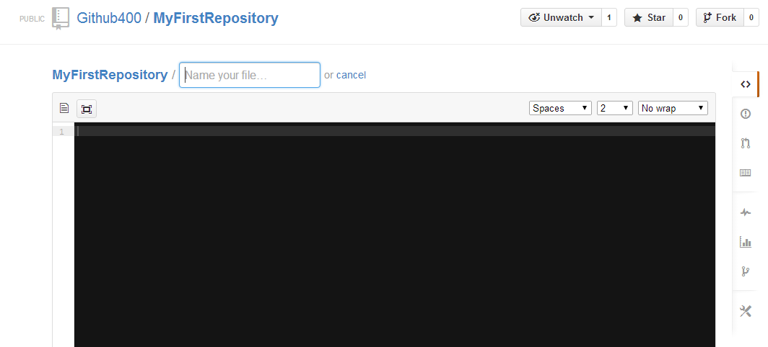
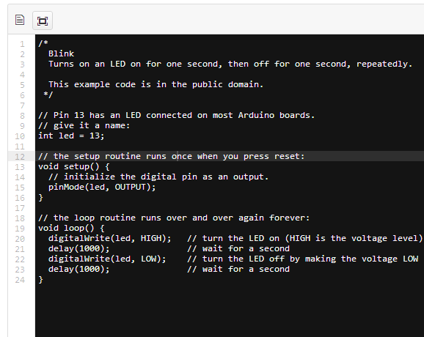
If you want to add a file to a folder, under the “Name your file” box follow this example:
MyFirstRepository/NewFolder/File
Your file name should include its extension.
I will add an Arduino blink file to Github into a
folder called blink.
After this you add the Blink code to the black
Windows space:
Click commit new file(at the bottom of the page) once done with these steps

Slide 8
If you want to add a file to the main repository, under the “Name your file” box follow this example:
MyFirstRepository/File
Your file name should include its extension.
I will add an Arduino blink file to Github into a
folder called blink.
After this you add the Blink code to the black
Windows space:
Click commit new file(at the bottom of the page) once done with these steps

Slide 9
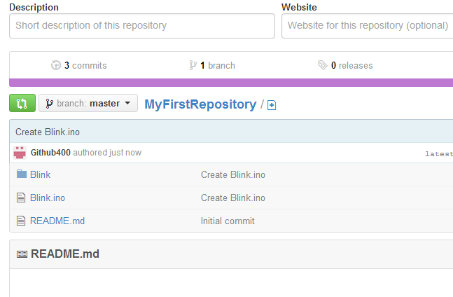
The Web Interface
After committing the new file you’ll see the files in your Repository as shown below. The Blink folder also contains a Blink.ino file.

Slide 10
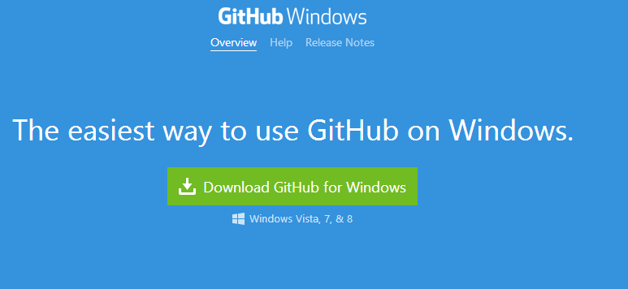
The Program Interface
https://windows.github.com/
https://mac.github.com/
To use the program interface you first need to download it from either of the following links depending on your computer’s operating system

Slide 11
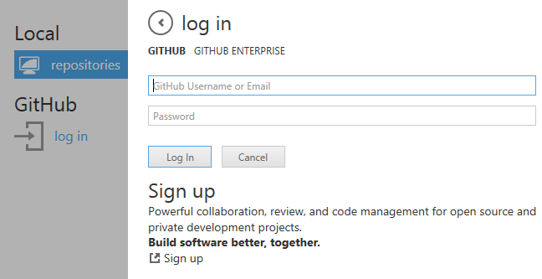
The Program Interface
When you open the program you’ll see the following: Click login
Type in your account info

Slide 12
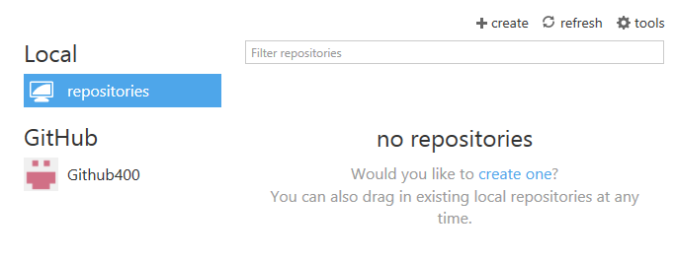
The Program Interface
There are two way of creating a repository on the program

Slide 13
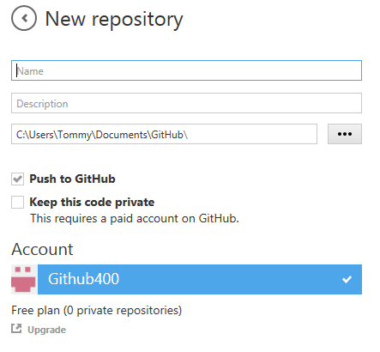
The Program Interface
When you hit create a New repository the New repository
screen will show up. Here you give
your repository a name and description and then hit create.

Slide 14
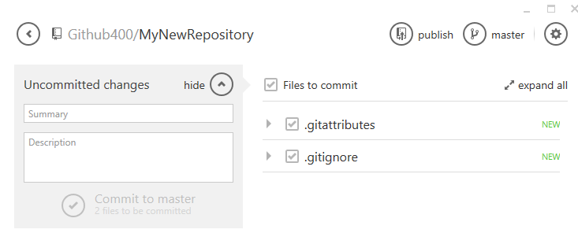
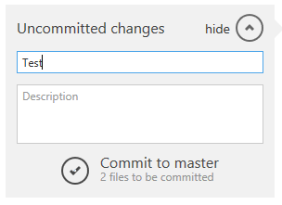
The Program Interface
From the previouse slide, I named the repository MyNewRepository. The window above is shown once you hit create button which was shown on the previous slide. double clicking on the new repository brings you to the window below. In the Uncommitted changes form fill out the summary section with a name or short
summary. Once you do, hit Commit to master and then hit publish.
Only clickable once
summary text field
has text.

Slide 15
The Program Interface
The easiest method is to drag the folder or individual files you want to the program
to immediately have a repository created for it.

Slide 16
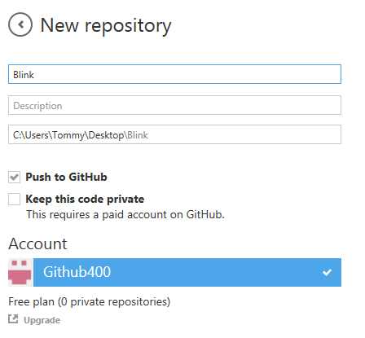
The Program Interface
A Blink example. I have dragged a folder name Blink that has a Blink.ino file inside.
The file name was automatically filled out and all you need to do is hit create.

Slide 17
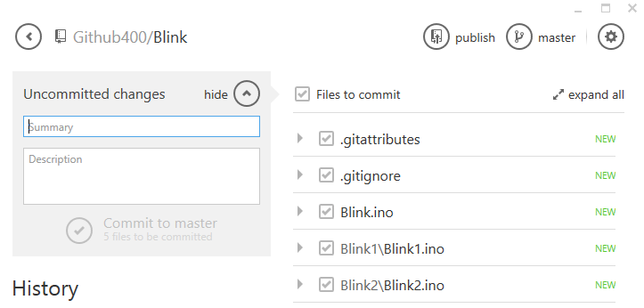
The Program Interface
The window above is shown once you hit create button which was shown on the previous slide. double clicking on the new repository brings you to the window below. In the Uncommitted changes form fill out the summary section with a name or short
summary. Once you do, hit Commit to master and then hit publish.
Only clickable once
summary text field
has text.

Slide 18
The Program Interface
If you notice, dragging a folder into the program creates a repository that includes all the code files in the folder. So if your folder contained many Arduino sketches they would all automatically be included.

Slide 19
Back On The Web Interface
If you notice there are two new repositories now: “MyNewRepository” created using the first method on the program interface,
And “Blink” using the second method on the program interface.
You can also see the “MyFirstRepository” created from the web interface.

Slide 20
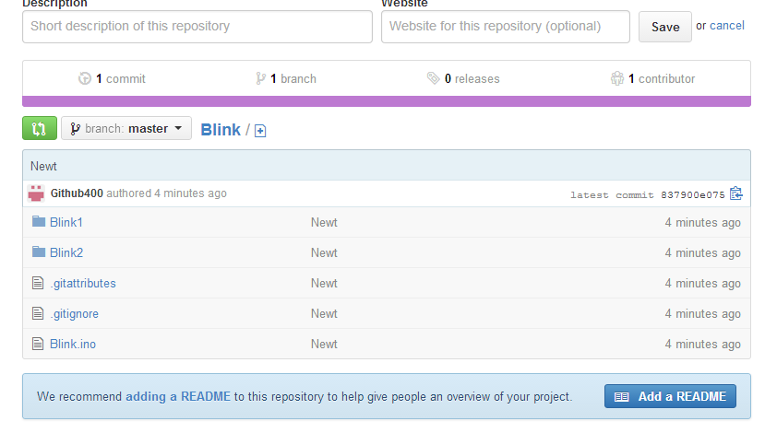
Back On The Web Interface
Clicking on the Blink folder will show you all its contents on the web interface.

Slide 21
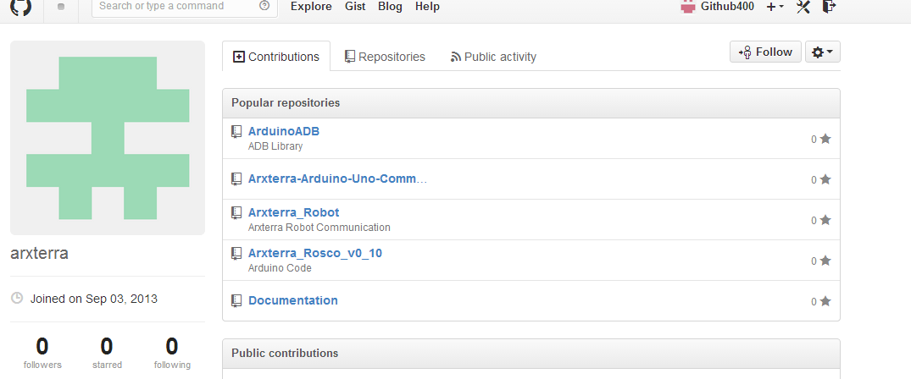
Downloading Code From Github
To download from Github you first click on a repository you want to download. In this instance I will be choosing Arxterra_Robot from Arxterra’s Github page as an example.

Slide 22
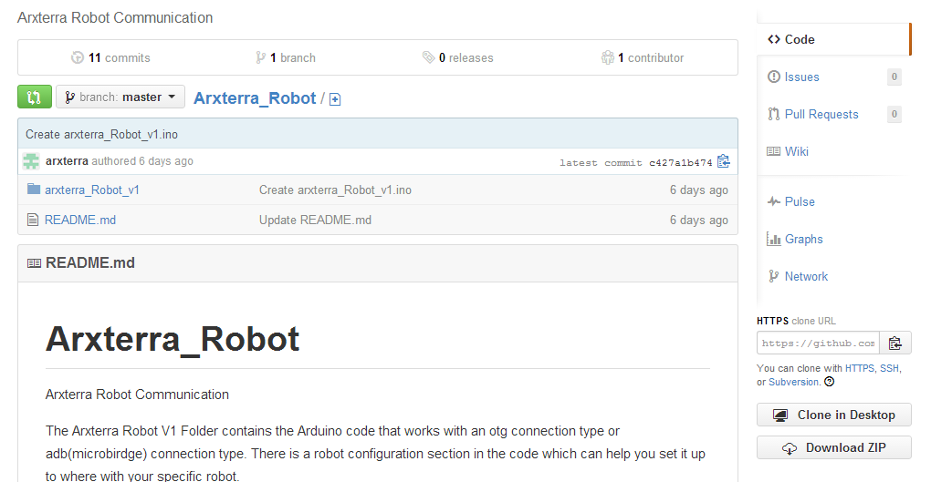
Downloading Code From Github
Once in the repository you can fine a “Download ZIP” button on the bottom right which will allow you to download the files in the repository. In this case it will be the arxterra_Robot_v1 folder.

Slide 23
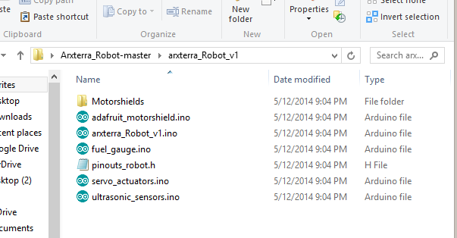
Uploading to Arduino
Once you extract the zip file to a folder of your choosing, open to find it’s content. In this instance the contents of the arxterra_Robot_v1 is what I want. I open the sketch by double clicking on its main part, the file named arxterra_Robot_v1.ino

Slide 24
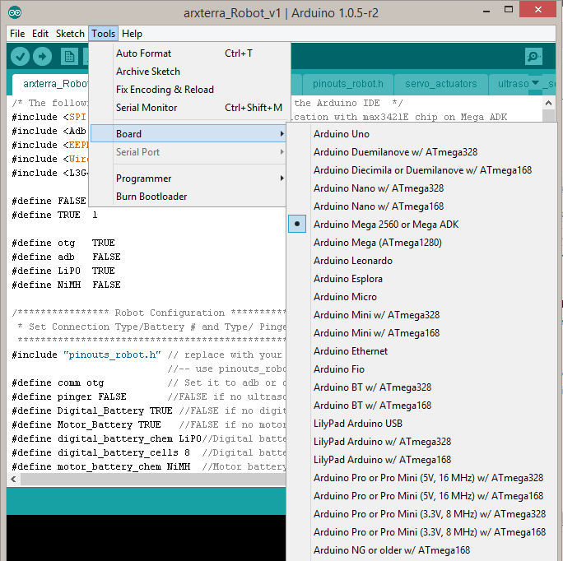
Uploading to Arduino
In order to make sure code uploads properly, two this are very important: One is you must define the board you are using and the Serial Port your device is connected to.
If you do have communication issues, one thing you can check is your serial baudrate.
You can read a little on baudrate here:
http://arduino.cc/en/Serial/begin

Slide 25
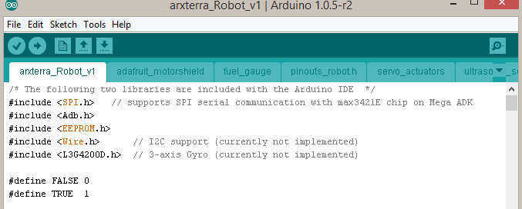
Uploading to Arduino
This check icon is clicked to compile your code and check for errors.
This right arrow icon is clicked to compile your code and check for errors first, and then upload it to your board.
Finally once you have the correct board and serial port connected click the check icon to compile the code, and click the right arrow icon to compile and upload.

Slide 26
Uploading to Arduino
If at the bottom of the Arduino program you see an error after trying to compile or upload, here is where you can get an idea of where you begin your troubleshooting.

