Slide 1
Creativity Exercise
By Lam Nguyen (Project Manager)
Hal Vongsahom (System Engineer)
Taylor Farr (Electronics and Controls Engineer)
Aaron Choi (Manufacture Engineer)

Slide 2
Spring 2016 Velociraptor Performance
Accomplished
Designed a biped robot that resembled a Tyrannosaurus class
Statically walk
Balance on Left/Right foot
Turn to an angle of 45 degrees left or right

Slide 3
Spring 2016 Velociraptor Problems
Problems:
Servos could not support the mass of the robot
Leg design fluid for like motion could be improved
Head and Tail limited to motion in the xy plane (left and right)
Accelerometer was limited the robots ability to balance itself on inclines
Turning motion was split into segments

Slide 4
Questions
How can we improve the design of the legs for a better fluid like motion?
Can we the expand the motion of the Head and Tail to move up and down?
What are the other options instead of servos
Do we need more servos/motors?
What can we use to have the foot inverted up?

Slide 5
Brainstorm
Leg Design
Theo Jansen Model by Mark Plecnik
Strandbeests by Mr. Theo Jansen – mechanism
Six – Bar Compliant Leg Design
Human Gait Motion
Foot can articulate upwards
Head & Tail improvements
Animatronix Tail
Planar Manipulation

Slide 6
Brainstorm (continued)
Replace Servos
DC motors
Stepper Motors
Other factors:
Accelerometer (Sensor)
I2C
3Dot Board

Slide 7
Attributes Properties
Major Attributes:
Material
Wood
Aluminum
Filaments
Input
I2C
Bluetooth interface
Motor shield
3. Output
DC motors/Stepper Motors/Servos
Bluetooth
I2C
Shape
Dinosaur: T-Rex
Head & Tail
Legs Design & Feet

Slide 8
Lateral Thinking
Forced relationship:
Compared raptor robot to a dog
A raptor that travels on 4 legs
A raptor that chews its food
A raptor that barks.
A raptor that wags its tail.
Compared raptor robot to fish
A raptor that uses its tail and head to swim
A raptor that is water resistance
Compared raptor robot to a swing
A robot that swings back from and forth
A raptor that is aerodynamic
Compared to a plane
A raptor that has basic mechanical structures
A raptor that uses jet fuel
A raptor that has engine
A raptor that is shielded from external forces

Slide 9
Different Point of View
Velociraptor in the future
Able to maneuver around builds, cars, and city objects
Apex Predator
Velociraptor with less resources for food
Conserve energy
Able to conceal itself around it’s environment to hunt for preys

Slide 10
Jansen’s Linkage
Theo Jansen’s Strandbeest
Models Humanoid Gait Motion
Actuation on Single Joint

Slide 11
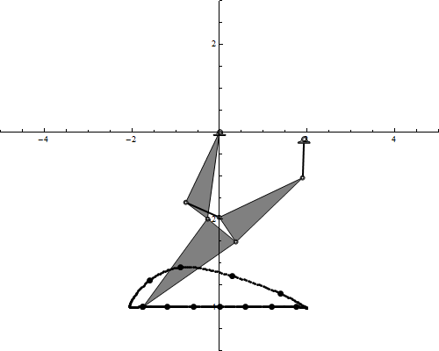
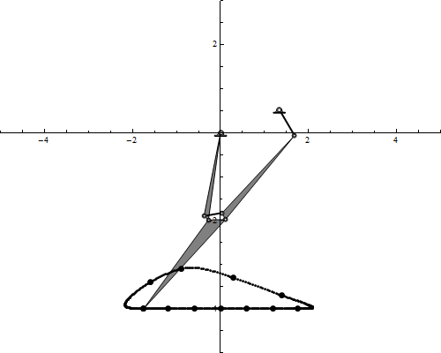
Walking Linkages
“Each are single degree-of-freedom and would be driven by a single crank rotating at constant angular velocity.“
-Mark Plecnik (UCI Professor)

Slide 12
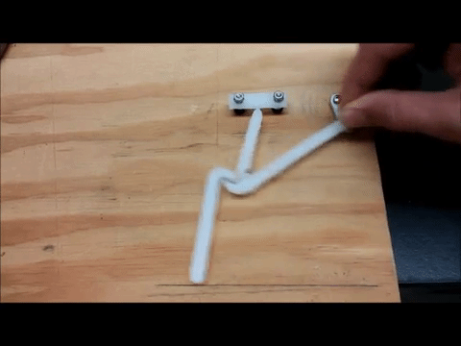
Prototype of Six-bar Compliant Leg Module

Slide 13
Human Gait Motion

Slide 14
Human Gait Motion
The function generator motions are passed to the distal joints by parallelogram linkages.
Dynamic simulation propels the body forward by friction forces at the foot
Hip assembly was permitted to bob up and down
fore-aft and lateral rotations were artificially constrained so that the machine does not tip over

Slide 15
Foot Design (Old Design)

Slide 16
Foot Design
Grip tape
Rubber
Mesh

Slide 17
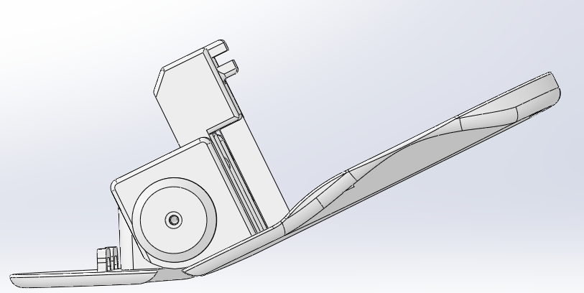
Foot Design
“Kinesiology-Based Robot Foot Design for Human-Like Walking “
Spring Mechanism
Enhance Performance and stability

Slide 18
Servos vs. DC Motors
Problem: Last semester’s project used servos for the legs. The servos provided sufficient torque, but there was too much weight applied to it.
DC motors can continuously run as opposed to servomotors which typically can only move 200 degrees.
Here is a clip demonstrating the differences:
https://www.youtube.com/watch?v=mSowgNx5u7I

Slide 19
DC motors vs Servo Motors

Slide 20
Servos vs. DC Motors (con’d)
Motors must use pwm to activate the dc motors
Pros:
-The DC motor provides continuous motion to the load.
-They can start and stop at a precise angle.
Cons:
-We need to implement position sensors in order to control the PWM, so this means additional effort would need to go into the design of the robot.

Slide 21
Stepper Motors
Stepper motors would also be a good design solution to our problem.
Pros:
- Stepper motors are brushless which means they have longer lifetimes.
- Stepper motors are digital, so they can be positioned accurately without overshoot (helps with controls)
- Speed control is more accurate
Cons:
- These motors might be jittery compared to a dc motor.
- They might not be able to stop at a necessary angle.

Slide 22
Possible Tests to be run
Once our team has established the load in the legs required to move the robot.
We would find an appropriate rating, and run the motor at this rating.
We can then measure the current, and thus determine the power required.

Slide 23
Work Cited for Motors
Position Feedback: http://www.infineon.com/dgdl/Position_Feedback_for_Motor_Control_Rev.1.1%5B1%5D.pdf?fileId=db3a3043293a15c4012940fa76d32a0b
Strengths of stepper motors: http://www.strobotics.com/stepper.htm

Slide 24
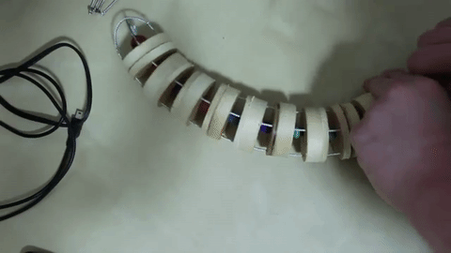
Animatronic Tail
Balancing capability
Able to shift the center of mass (left, right, up, or down)

Slide 25
Animatronic Tail (Other options)

Slide 26
Planar Manipulation
Have a mechanical design along certain axis for balance
Rotate the gears to manipulate the head and tail to get (left, right, up, and down)
Simple design

Slide 27
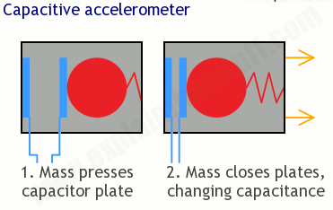
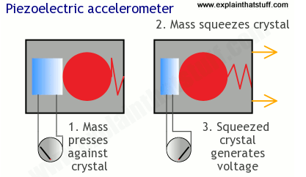
What is a Accelerometer?
Accelerometer is an electromechanical devil that measure acceleration forces.

Slide 28
Accelerometer
Last semester's robot had problems associated with the Accelerometer. There was too much of a time delay which causes the systems to go unstable. In addition, when the sensor data was uploaded the Arduino it used up to 50% memory.
A solution is to improve and test the code so that the time delay is minimal. One is shorting the line of codes. This usually has to do with memory. The sampling rate of data can be reduced such that less data is stored in microprocessor. Another option is to have increase memory for the Arduino.
Connect the Accelerometer directly to the I2C or SPI for a accurate and faster response.
Another option would be to chose a microprocessor that has a higher clock speed.
Use a digital accelerometer rather than analog from previous semester which also improve shorting the codes.
Consulting with the electronics and control division manager would help to figure out what king of controller would be necessary to understand the specs that may be out of our scope.

Slide 29
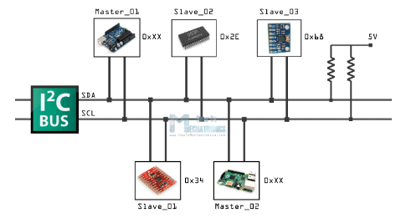
Why I2C board?
We are limited to 2 DC motors and 2 servos for the 3DOT board.
IC2 we will not be restricted to 2 DC motors and 2 servos . We can have multiple motors.
Source: http://www.dimensionengineering.com/info/accelerometers & explainthatstuff.com

Slide 30
Work Cited
Leg Design
Prototype of Six-bar Compliant Leg Module
Link: https://www.youtube.com/watch?v=4LEE9VlVABU
Strandbeests by mr. theo jansen – mechanism
Link: https://www.youtube.com/watch?v=NM4q-f68TlY
Leg Mechanism Design
Link: http://sites.uci.edu/markplecnik/projects/leg_mechanisms/leg_designs/
Dual Leg Mechanism
Link: https://www.youtube.com/watch?v=NM4q-f68TlY

Slide 31
Work Cited (cont’d)
Motion
Theropod (Biped Dinosaur) Motion Theory:
Link: https://www.youtube.com/watch?v=Cu3kgDwhca0
4 Leg Walking Robot Developement Part 1
Link: https://www.youtube.com/watch?v=qqfmUl49f-4
Dinosuar-like Biped Robot TITRUS-III
Link: https://www.youtube.com/watch?v=GxVv4WNlXMA
Animatronic Characteristic Basic
Link: https://www.youtube.com/watch?v=0eOjTqVWMB0
Animatronic Tentacle
Link: https://www.youtube.com/watch?v=6DnLeDYwXVE
Design of a biped robot actuated by pneumatic artificial muscles
Link: http://content.iospress.com/download/bio-medical-materials-and-engineering/bme1367?id=bio-medical-materials-and-engineering%2Fbme1367

Slide 32
Work Cited (cont’d)
Head & Tail Design
Animatronic Tail
Link: https://www.youtube.com/watch?v=39v8euC7XNs
Animatronic Tongue
Link: https://www.youtube.com/watch?v=nk4vu-Mi6c0
Animatronic Arduino based tail
Link: https://www.youtube.com/watch?v=K3zMpfdUjAs
PEAUCELLIER MECHANISM CATIA V5
Link: https://www.youtube.com/watch?v=BIbq-ZIuHi8
TITRUS -III
Link: https://www.youtube.com/watch?v=GxVv4WNlXMA

Slide 33
Work Cited (cont’d)
Other topics
Joints:
Pipe movable connection 1
Link: https://www.youtube.com/watch?v=DwrlPPTBrPA&list=PLxhvN8x26MRQiSqB18C3Iw_-DX7EdfBWZ&index=106
Humanoid-gait
Link: http://sites.uci.edu/markplecnik/projects/humanoid-gait/
Bio-inspired Robotics
Link: https://www.youtube.com/watch?v=fL83al5Ew-s

