Slide 1
Critical Design Review
Lam Nguyen (Project Manager)
Gifty Sackey (System Engineer)
Taylor Farr (Electronics & Controls Engineer)
Aaron Choi (Manufacturing Engineer)

Slide 2
Executive Summary - Project Objectives
The objective of Fall 16 Velociraptor is to use the Theo Jansen robot design to produce a walking robot. The robot will be remotely controlled through Bluetooth communication by utilizing the Arxterra Control Panel. The robot’s application will utilize the 3DoT MCU board and demonstrate it’s feasibility by participating in a game with other robots.

Slide 3
Executive Summary - Mission Profile
The Mission Profile of the Fall 16 Velociraptor is to participate in the game arena called Save the Robot on the last day of school, December 14th 2016. The game will involve Velociraptor chasing other toy robots through various terrains tele-robotically from the Arxterra control panel. The robot’s application of the 3DoT board MCU will demonstrate it’s walking capabilities by navigating through terrains in a game.

Slide 4
Executive Summary - The Design

Slide 5
Executive Summary - Project Features (1)
Rod application and body platform
Load = Rod
Fulcrum = Center of Gravity
Effort = desired position for the rod

Slide 6
Executive Summary - Project Features (2)
2 DC motors
Theo Jansen Model
Leg Design covered movement motion
Gear Manipulation
Controls the head and tail with one servo
Source: https://www.adafruit.com/product/1841

Slide 7
Executive Summary - Experiment List/Checklist
Head and Tail with one servo
Back of the Envelope calculation for Torque requirements
Stress test on Solidworks for our 3D Model

Slide 8
System Design - System Block Diagram

Slide 9
Interface Definition

Slide 10
Interface Definition: Cable Tree

Slide 11
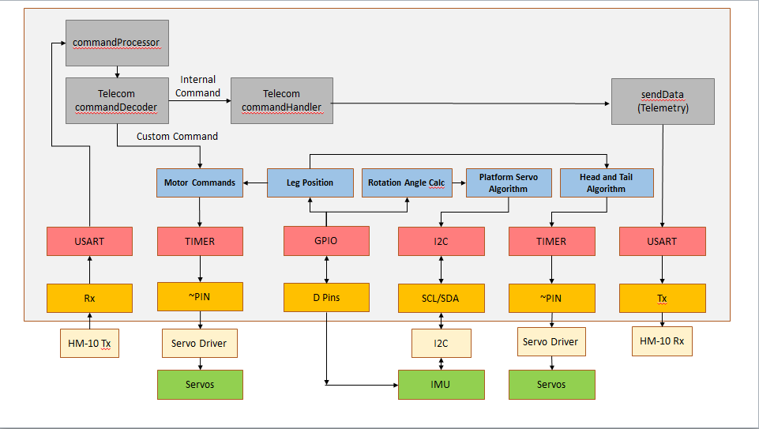
Software Block Diagram

Slide 12
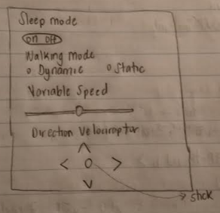
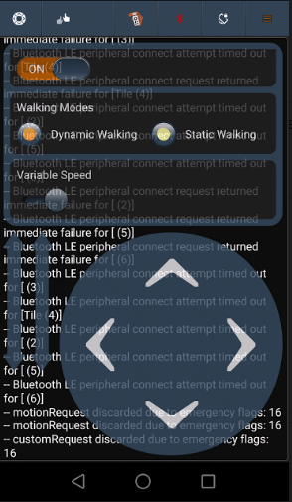
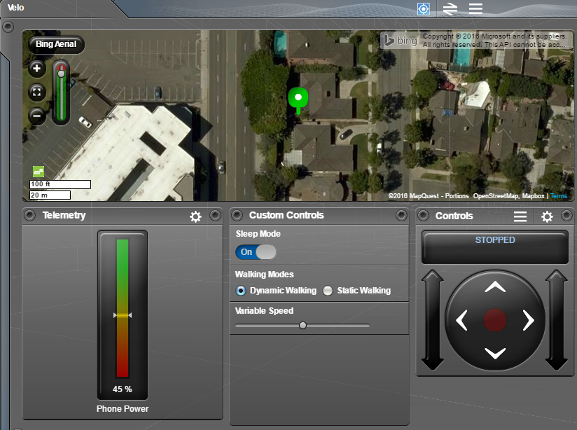
Mission Command and Control - Software Block Diagram

Slide 13
Electronics Design - IMUs
MPU 6050
MPU 9250
Features:
6 axis gyro and accelerometer.
gyro full-scale range of ±250, ±500, ±1000, and ±2000 °/sec (dps)
accelerometer full-scale range of ±2g, ±4g, ±8g, and ±16g
Features:
9 axis gyro, accelerometer, and compass
gyro full-scale range of ±250, ±500, ±1000, and ±2000 °/sec (dps)
Incorporates Magnometer

Slide 14
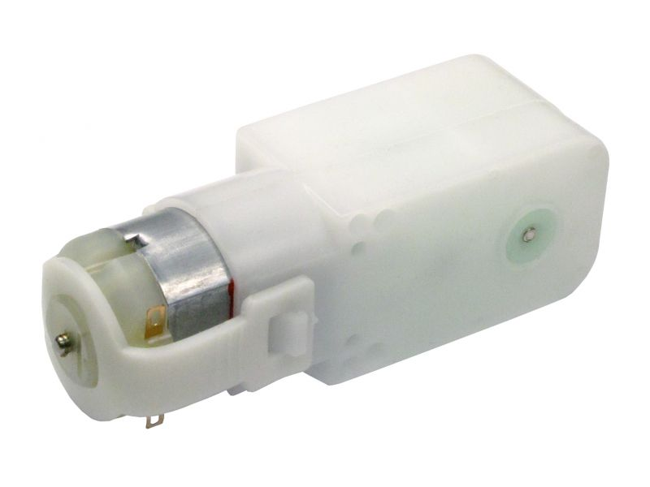
Electronics Design – DC Motors
Motor | Voltage | Speed | Torque | Free-Running Current | Stall Current
Gm9 | 3 | 40 rpm | 44.4 oz-in | 50 mA | 400 mA
Gm6 | 3 | 64 rpm | 25 oz-in | 64 mA | 326 mA

Slide 15
Electronics Design – Rotary Encoders
In order to control the velociraptor speed and position of the legs, we must have a sensor to indicate this.
Most I2C encoders have a long potentiometer attached to them which makes them very awkward for our design.
Bourns 3382 position sensor is slim.
It is a potentiometer that produces an analog signal

Slide 16
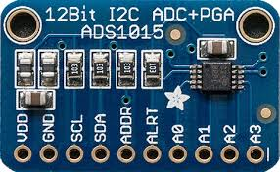
A/D for Rotary Encoders
We will use the ADS1015 12 bit, I2C A/D converter.
This will allow us to digitize the potentiometer signal that will be used as an input that will determine the position and rpm of our motors for control.

Slide 17
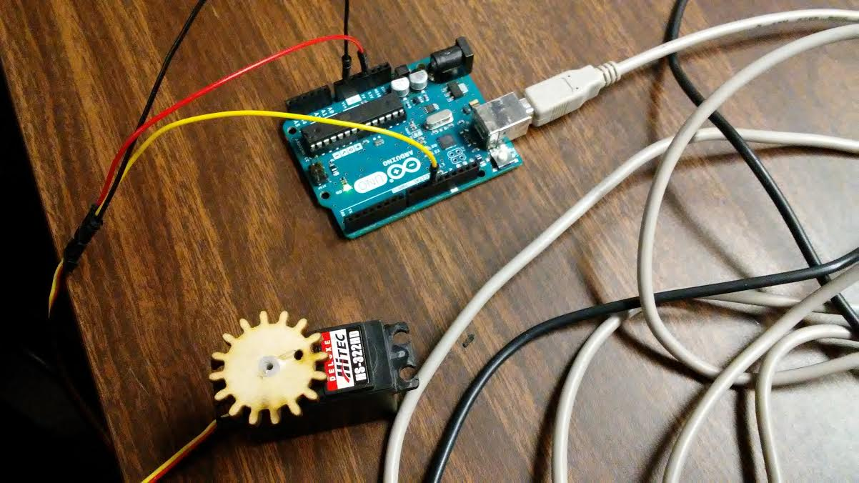
Servos

Slide 18
PCB Schematic – Fritzing diagram

Slide 19
PCB Schematic - EagleCAD Schematic

Slide 20
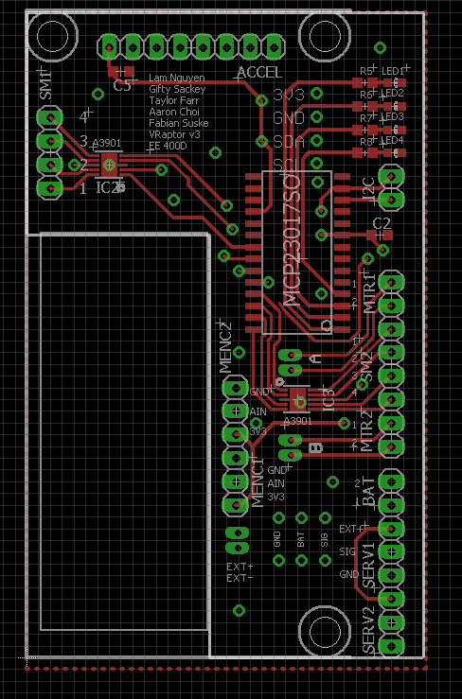
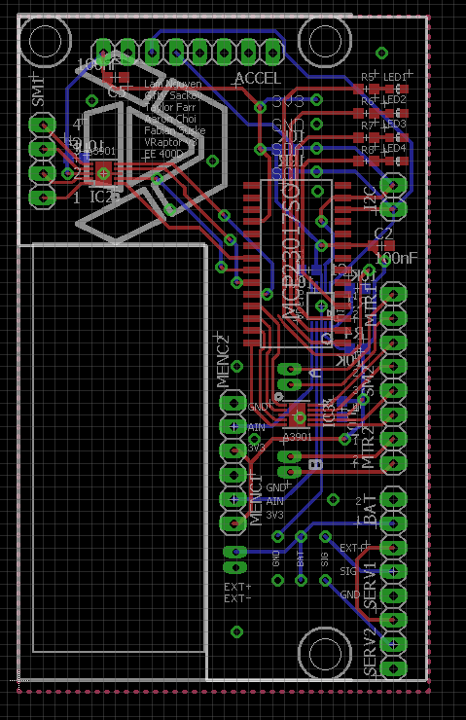
PCB Layout - EagleCAD PCB
Top View
Bottom View

Slide 21
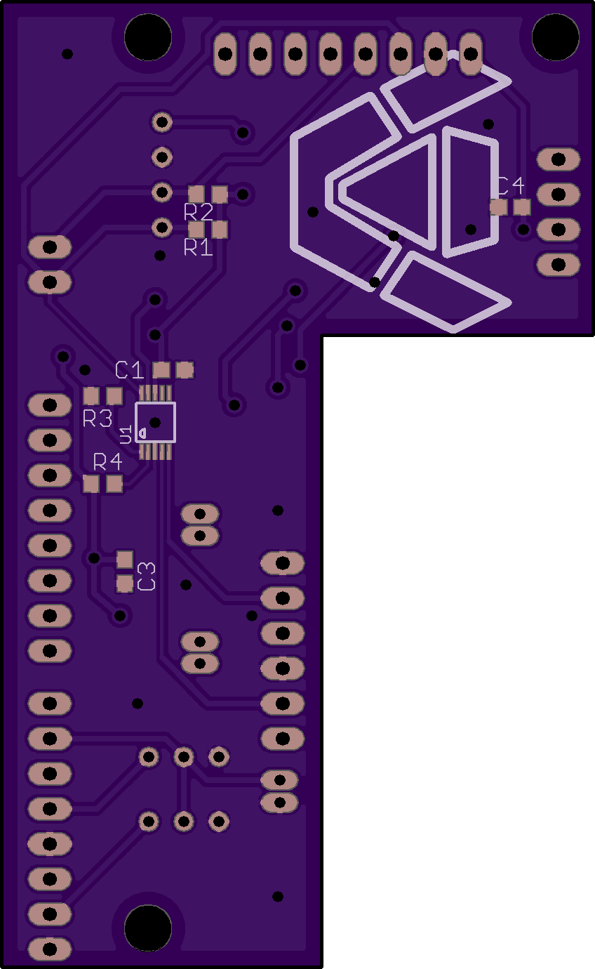
PCB Layout - Physical
Top View
Bottom View

Slide 22
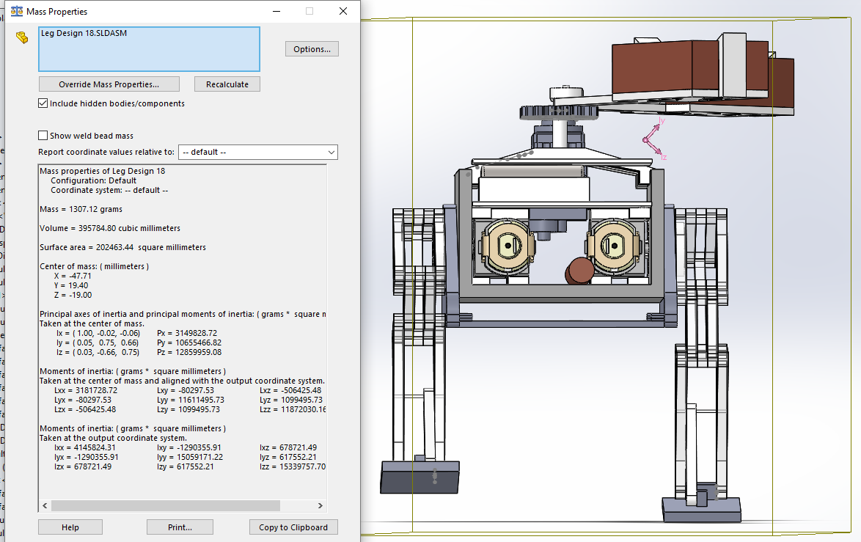

Slide 23
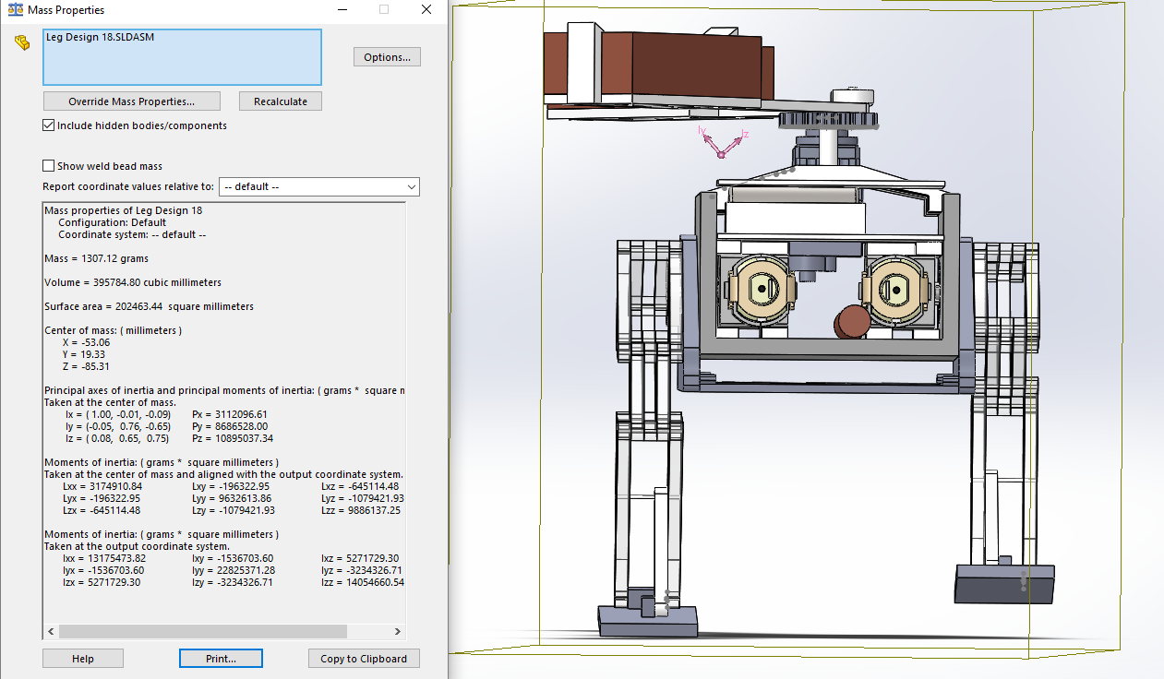
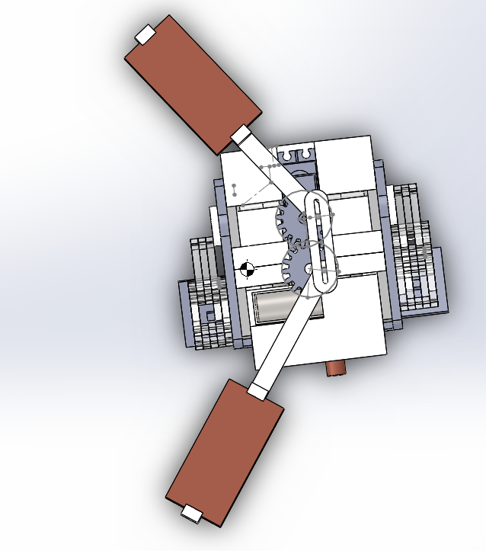

Slide 24
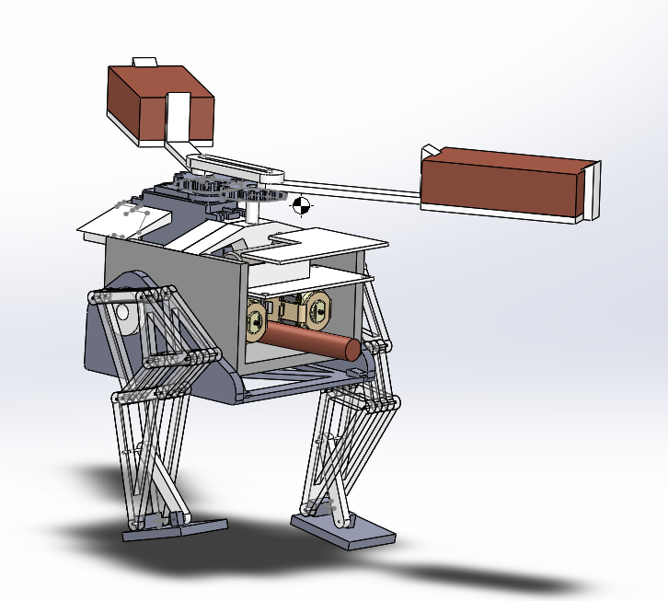

Slide 25
Steps Toward Validation & Verification
Battery testing that needs to performed in order to determine how long the length duration for the velociraptor to walk during the end of semester game
Determining the right center of gravity in order to allow proper weight shifting of the velociraptor
Identifying the proper angles for the velociraptor to make a complete left or right turn

Slide 26
Validation
Requirement : The Velociraptor should be similar to Titrus –III
Success Criteria : The overall physical representation of the Velociraptor should look like a Titrus-III
Validation Method : Inspection
Requirement: Shall be able to walk on inclines of (+/-) 6.5 degrees
Success Criteria: It shall be able to walk on inclines and declines as well as flat terrains
Validation Method: Demonstration

Slide 27
Validation
Requirement :Should dynamically walk on all surfaces of the game
Success Criteria : The velociraptor has to shift its weight on one leg to achieve dynamic walking
Validation Method : Demonstration
Requirement: Shall use Bluetooth to communicate with Arxterra Control Panel
Success Criteria: The control panel shall be done on Arxterra firmware on an android device via Bluetooth telemetry
Validation Method: Demonstration

Slide 28
Verification
Requirement : Shall use DC motors to control the robot’s walking motion
Success Criteria : Both legs will be powered by DC motors instead of servos
Validation Method : Demonstration
Requirement: Shall have a shield for the 3DOT board and implement the I2C interface
Success Criteria: External PCB shield will be implemented using I2C interface to communicate with 3DOT board
Validation Method: Inspection

Slide 29
Verification
Requirement : Shall use DC motors to operate legs at optimal torque [TBD] rated for 50% margin of mass driven
Success Criteria : The maximum torque that the motor outputs will be less than the optimal torque.
Validation Method :Inspection
Requirement: The IMU shall track acceleration, gyration, and magnetic force and provide location angles for the robot
Success Criteria: A control algorithm PID will be used to make sure the right angles are being produced
Validation Method: Testing

Slide 30
Project Status - Power Report
Item | Quantity Required | Individual Current Draw (mA) | Expected Current Draw (mA) | Measured Draw (mA) | Uncertainty (%) | Margin (+/-mA) | Allocation Total (mA)
Mini Stepper Motors | 2 | 250 | 500 |  | 10
Servos (HS-322HD) | 1 | 700 | 700 |  | 10 | 70.0
Servos (SG90) | 1 | 250 | 250 |  | 10 | 25.0
DC motors (GM 9) | 2 | 600 | 1200 |  | 10 | 120.0 | -
3DoT | 1 |  | 50 |  | 20 | 10.0
- | - | - | - | - | - | - | -
Project Allocation
Total Margin |  |  |  |  |  |  | 225.0
Total Estimated Current Draw |  |  |  |  |  |  | 2700.0
Contingency |  |  |  |  |  |  | -2475.0

Slide 31
Project Status - Mass Report
Item | Quantity Required | Individual Weight (g) | Expected Weight (g) | Measured Weight (g) | Uncertainty (%) | Margin (+/-g) | Allocation Total (g)
Frame |  |  | 154 |  | 10 | 15.4 | -
Head | 1 |  |  |  | 10 | 0.0 | -
Tail | 1 |  |  |  | 10 | 0.0 | -
Body | 1 |  |  |  | 10 | 0.0 | -
Legs (with Feet) | 2 |  |  |  | 10 | 0.0 | -
Systems |  |  |  |  |  |  | -
PCB Board | 1 |  | 30 |  | 10 | 3.0 | -
3DoT | 1 |  | 37 |  | 10 | 3.7 | -
Servo (SG90) | 1 | 9 | 9 |  | 10 | 0.9 | -
DC Motors (GM-09) | 2 | 120 | 240 |  | 10 | 24.0 | -
Cables | N/A |  | 30 |  | 10 | 3.0 | -
Battery | TBD |  | 100 |  | 10 | 10.0 | -
- | - | - | - | - | - | - | -
Project Allocation |  |  |  |  |  |  | 657
Total Mass |  |  |  | 657
Total Margin |  |  |  |  |  |  | 60.0
Total Estimated Mass |  |  |  |  |  |  | 600.0
Contingency |  |  |  |  |  |  | 117.0

Slide 32
Project Status - Cost Report
Cost Report
Resource | Quantity | Expected Cost ($) | Actual Cost ($) | Uncertainty (%) | Margin (±%)
PCB | 2 | 30.00 | To be determined | 15% | 0.00
IMU | 1 | 0.00 | 0.00 | 10%
Rev/min Senor | 2 | 3.00 | 8.00 | 10%
MCP 23017 I2C GPIO Expander | 1 | 3.00 | 2.40 | 10%
Linear Actuators | 2 | 3.00 | 10.00 | 10%
Servos (HS-322HD) | 1 | 0.00 | 0.00 | 10%
Servos (SG90) | 1 | 0.00 | 0.00 | 10%
DC motors (GM 9) | 2 | 0.00 | 0.00 | 10%
3DoT | 1 | 0.00 | 0.00 | 10%
Materials |  | 0.00 | 0.00 | 10%
Mounting Hardware |  | 0.00 | 0.00 | 10%
Project Allocation
Total Margin |  |  |  |  |  | 0.00
Total Expected Cost |  |  |  |  |  | 39.00
Contingency |  |  |  |  |  | -39.00

Slide 33
Updated Schedule - Microsoft Project

Slide 34
Updated Schedule - Critical Path

Slide 35
Burndown and Percent Complete

