Slide 1
Preliminary Design Review
By Lam Nguyen (Project Manager)
Hal Vongsahom (System Engineer)
Taylor Farr (Electronics and Controls Engineer)
Aaron Choi (Manufacture Engineer)

Slide 2
Program Objectives/Mission Profile
The Fall 2016 Velociraptor is inspired by the biped Titrus-III robot developed by the Tokyo Institute of Technology. The Fall 2016 Velociraptor is the third generation biped robot and we’re expanding from previous semester’s design.
Notes:
http://arxterra.com/fall-2016-game-save-the-human/

Slide 3
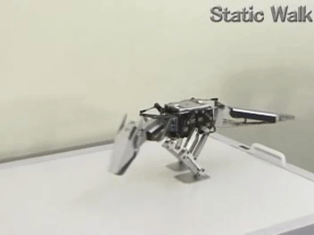
Mission Profile
The Fall 2016 Velociraptor is the 3rd Generation biped robot
Inspired by the Titrus III by the Tokyo Institute of Technology

Slide 4
Program Objectives
Customer’s Expectation
Utilize the 3DoT Board as our microcontroller
Use the Arxterra Control Panel by using tele robotic communication
Motors instead of Servos
Notes:
http://arxterra.com/fall-2016-game-save-the-human/

Slide 5
Design Innovation
The brainstorm activity did not benefit the design process
Good Ideas but time was an issue

Slide 6
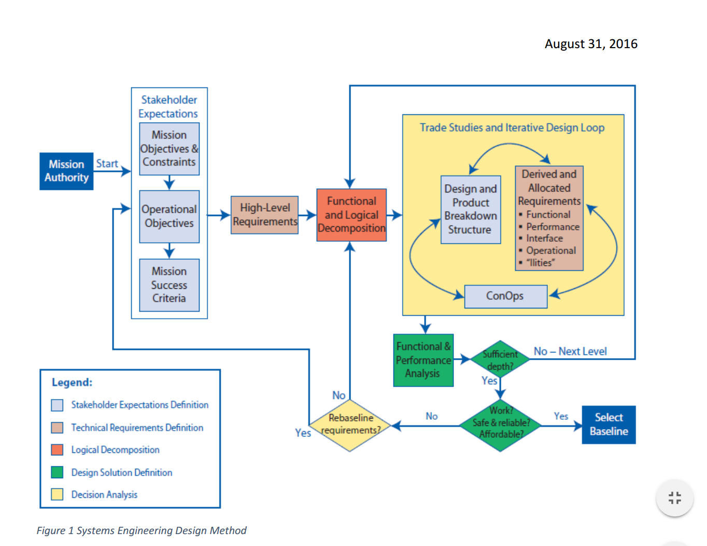
Requirements & Verification
Level 1 Program Requirements
CSULB Fall 2016 Velociraptor …
Shall cost no more than $400.00 [1] [2]
Shall participate in the Game: Save the Human provided by the Game Committee and the customer [3]
Shall demonstrate its capabilities on the final day of school, Wednesday, December 14, 2016 [4]

Slide 7
Level 1 Program Requirements Resources
[1] Khoivu0814. (2016). Retrieved September 21, 2016, from http://www.arxterra.com/spring-2016-velociraptor-preliminary-project-plan/
[2] Plaulsible. (2015). Retrieved September 23, 2016, from http://www.arxterra.com/fall-2015-microbiped-preliminary-project-plan/
[3] Paul Ahumada. (2016). Retrieved October 05, 2016, from http://arxterra.com/fall-2016-game-save-the-human/
[4] Time, B. C. (n.d.). Final Exam Fall 2016 Schedule Charts. Retrieved September 21, 2016,from http://web.csulb.edu/depts/enrollment/registration/final_exam/fall_chart.html

Slide 8
Level 1 System Requirements
The CSULB Fall 2016 Velociraptor shall…
Resemble a Theropoda Dinosaur [1]
Statically walk [2]
Dynamically walk [2]
Use Bluetooth to communicate with the Arxterra Control Panel [3]
Use a 3DoT board with a custom i2C shield [3]
Navigate through the game terrain provided by the game committee [4]

Slide 9
Level 1 System Requirements (Continued)
The CSULB Fall 2016 Velociraptor shall navigate through the game terrain provided by the game committee shall…
Utilize a foot design capable of traction of all surfaces [4]
Navigate on uneven surface height no larger than 0.5 cm [4]
Use a battery to sufficiently power the biped robot for the duration of the game [4]

Slide 10
Level 1 References
[1] Theropod dinosaurs - Google Search. (n.d.). Retrieved September 23, 2016, from https://www.google.com/search?q=Theropod dinosaurs
[2] Robotics/Types of Robots/Walkers. Retrieved October 05, 2016, from https://en.wikibooks.org/wiki/Robotics/Types_of_Robots/Walkers
[3] 3DoT. (n.d.). Retrieved October 05, 2016, from http://www.arxterra.com/3dot/
[4] Paul Ahumada. (2016). Retrieved October 05, 2016, from http://arxterra.com/fall-2016-game-save-the-human/

Slide 11
Level 2 requirements
1. The velociraptor shall have two feet to support a mass of the robot which shall not exceed 900 grams.
The velociraptor shall implement a control system [PID] that should shift the center of gravity along the axis of the legs (left and right). The center of gravity shall be controlled by two servo that c ontrols both head and tail.
The acceleration of the Velociraptor head and tail movement shall not exceed [to be calculated in m/s^2] to avoid the velociraptor tipping point, and falling down.
The velociraptor shall have a threaded rod be placed horizontally with respect to head and tail. The length of the threaded rod [to be determine cm], and thickness [to be determine mm] to ensure it fits in the body. The threaded rod shall move along the axis of the head, tail, and body to shift the center of gravity.
The velociraptor shall utilize DC motors [to be determine] for continuous static and dynamic movement.
The velociraptor shall shift the center of gravity over the leg while statically walking. The center of gravity shall be within a region of stability of [to be calculated] mm from the center of the foot.

Slide 12
Level 2 Requirement (continued)
The velociraptor shall use a gyroscope which tracks X, Y, and Z angles and transmit input data to the MCU.
The velociraptor shall implement an accelerometer which tracks acceleration in the X, Y, and Z planes.
The Velociraptor shall implement an IMU MPU-6050 to communicate with the I2C at a frequency rate of [to be determined] Hz. The MPU-6050 will collect input data and implement that into the control system.
The velociraptor shall utilize HC-06 Bluetooth to communicate with the Arxterra control panel at a maximum range of 12 feet.
The Velociraptor shall implement a motor controller [to be determined what kind] on the motor shield that communicates to the I2C at the frequency rate [to be calculated] Hz.
The velociraptor shall utilize the two servos for the head and tail through the 3DoT board.
The velociraptor shall use 2 batteries to power the 3DoT Board and motor shield.

Slide 13
Level 2 requirement continue..
The Velociraptor shall be able to continuously operate in game arena for minimum one hour.
The IMU shall send input data to the control system when encountering uneven surfaces, inclines, and declines.
The model of the foot [to be decided] design shall have a surface area of [ to be calculated] in order to provide stability and not put stress on movement.
The material for the traction of foot [to be determined] shall provide enough friction on all surfaces [study to be shown] of game terrain to prevent raptor from falling over.
The Velociraptor shall be able to turn left or right from 0 – 360 degrees, standing on foot while not walking.

Slide 14
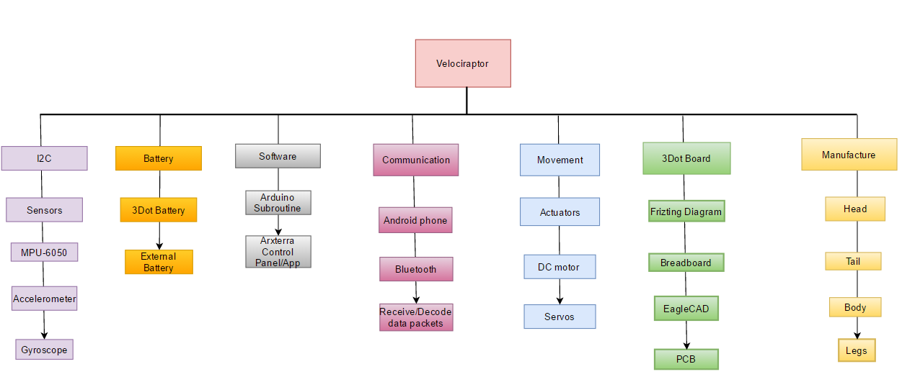
Product Breakdown Structure
The structural of the project.

Slide 15
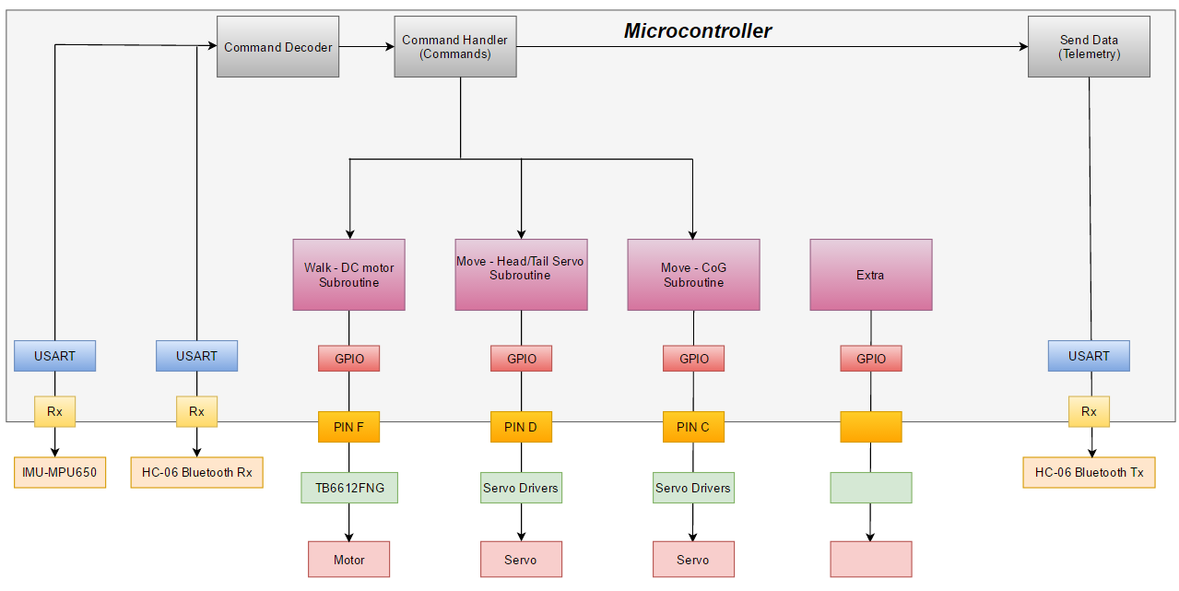
Software Design
Software Block Diagram

Slide 16
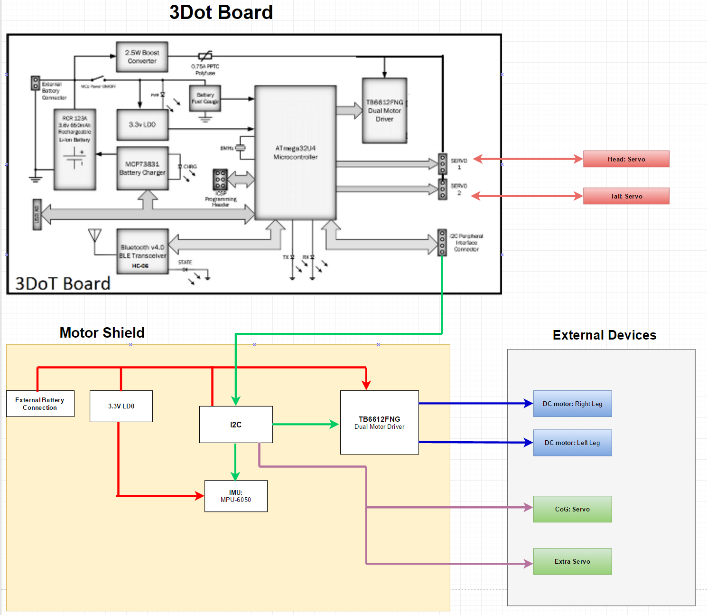
Electronic System Design
System Block Diagram
The 3rd servo will added through the I2C bus.

Slide 17
Interface Definitions
Complete interface matrix
The pin mapping data was collected directly from the Arduino website.

Slide 18
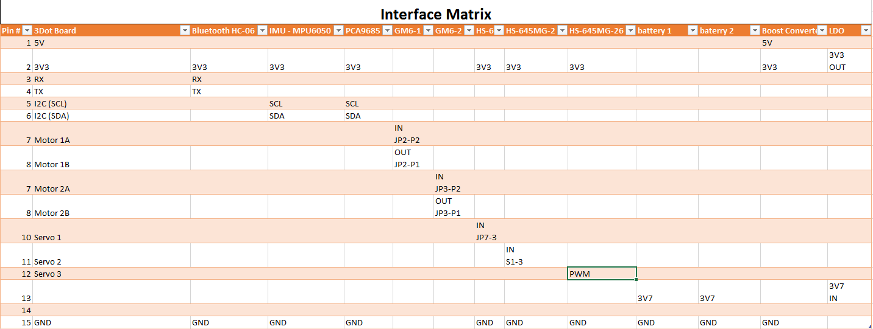
Interface Definitions
Simplify Interface Matrix, “3Dot Board”
This interface matrix is map to the 3 Dot board.
The third servo is to be map to an I2C pin.

Slide 19
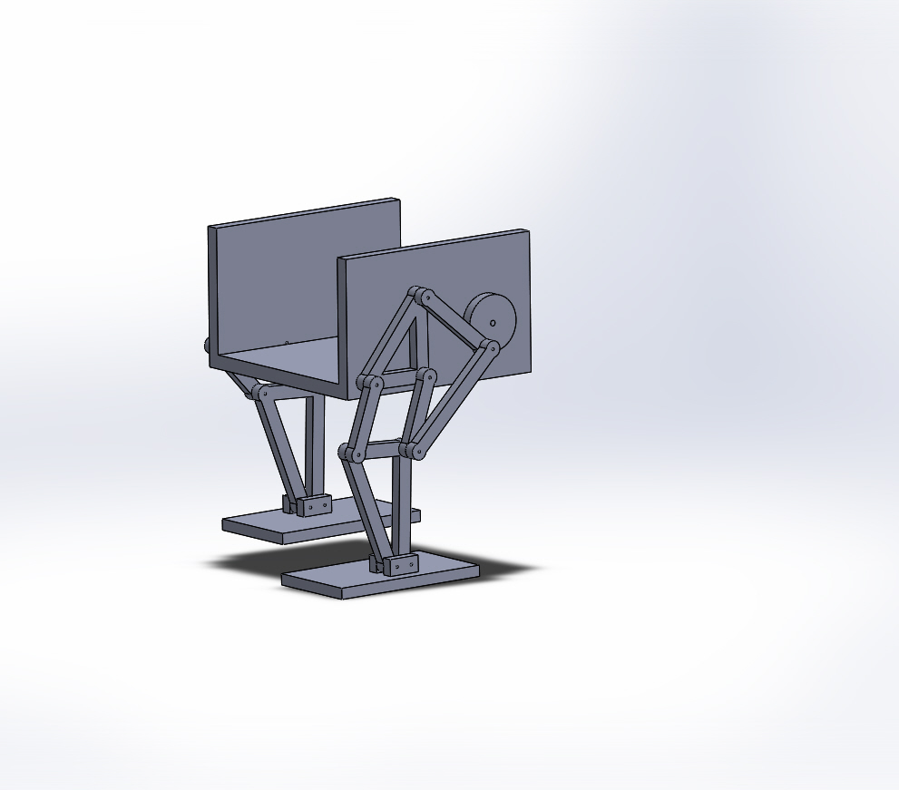
Mechanical Design
Complete 3D Model

Slide 20
Measurements

Slide 21
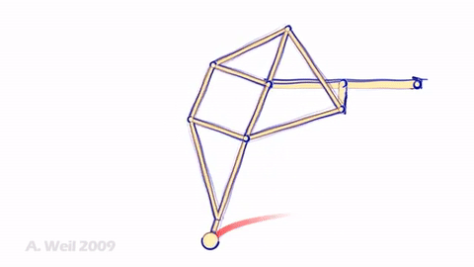
Leg Design: Theo Jansen’s Linkage
Eight-Bar Mechanism
Single rotation crank
Smooth walking motion

Slide 22
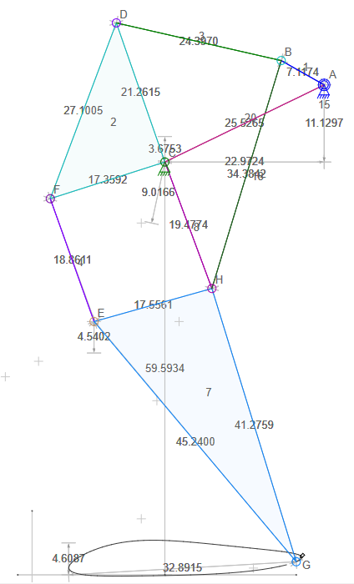
Design and Unique Tasks
Leg Design: Initial Idea

Slide 23
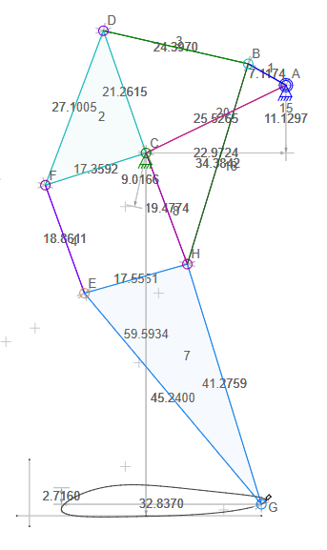
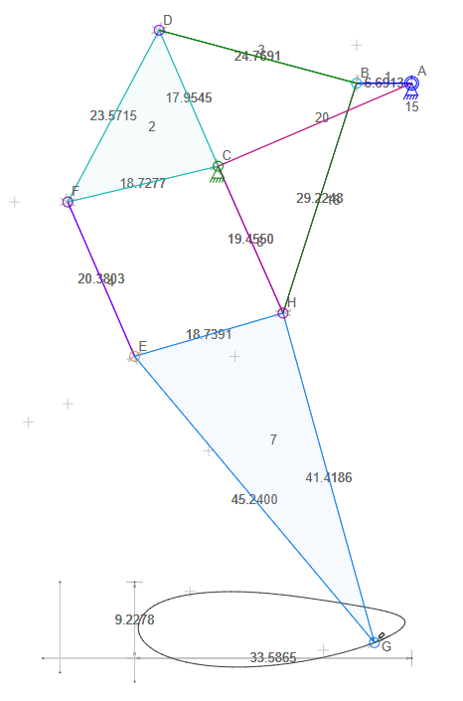
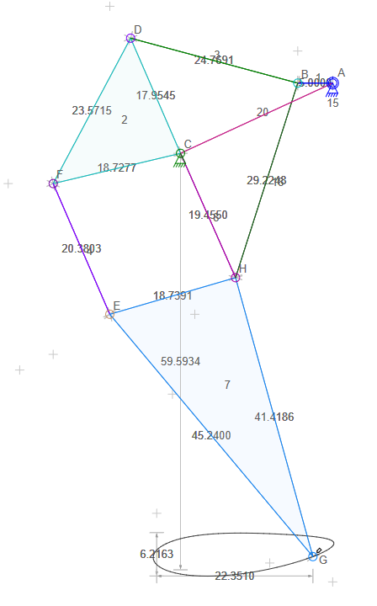
Leg Design: Current Design
Jansen’s Linkage
Leg Design v1.0
Leg Design v1.3
Leg Design v1.6

Slide 24
3D Model Simulation

Slide 25
Torque Calculations for DC Motors
Mass of the robot ~ 1kg
Force(gravity) = Mass*g = 1kg*9.8m/s^2 = 9.8 N
Radius of turn shaft for legs = 7mm
Force of friction = µ*Force(gravity) = 0.5*9.8N = 4.9N
Force(Total) = 9.8N + 4.9N = 14.7N
Torque = 0.007m*14.7N = 0.1029 Nm = 14.6 oz-in

Slide 26
DC Motor Trade off Study
Requirement: The velociraptor shall have two feet to support the full mass of the robot of 900 grams.
Motor | Voltage (Volts) | Speed (RPM) | Torque (Oz-in) | Current (mA) | Weight (grams) | Price | Reference
Gear Motor 8 by Solarbotics | 5 | 70 | 43 | 57.6 (670 stall) | 32 | $5.75 | [1]
Gear Motor 9 by Solarbotics | 5 | 66 | 43 | 73.2 (670 stall) | 34.1 | $5.25 | [2]

Slide 27
Motor References
[1] http://www.robotshop.com/en/solarbotics-gm8-gear-motor-8-offset.html
[2] http://www.robotshop.com/en/solarbotics-gm9-gear-motor-9.html

Slide 28
Servo Calculations
Mass of head = Mass of Tail = 150g
Force (gravity) = (0.150 kg)*(9.8 m/s^2) = 0.0153 N
Radius = 6 cm
Torque = (0.0153N)*(0.06m) = 0.000918 Nm = 0.13 oz-in

Slide 29
Servo Motors Requirement:
Servo | Torque (oz-in) | Weight (grams) | Speed (sec/60°) | Price | Reference
HS-422 Servo Motor | 57 | 45.5 | 0.16 | $9.69 | [1]
HS-645MG Servo Motor | 133 | 55.2 | 0.20 | $28.59 | [2]
HS-485HB Servo Motor | 72 | 45 | 0.20 | $14.99 | [3]

Slide 30
Servo references
[1] http://www.robotshop.com/en/hitec-hs422-servo-motor.html
[2] http://www.robotshop.com/en/hitec-hs645mg-servo-motor.html
[3] http://www.robotshop.com/en/hitec-hs-485hb-servo-motor.html

Slide 31
Fritzing

Slide 32
Work Breakdown Structure

Slide 33
Project Schedule
Project Status
Challenges:
Tests/Experiment
3D Modeling
Simulation
Trade Off Studies
CDR Presentation
Top Level Schedule
System and Subsystem Level Tasks

Slide 34
Top Level Schedule

Slide 35
System and Subsystem Level Tasks
System Engineer (Hal Vongsahom)
Learn C++ programming language for the 3DoT board
Generate system resource report (Mass, Power, Cost)
Continue refining level 2 system requirements
Verification and Validation test plan
Electronic & Controls (Taylor Farr)
Research servo, motor specification and conduct a trade off study
Research power subsystem requirements
Generate Fritzing diagram
Circuit schematic in Eagle CAD

Slide 36
System and Subsystem Level Tasks (continued)
Manufacturing & Design Engineer (Aaron Choi)
Complete the 3D Model of the Velociraptor on Solidworks
Simulate the walking movement on Solidworks
Coordinate with E&C for PCB design

Slide 37
Burn Down and Project Percent Completion

Slide 38
Power report
All the data was collected from the manufacture website except for the 3Dot board. Data for 3Dot was collected from measurement of last semester.
The servo and DC motor will consume the most Amps.

Slide 39
Mass Report
The weight of the frame will weigh the most.
The second contributor to weight are the three servos.
Notes:
Source?

Slide 40
Cost Report
The most expensive item will be the frame.
The prototype will cost as much as the frame.
The 3 servo is the 3rd expensive component.

Slide 41
Resource Report Resources
https://www.pololu.com/product/182/specs
https://www.cdiweb.com/datasheets/invensense/PS-MPU-6000A.pdf
https://cdn-shop.adafruit.com/datasheets/PCA9685.pdf
http://www.arxterra.com/spring-2016-3dot-spider-bot-preliminary-design-document/
https://www.bhphotovideo.com/bnh/controller/home?O=&sku=1018868&gclid=Cj0KEQjw1K2_BRC0s6jtgJzB-aMBEiQA-WzDMZ4G93fpLNmiUX-CGjONHm0czidWkbbSiUMk3B_luoAaAqM68P8HAQ&Q=&ap=y&m=Y&c3api=1876%2C92051678402%2C&is=REG&A=details
http://www.arxterra.com/spring-2016-velociraptor-project-summary/#Size_Weight
https://www.grainger.com/category/threaded-rods/bolts/fasteners/ecatalog/N-8k5
http://www.ebay.com/itm/2x-2000mAh-16340-Rechargeable-Li-ion-Battery-For-LED-Flashlight-CR123A-Charger-/152231509443?_trksid=p2141725.m3641.l6368
http://www.robotshop.com/media/files/pdf/hs645mg.pdf
http://web.csulb.edu/~hill/ee400d/Technical%20Training%20Series/3DoT%20Datasheets/3DoT_Schematic.pdf
https://www.arduino.cc/en/Hacking/PinMapping32u4

