Slide 1
3DOT HEXY: PRELIMINARY DESIGN REVIEW
BY: EDUARDO DE LA CRUZ (PROJECT MANAGER & MANUFACTURING AND DESIGN)
RAYMUNDO LOPEZ-SANTIAGO (MISSION, SYSTEMS, & TESTING)
KRIS OSUNA (ELECTRONICS & CONTROL)

Slide 2
MISSION OBJECTIVES
Design and fabricate a remote controlled, competitively priced, toy robot that is capable of memorizing and traversing a path.
The child “teaches” his/her robot by guiding it through a maze. Once the child and robot team solve the maze. The child returns the robot to the entrance of the maze and quizzes the robot to see if it has learned the maze.
Additional robots may be introduced into the maze while the robot is moving through the maze. The robot should avoid collisions with the other robots.
Parents and friends may remotely view the progress of their child’s robot.
Our game testers will be given the robots on the day of the final. The test room is ECS 316. The maze will be located in the front of the room (about 8 ft x 18 ft).

Slide 3
LEVEL 1 PROGRAM REQUIREMENTS
In accordance with the Spring 2018 final schedule, the project shall be completed by May 8th, 2018 and shall be prepared for a demonstration on the linoleum floor of ECS 316 on May 15th between the hours of 10:15 am - 12:15 pm.
Documentation for the project shall be completed a week prior to the day of demonstration (May 8, 2018).
The robot will be designed to be a toy for people ages 8+.
In order to minimize manufacturing cost, and packaging cost the robot shall be able to be constructed from subassemblies within 10 minutes.
The robot will be remotely controlled wirelessly via bluetooth using the ArxRobot Android or iPhone application.
The robot will need to navigate remotely through a custom-built maze (built by AoSa image), memorize the path it took, start over, and autonomously travel through the path it took.

Slide 4
LEVEL 1 PROGRAM REQUIREMENTS CONT.
Video support during autonomous navigation will be provided via the Arxterra control panel, as well as a live VR feed.
The robot shall avoid collisions if it encounters other robots while navigating through the maze. This involves detecting the robot, retracing steps back, and moving to a room that allows the other robot to have a safe passage.
For quick production of the prototype, the preliminary project shall be restricted to six hours of total printing time with a 2 hours limit for each single print.
The robot shall use a v6.16 3DoT board.
The robot shall demonstrate the capabilities of the 3DoT micro-controller for DIY hobbyists.
The robot shall be designed in such a way that there are no dangling or exposed wires and the final fabrication is pleasing to the customer.
The robot shall incorporate 3D printed parts to demonstrate the feasibility of the 3DoT board for 3D printed robots.

Slide 5
LEVEL 1 PROJECT REQUIREMENTS
3DoT Hexy shall use sensors to: detect robots disrupting their path, for intersection detection, and for either line following or hedge following.
3DoT Hexy shall use the same maze to compete in a game of who gets out first. (Defined by both 400-D sections).
To keep cost down, and keep as a toy aspect, 3DoT Hexy shall use only 2 micro motors to drive the movement of the robot.
3DoT Hexy shall have an allocated budget of $250, however to compete with the existing robot toy market we shall try to minimize the cost of production as much as possible.
3DoT Hexy shall have custom SMD I2C shield as platform to build from and will incorporate peripherals for sensors.
3DoT Hexy’s dimension shall have a chassis large enough to house a 3x7 cm 3DoT board.

Slide 6
LEVEL 2 SYSTEM REQUIREMENTS
Communication to 3DoT Hexy will be through the HM-11 bluetooth module.
3DoT Hexy shall use a single RCR123A 3.7 V, 650mA rechargeable Li-ion battery to power the 3DoT board, which will power the drivetrain and all attached peripherals.
3DoT Hexy shall use 3 UV sensors connected to a custom PCB.
3DoT Hexy shall use a HC-SR04 ultrasonic sensor to handle robot avoidance.
3DoT Hexy shall use 3D printed chassis and legs. This follows from the project level requirement about using 3D printed parts.
3DoT Hexy will use a cam system identical to that of 3DoT David to drive the movement of the legs while navigating through the maze.

Slide 7
LEVEL 2 SYSTEM REQUIREMENTS CONT.
3DoT Hexy shall use (2) 530 RPM micro guard motors to drive the motion of the robot.
3DoT Hexy shall incorporate 6 legs in the design of the drivetrain to improve stability while moving, to support its own weight and to mimic the behavior of a spider.
The Arxterra control panel shall display the current battery level, as well as all sensor data.

Slide 8
LEVEL 2 SUB-SYSTEM REQUIREMENTS
Ultrasonic sensor shall have a range of 0.5-meter radius to detect and respond accordingly to other robots.
3DoT Hexy shall use PLA or ABS filament in the fabrication of the chassis and legs. This will minimize the mass of the robot, while at the same time being strong enough to hold its weight.
Gears shall have a gear capture system to prevent them from popping (main issue encountered in 3DoT David design). This ensures the cam system will work without fear of popping gears.
3DoT Hexy shall operate in a tripod form, having three legs (2 outer in one side and middle leg in the other side) to provide stability while moving.

Slide 9
SYSTEMS & SUBSYSTEM DESIGN
Product Breakdown Structure
Electronic System Diagram
System Block Diagram
Interface Matrix

Slide 10
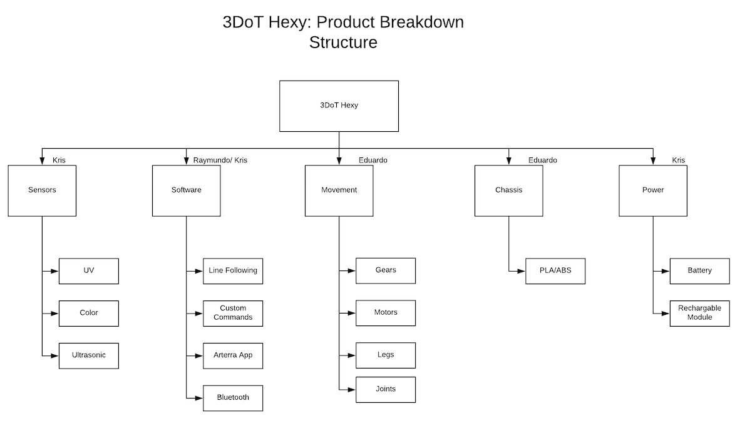
PRODUCT BREAKDOWN STRUCTURE

Slide 11
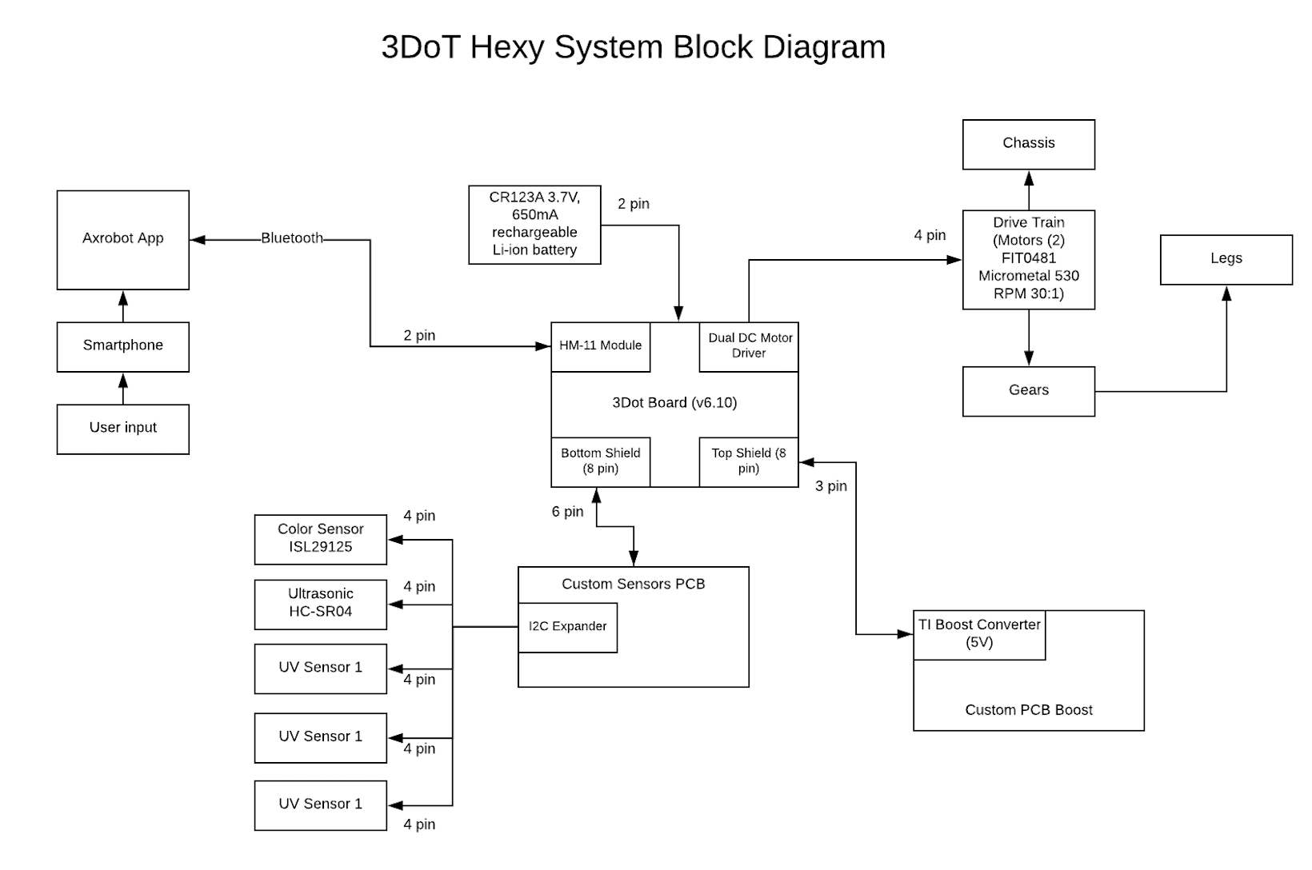
SYSTEM BLOCK DIAGRAM

Slide 12
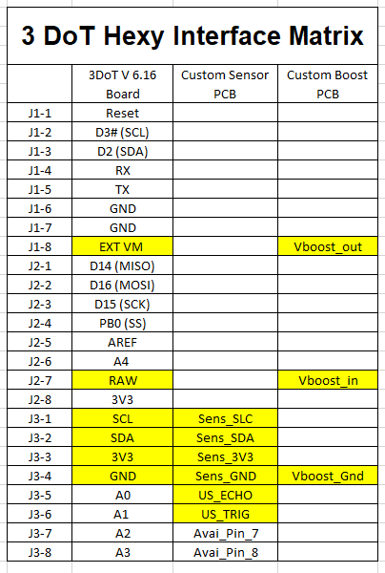
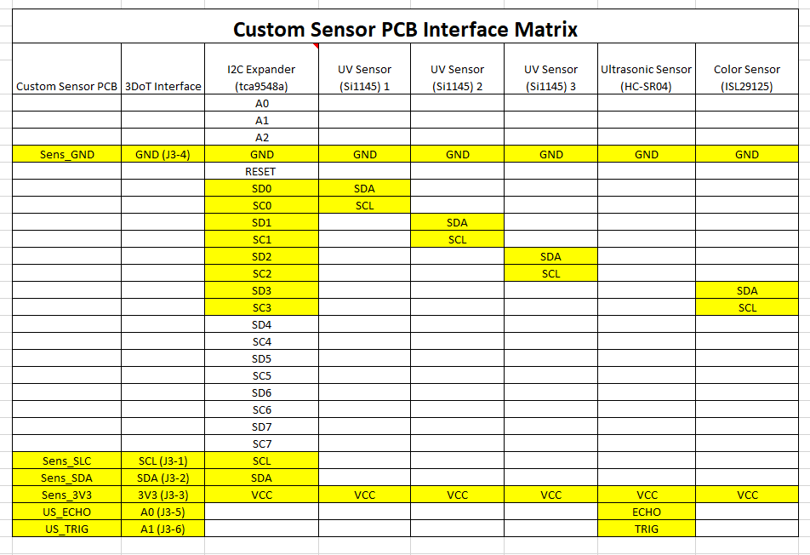
INTERFACE MATRIX

Slide 13
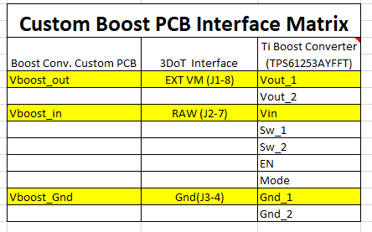
INTERFACE MATRIX CONT.

Slide 14
ELECTRONICS DESIGN
Fritzing Diagram

Slide 15
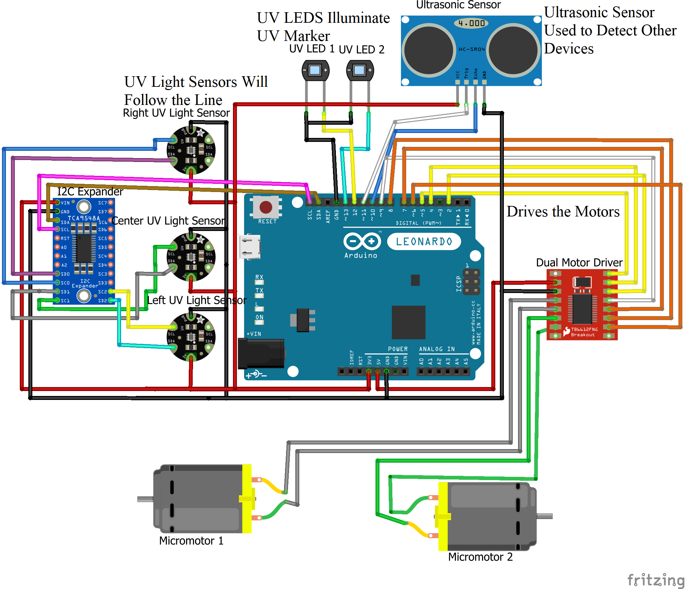
FRITZING DIAGRAM

Slide 16
MANUFACTURING DESIGN & INNOVATIONS
Improving 3DoT David Design
Mechanical Drawings
Rendering first iteration on Solidworks
3DoT Hexy Simulation

Slide 17
IMPROVING 3DOT DAVID DESIGN
Gear capture system
Gear to motor shaft connection
Leg joints
Lift Mechanism
Wire management
Re-designing top and bottom panel to accommodate design changes

Slide 18
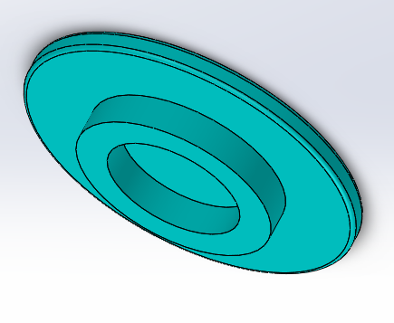
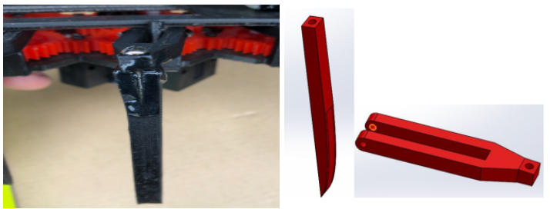
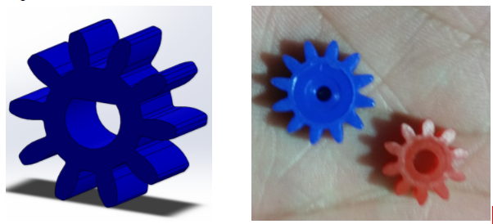
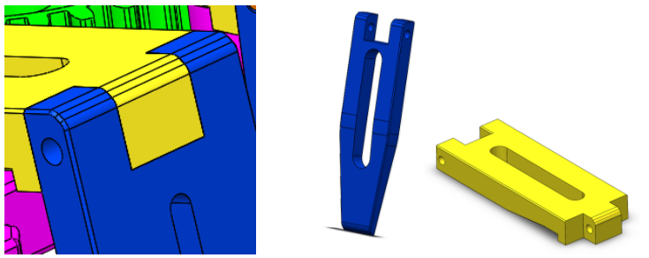
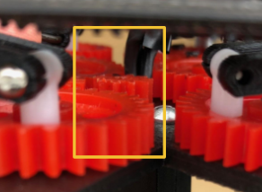
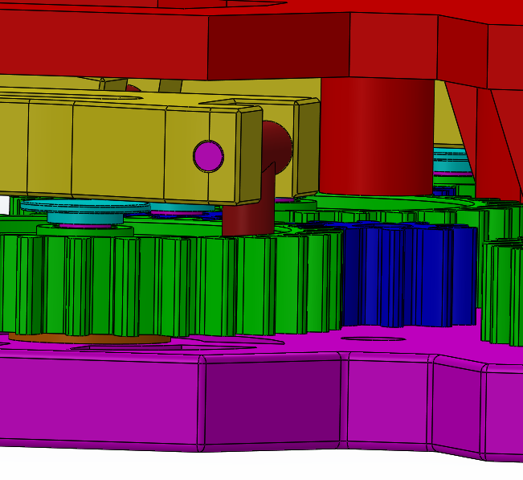
IMPROVING 3DOT DAVID DESIGN
Gear Capture:
Gear to motor shaft connection:
Leg Joints:
Old:
New:
Old:
Old:
New:
New:
Old:
New:

Slide 19
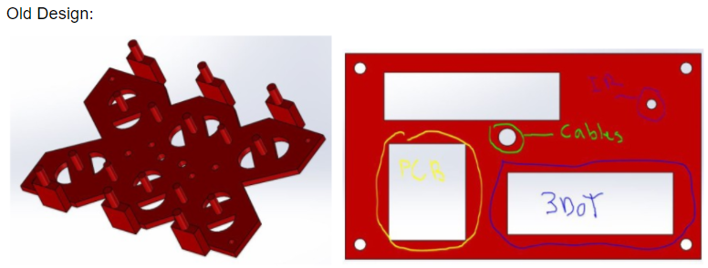
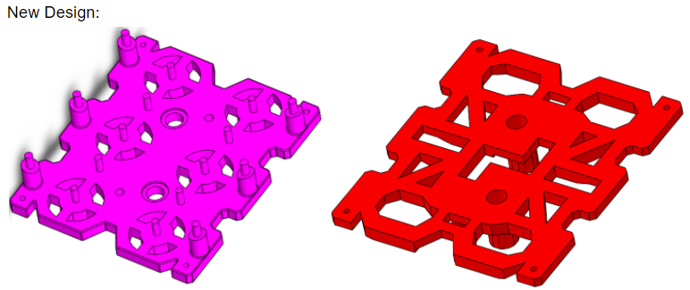
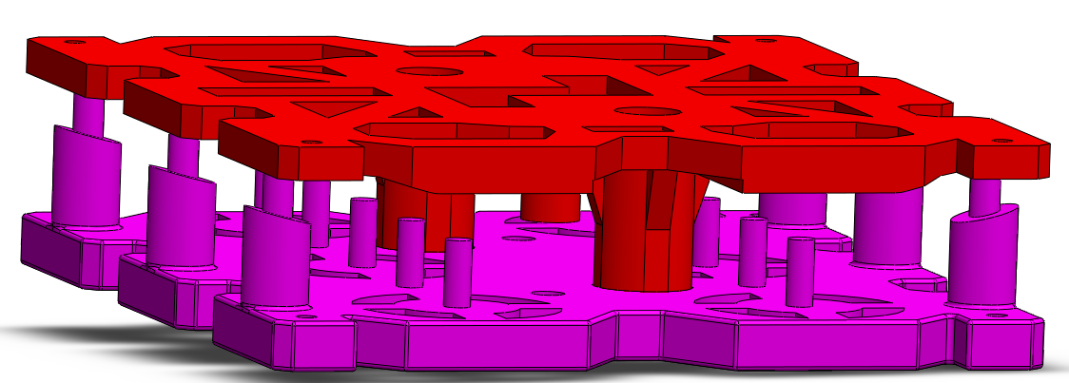
IMPROVING 3DOT DAVID DESIGN CONT.
Wire Management
Redesigning Top & Bottom Plate
Old:
New:

Slide 20
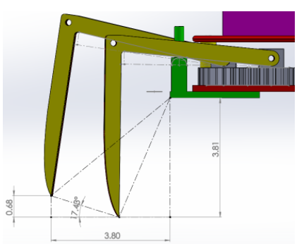
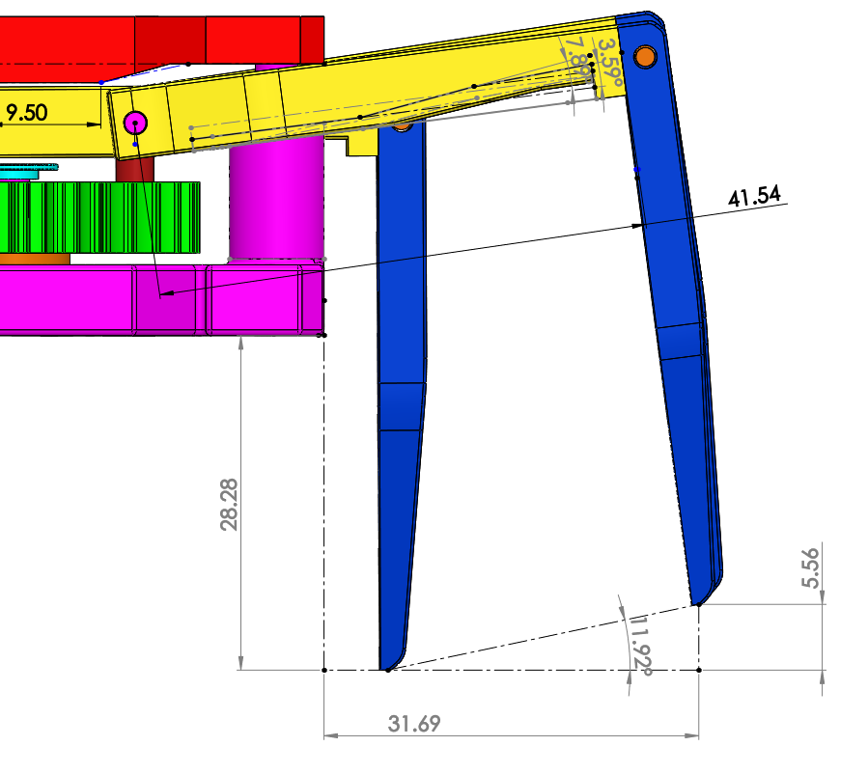
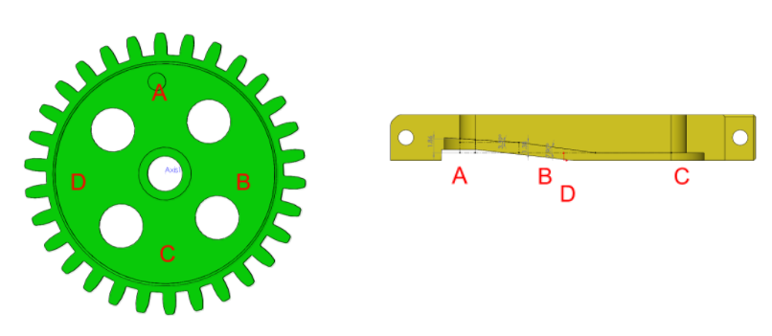
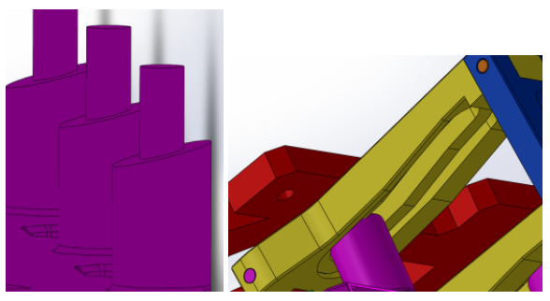
IMPROVING 3DOT DAVID DESIGN CONT.
Lift Mechanism
Old:
New:

Slide 21
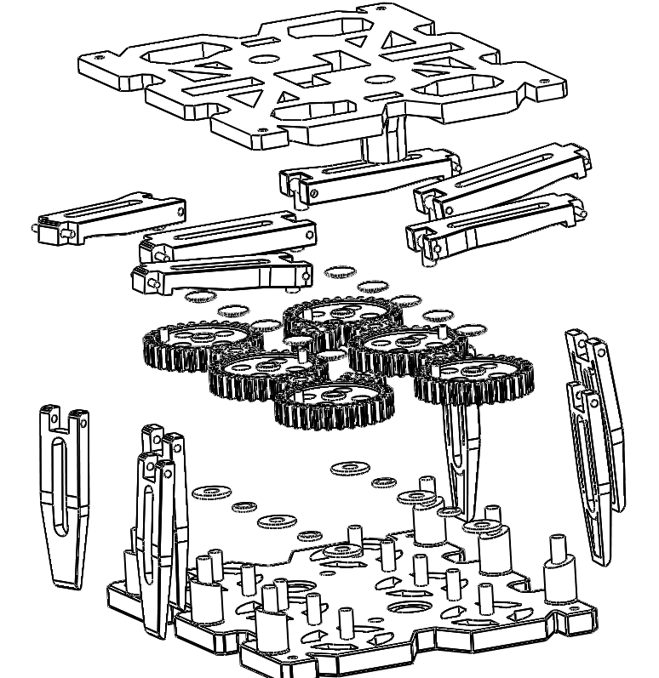
MECHANICAL DRAWINGS
Top Plate
6 femurs
6 tibias
Cam system
6 30T Gears
8 10T Gears
6 gears-to-femurs joints
Gear Caps
Washers
Bottom Plate

Slide 22
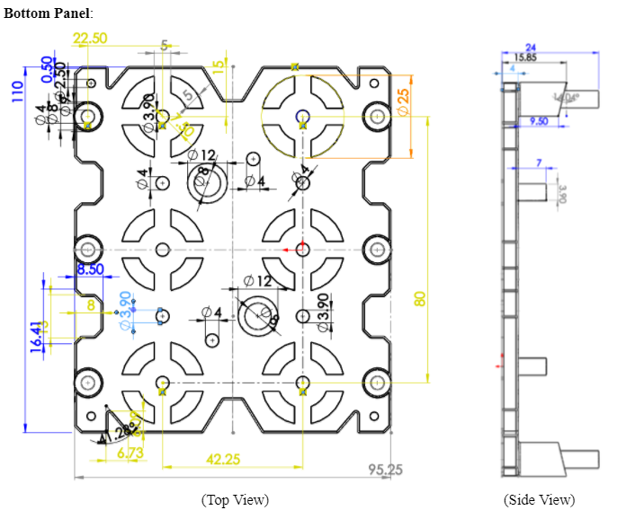
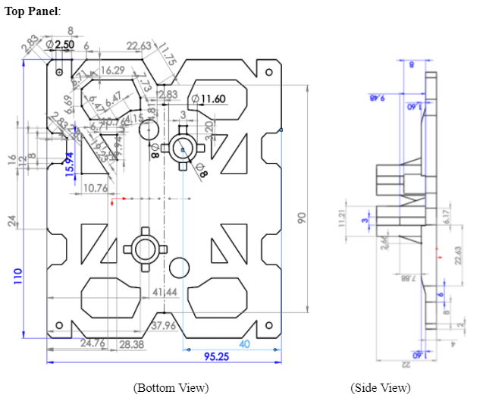
MECHANICAL DRAWING CONT.

Slide 23
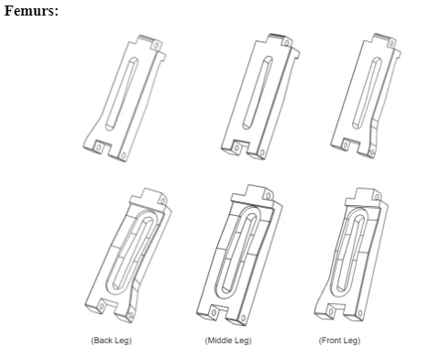
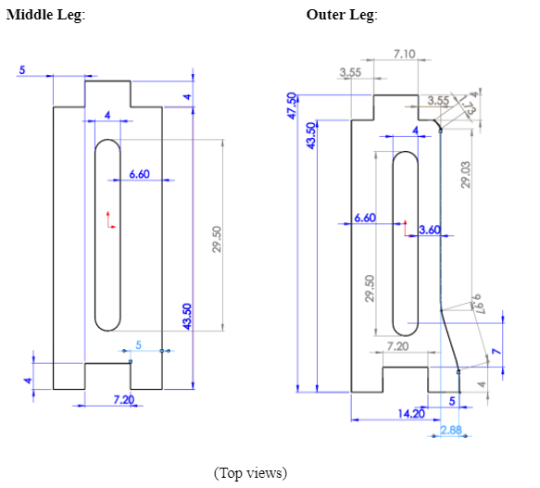
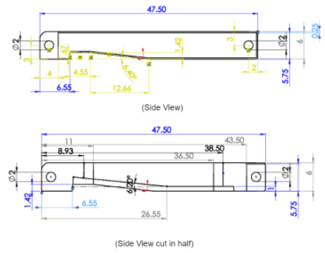
MECHANICAL DRAWING CONT.

Slide 24
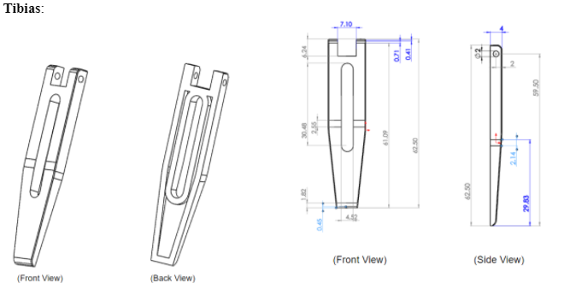
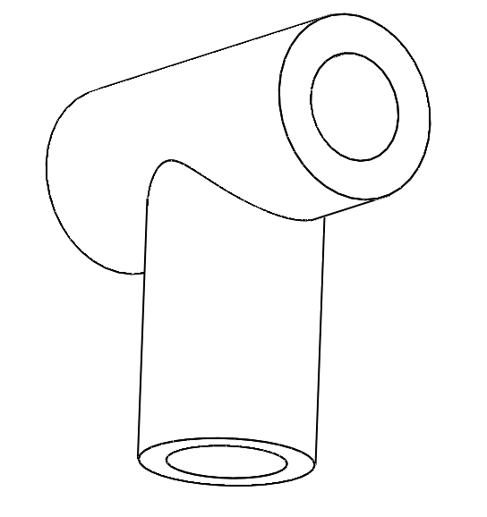
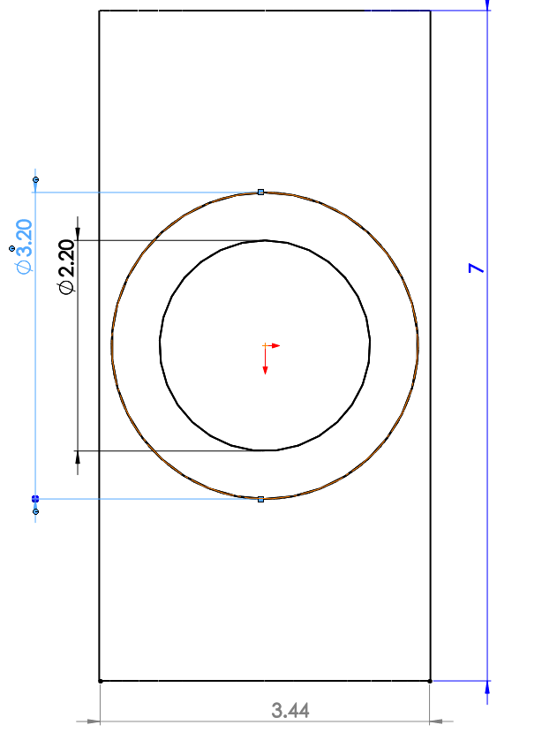
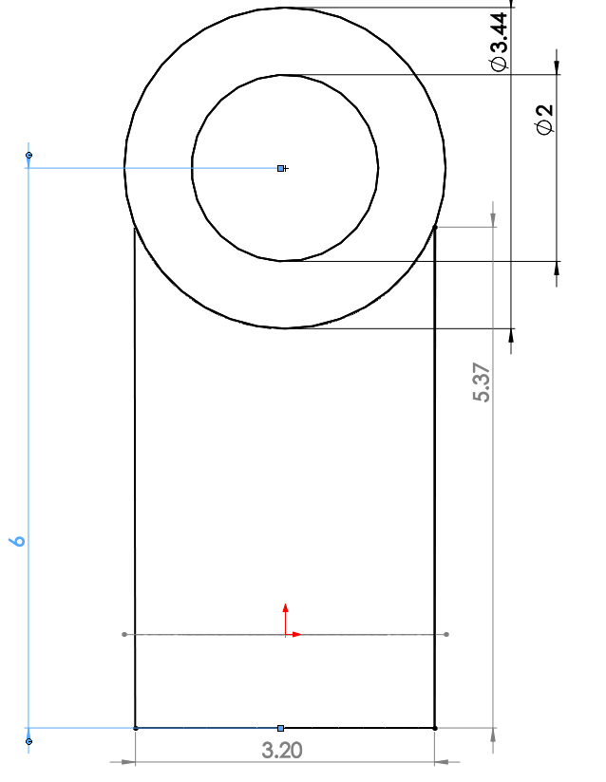
MECHANICAL DRAWING CONT.
Gear-to-femur joints:

Slide 25
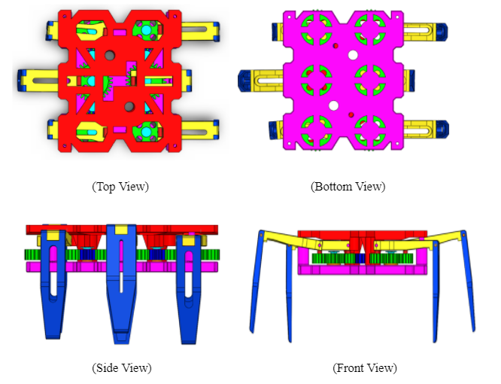
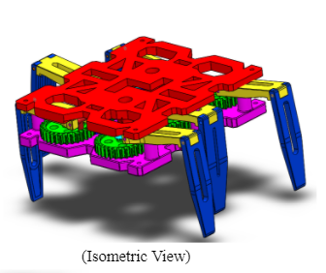
3D MODEL
3DoT Hexy Mk-1

Slide 26
SIMULATION

Slide 27
TRADE-OFF STUDIES
UV Testing

Slide 28
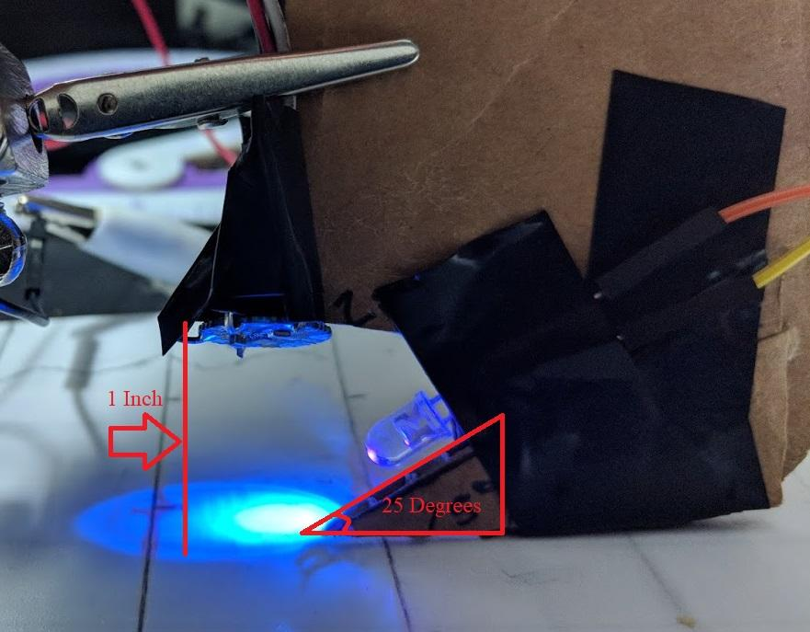
UV TESTING CONT.
2x2” square had UV Marker on it
Measurements were taken on:
Center of UV marked square
Edge of marked square
0.5” from the edge
1.0” from the edge
1.5” from the edge
2.0 from the edge
Original UV study showed:
UV sensor 1” facing straight down gave best results
White plastic and paper gave best results
LED facing at an angle gave best results
Setbacks:
Second LED broke and replacement didn’t arrive in time
UV sensor was attached to the Lab robot and ran on marked line
More UV sensors were ordered to being more testing

Slide 29
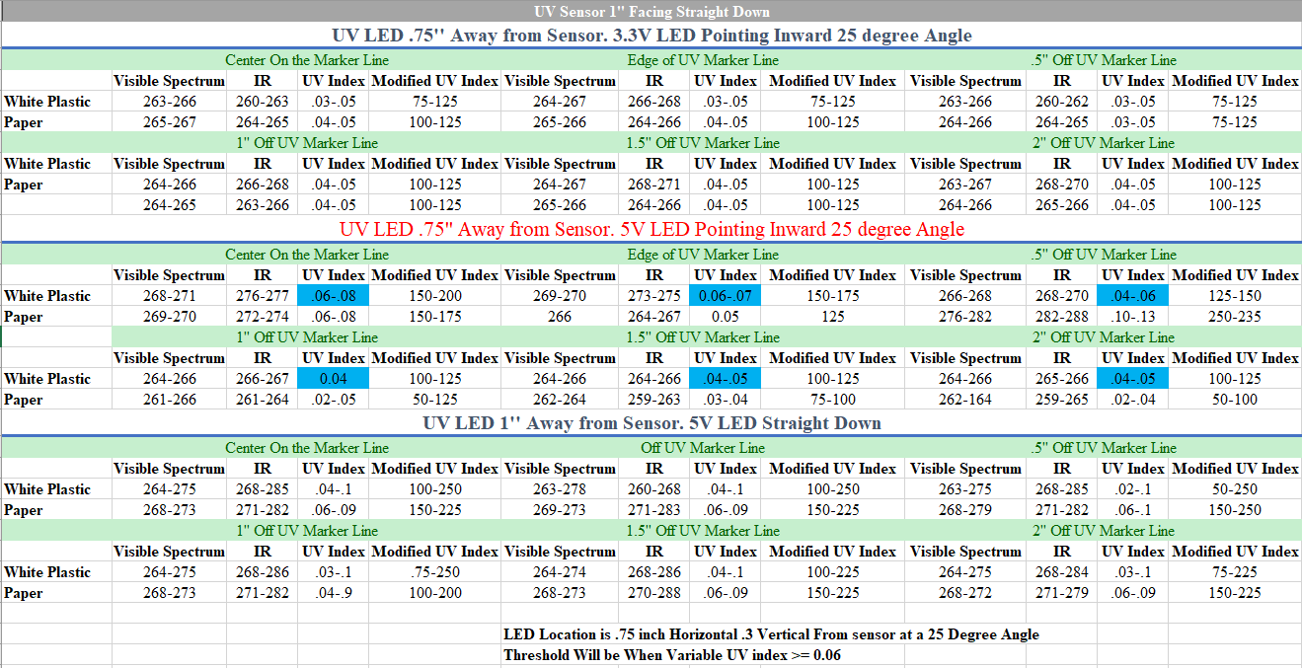
UV TESTING CONT

Slide 30
PROJECT PLAN
Work Breakdown Structure
Project Schedule
Project Burndown
Resource Report
Project Cost Estimate

Slide 31
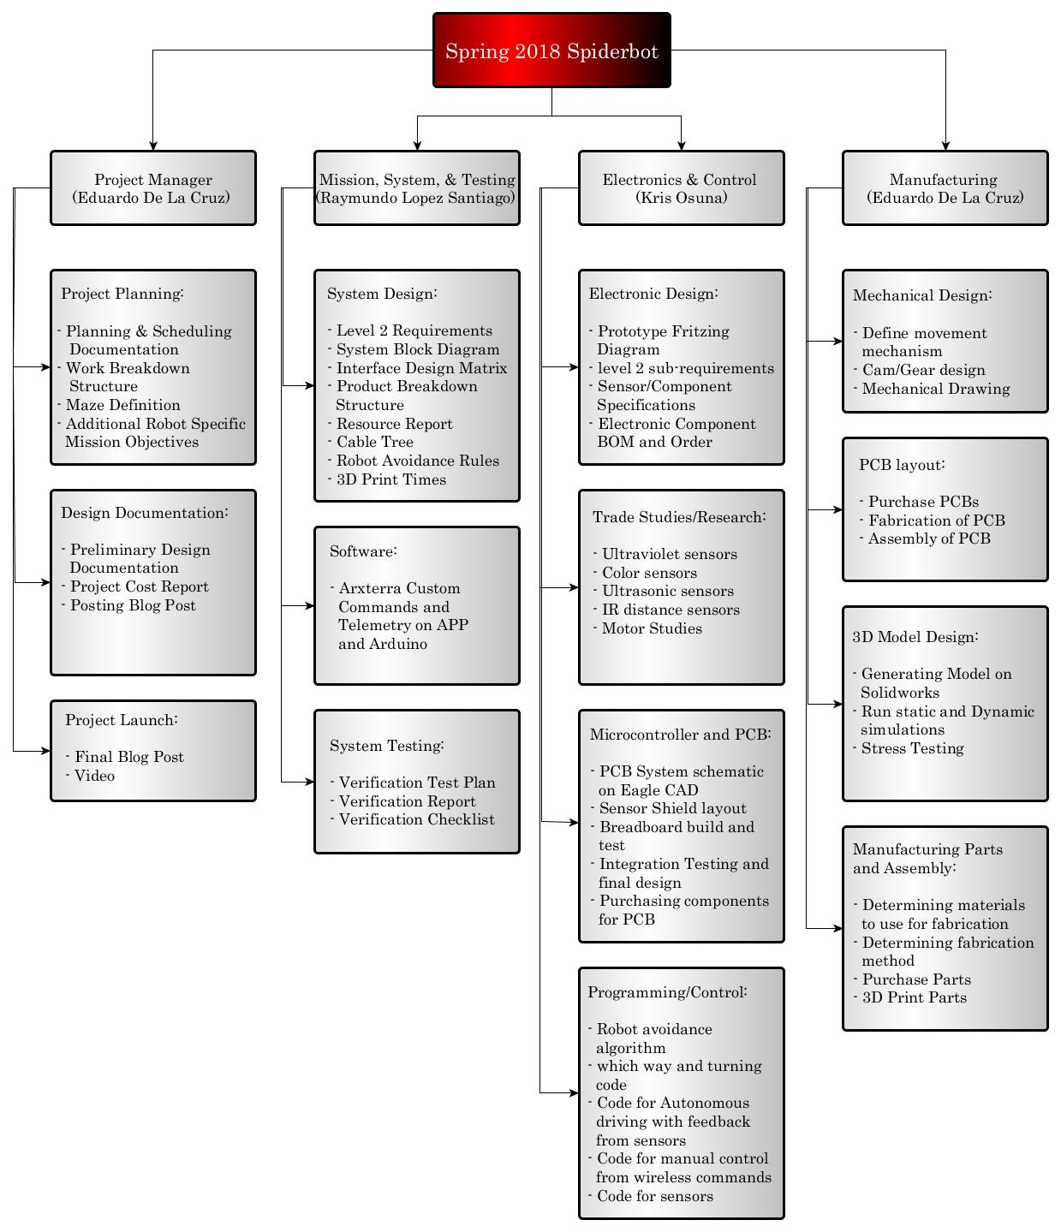
WORK BREAKDOWN STRUCTURE

Slide 32
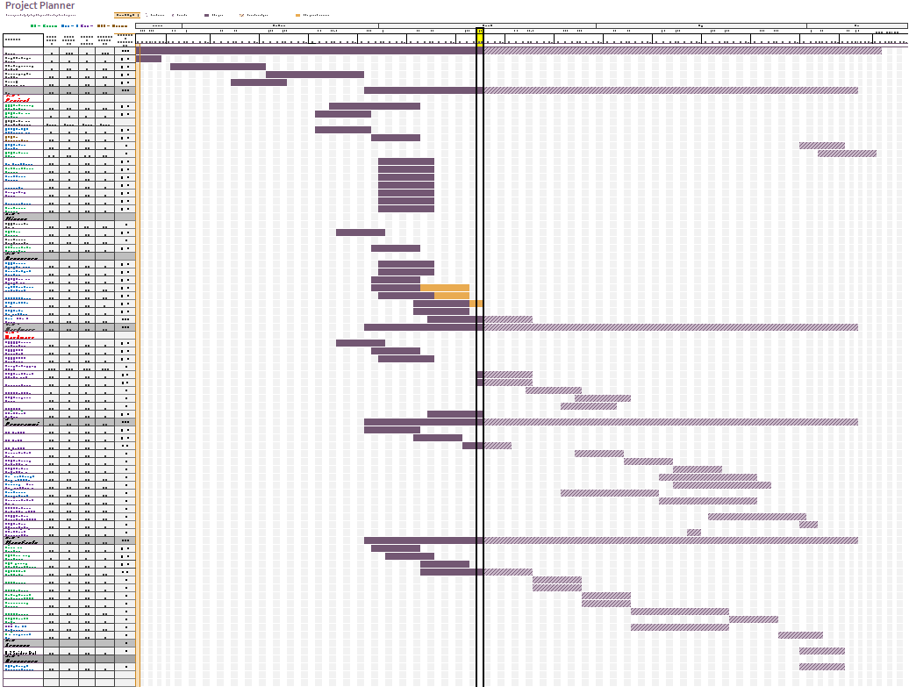
PROJECT SCHEDULE

Slide 33
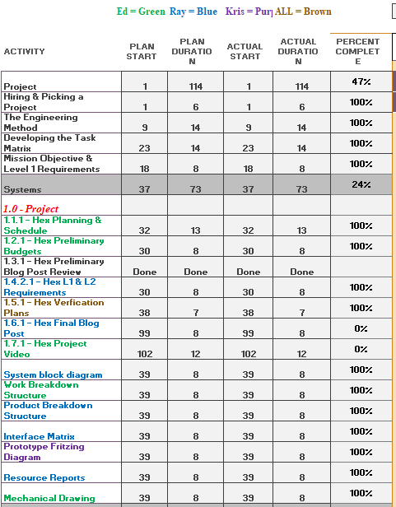
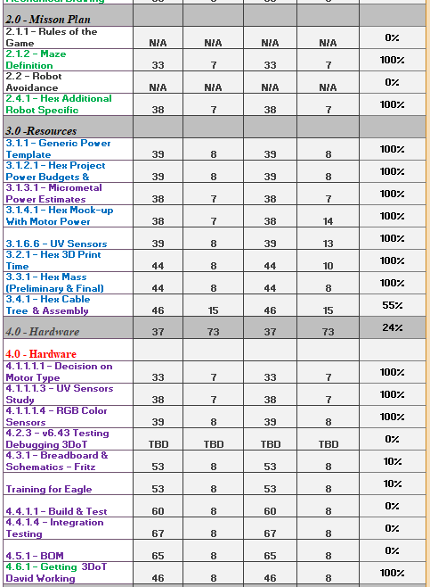
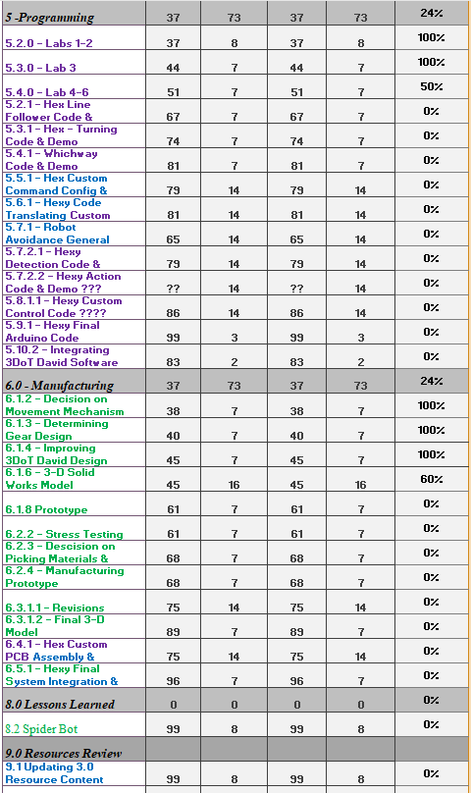
PROJECT TASK

Slide 34
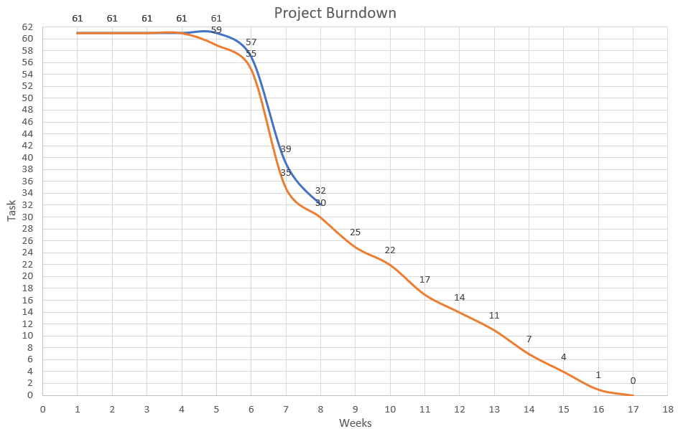
PROJECT BURNDOWN
--- = Current Progress,
--- = Desired Progress

Slide 35
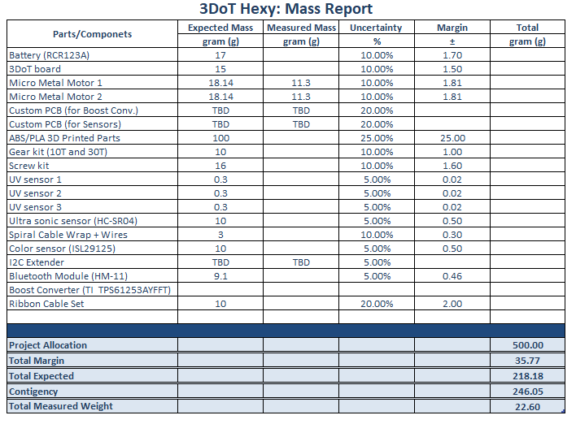
RESOURCE REPORT (MASS)

Slide 36
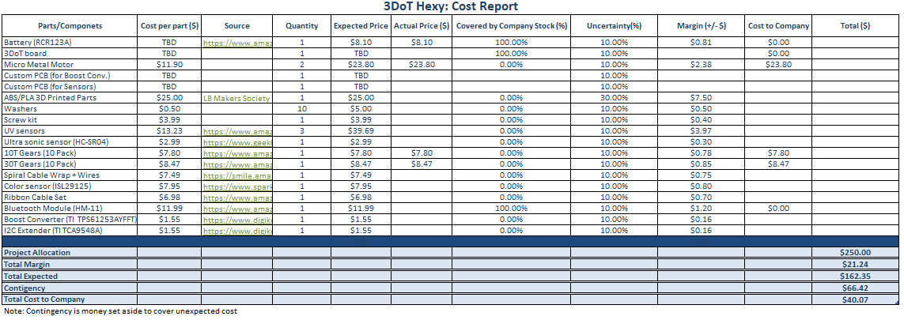
RESOURCE REPORT (COST)

Slide 37
RESOURCE REPORT (POWER)

Slide 38
THANK YOU
Any Questions?

