Slide 1
Micro FOBO Preliminary Design Review
Miguel Gonzalez
Project Manager & Manufacturing
Jorge Hernandez
Electronics & Control
Jeffery De La Cruz
Mission, System, and Test

Slide 2
1.
Program Objectives & Mission Profile
Miguel Gonzalez Project Manager & Manufacturing

Slide 3
Program Objectives
Our goal for this project is to design and manufacture a BiPed Robot. We will be using the original FOBO* designed by Jonathan Dowdall. Using his BiPed as a guide we will develop a much smaller robot that utilizes micro servos for movement in walking and turning. The robot will sense its surrounds by utilizing ultrasonic and color(UV) sensors.
*source: http://www.projectbiped.com/prototypes/fobo

Slide 4
Program Objectives cont.
Other changes include:
Ⓡ
Configurable Walking Patterns
Bluetooth Compatibility
Smartphone App Control
Multiple Sensory Inputs

Slide 5
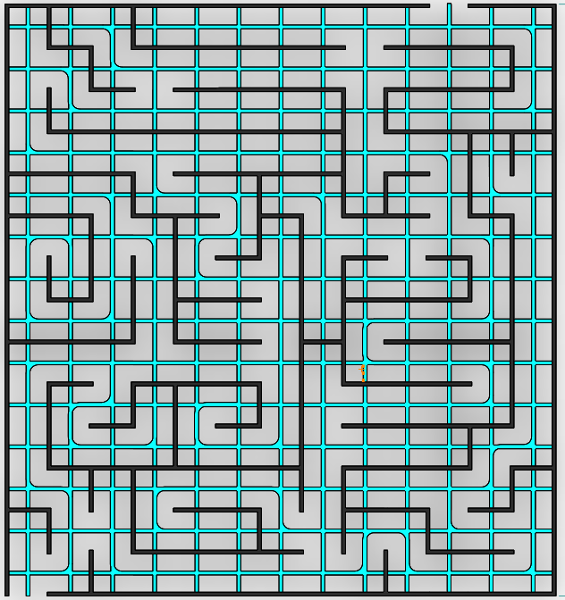
Mission Profile
The mission of Project BiPed is to design the BiPed to navigate a predesigned maze. The BiPed shall be able to navigate the maze with user input from the Arxterra App/Control Panel. The BiPed will be able to memorize the user-defined path and will be able to navigate it autonomously. In addition, the BiPed will acknowledge other robots while traversing the maze and avoid collisions using its sensors.
END
START
Photo Credit: Eduardo De La Cruz

Slide 6
2.
Requirements
Jeffrey De La Cruz Mission, System, and Test

Slide 7
Level 1 Requirements
Will
L1-1: Micro FOBO will stand on its own without any physical help. L1-2: Micro FOBO will be easily assembled and disassembled and demonstrate good system engineering practices. L1-3: Micro FOBO will use micro servos. L1-4: Micro FOBO will have 2 legs.
Shall
L1-5: Micro FOBO shall not exceed a cost of $200 to construct.
L1-6: Micro FOBO shall detect intersections.
L1-7: Micro FOBO shall be able to perform dynamic walking

Slide 8
Level 1 Requirements
Shall
L1-8: Micro FOBO shall be controlled with the use of the Arxterra phone application. In which the user will guide the robot through a maze, record that path, move it back to the start of the maze, and observe it traversing the path.
L1-9: The Final Biped shall be completed by May 10th, 2018.
Should
L1-10: Micro FOBO should utilize a 3Dot board with custom SMD I2C shield
L1-11: Micro FOBO should be able to produce sweeping turns
L1-12: Micro FOBO should fit within the classroom cabinets
L1-13: Micro FOBO should step over obstacles in a terrain field

Slide 9
Level 2 Requirements
Will L2-1: The MicroFOBO will be able to see intersection sign on the maze and differentiate its color from the path lines. L1-7
L2-2: The Micro FOBO will use UV sensors to detect intersections. L2-3: The Micro FOBO will allow usage of the app to navigate the robot through the maze with forward, back, left, and right commands. L1-9
L2-4: The Micro FOBO will record path of the robot in 3Dot board to navigate robot without the user controlling it. L1-9
L2-5: The Micro FOBO will be connected via Bluetooth to the app on an android phone. L1-9
L2-6: The Micro FOBO will record path of the robot in 3Dot board to navigate robot without the user controlling it. L1-9
L2-7: The robot will be connected via Bluetooth to the app on an android phone. L1-9
L2-9: The Micro FOBO dimensions of robot will need to be small enough to fit in a 4in by 4in box for maze purposes. L1-12
L2-10: The Micro FOBO power management system will use Samsung ICR18650. L1-10

Slide 10
Level 2 Requirements
Should:
L2-2: The Micro FOBO should be able to see other robots to avoid collusion. Robot will stop completely and wait for command. (Ultrasonic sensor)
L2-4: The Micro FOBO should have indicating LEDs to show where the robot plans to make a turn (left or right) L1-11
Shall:
L2-9: The Micro Fobo connectors shall be able to connect and reconnect all the wiring in less than 5 min. L1-2
L2-8: The Micro FOBO wiring shall be nice and clean with the usage of terminal blocks, contact pins, 2.0mm PH series JST connectors, and barrel connectors. L1-2 L2-12: The robot should play a musical tune when the maze is completed.

Slide 11
3.
Design Innovation
Miguel Gonzalez Project Manager & Manufacturing

Slide 12
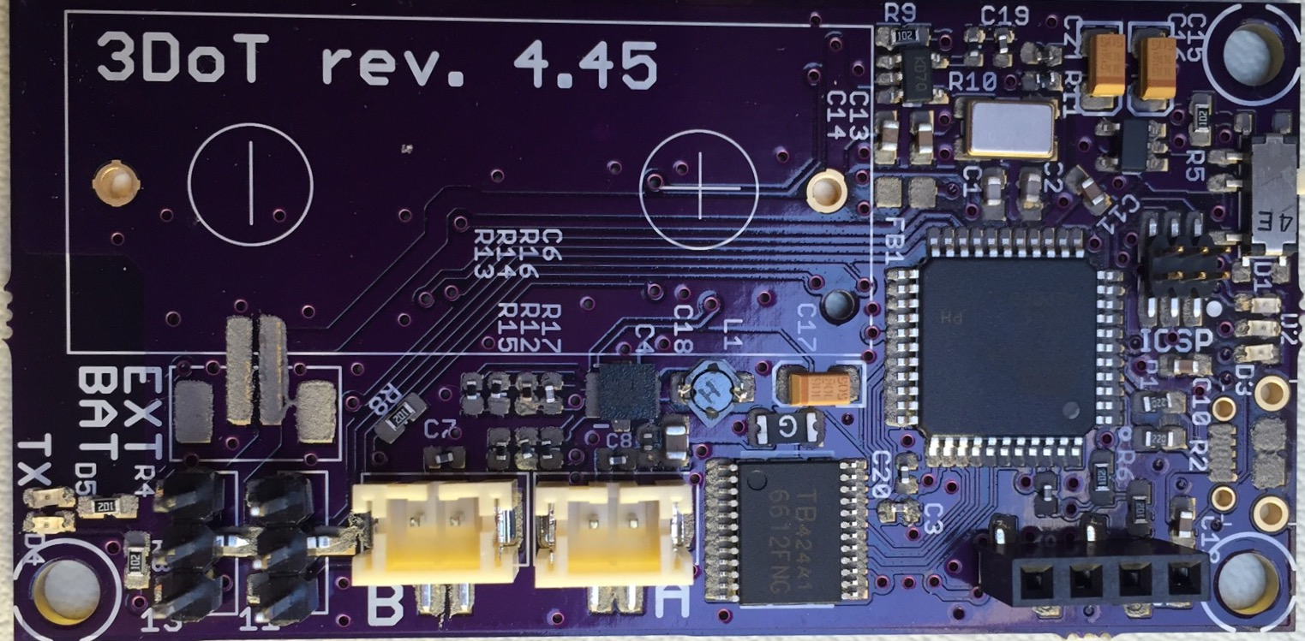
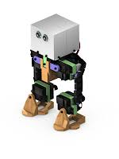
Design Creativity and Innovation
Our BiPed Robot will be based on the FOBO from 2012 but will implement different designs in the feet and head of the robot.
Head: Will house the 3DoT Board as main controller (possibly Sparkfun Pro Micro), an ultrasonic sensor, on/off indicator, and turning signal lights.
Feet: The feet of the robot will house the UV sensors that will be responsible finding out how many rooms have been traversed.
Key differences between past BiPed robots and our robot: 1. The head of the robot shall house a 3DoT board, servos controller shield, and
a sensor shield. 2. The movement of the robot will be conducted via SG90 micro servos that will
replace the clunky and oversized Hitec HS-805BB servos. 3. The legs of the robot will have a more efficient method to mount and utilize
its servos for weight reduction longer walking steps.
4. MORE Sensors! Feet will house UV sensors for close to ground detection.
Photo Credit: Omar Mouline (3DoT Board) , Stuart Dixon (Original FOBO)
Notes:
Photo Credit:
Omar Mouline (3DoT Board) https://www.arxterra.com/spring-2016-3dot-board-assembly/
Stuart Dixon (Original FOBO) http://www.projectbiped.com/prototypes/fobo/photos

Slide 13
4.
System Design
Jorge Hernandez Electronics & Control
Jeffrey De La Cruz Mission, System, and Test

Slide 14
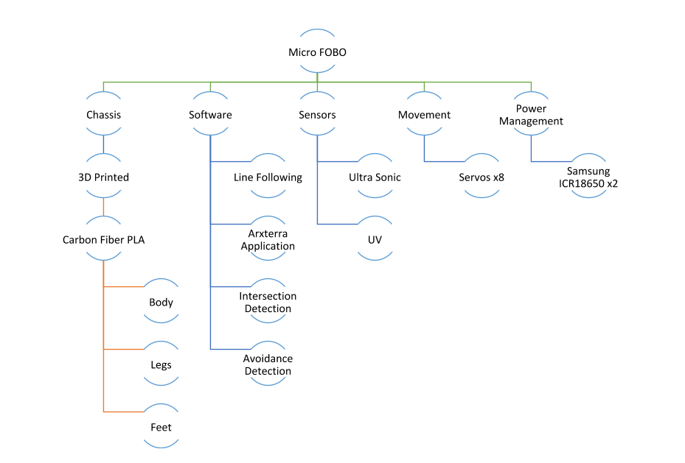
Product Breakdown Structure

Slide 15
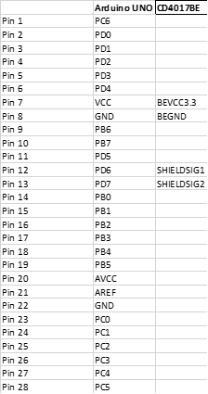
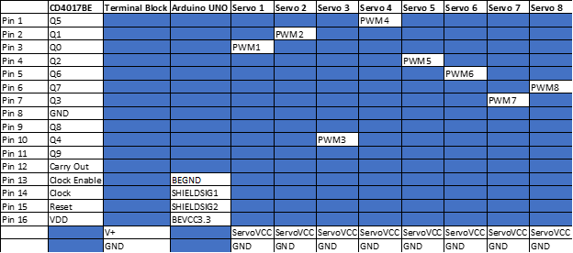
Interface Matrix

Slide 16
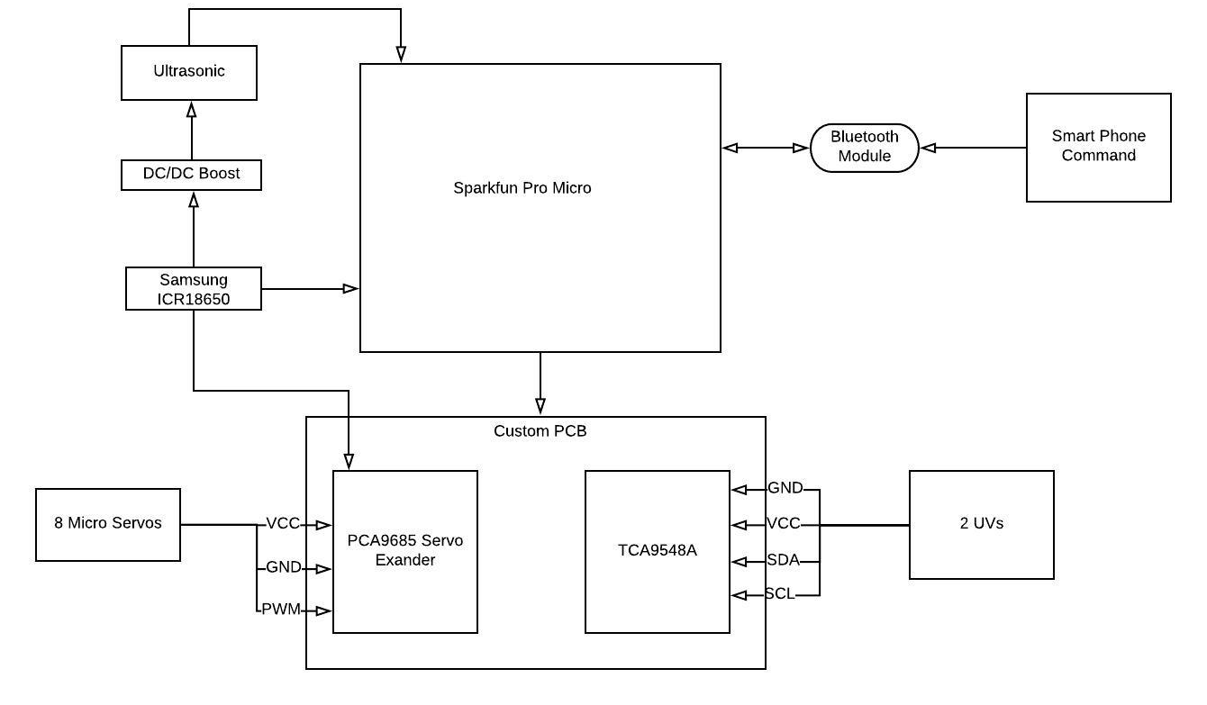
System Block Diagram

Slide 17
Interface definition II
Wiring Management
Wiring for sensors, Pro Micro, and PCB will not be exposed and will all be within the head of Micro Fobo
1/8 Inch PET Expandable Braided Sleeving with quarter inch heat shrink tubing
Used to cover the wires of the SG90 micro servo
Ensures complete coverage and protection of wires
Clean design
The cables for the servos are route out of the head encasement and directly to the servos through the back of Micro Fobo

Slide 18
5.
Mechanical Design
Miguel Gonzalez Project Manager & Manufacturing

Slide 19
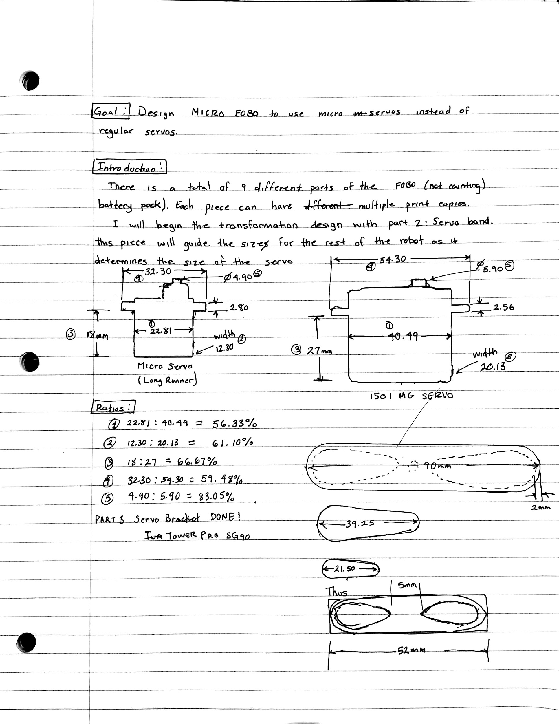
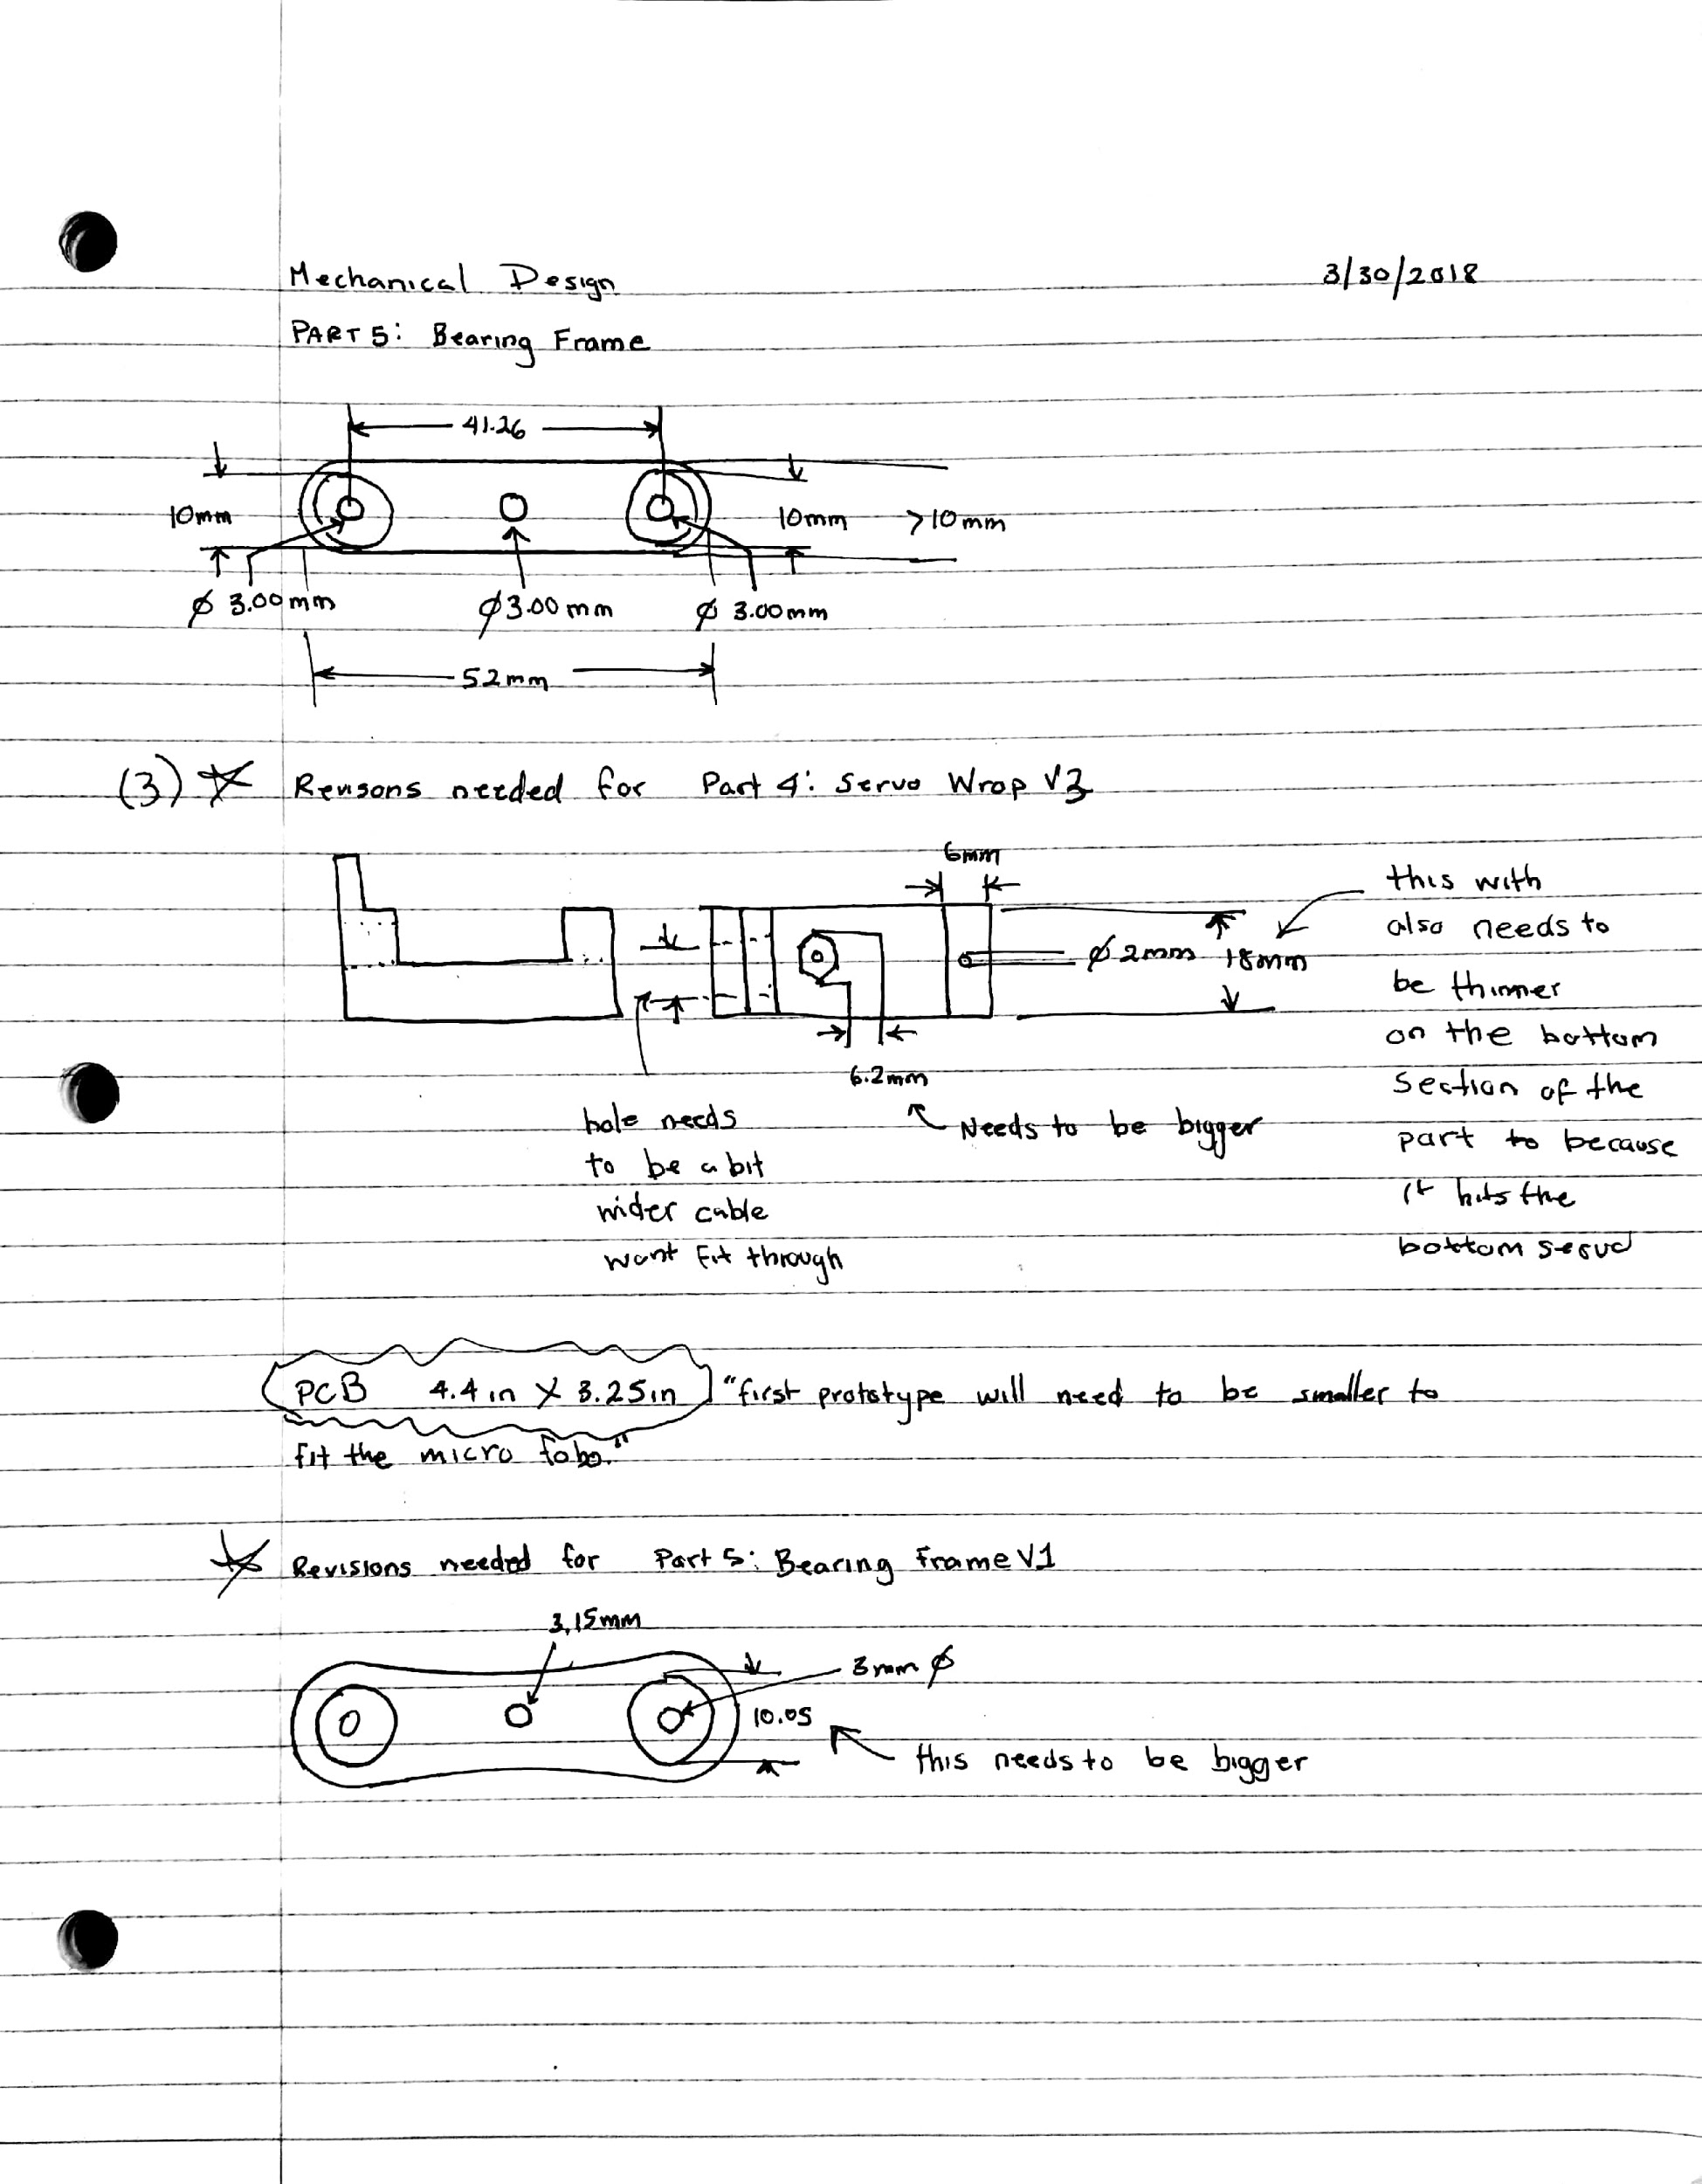
Early Mechanical Designs
Notes:
Miguel: Talk about how the Micro FOBO is approx 60% the size of the original FOBO

Slide 20
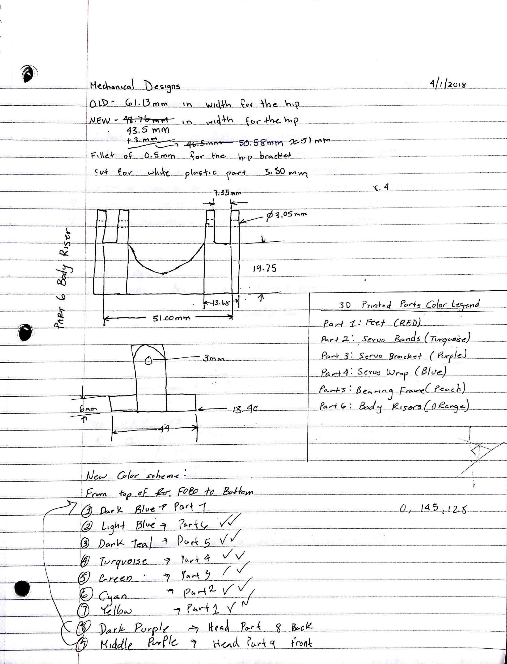
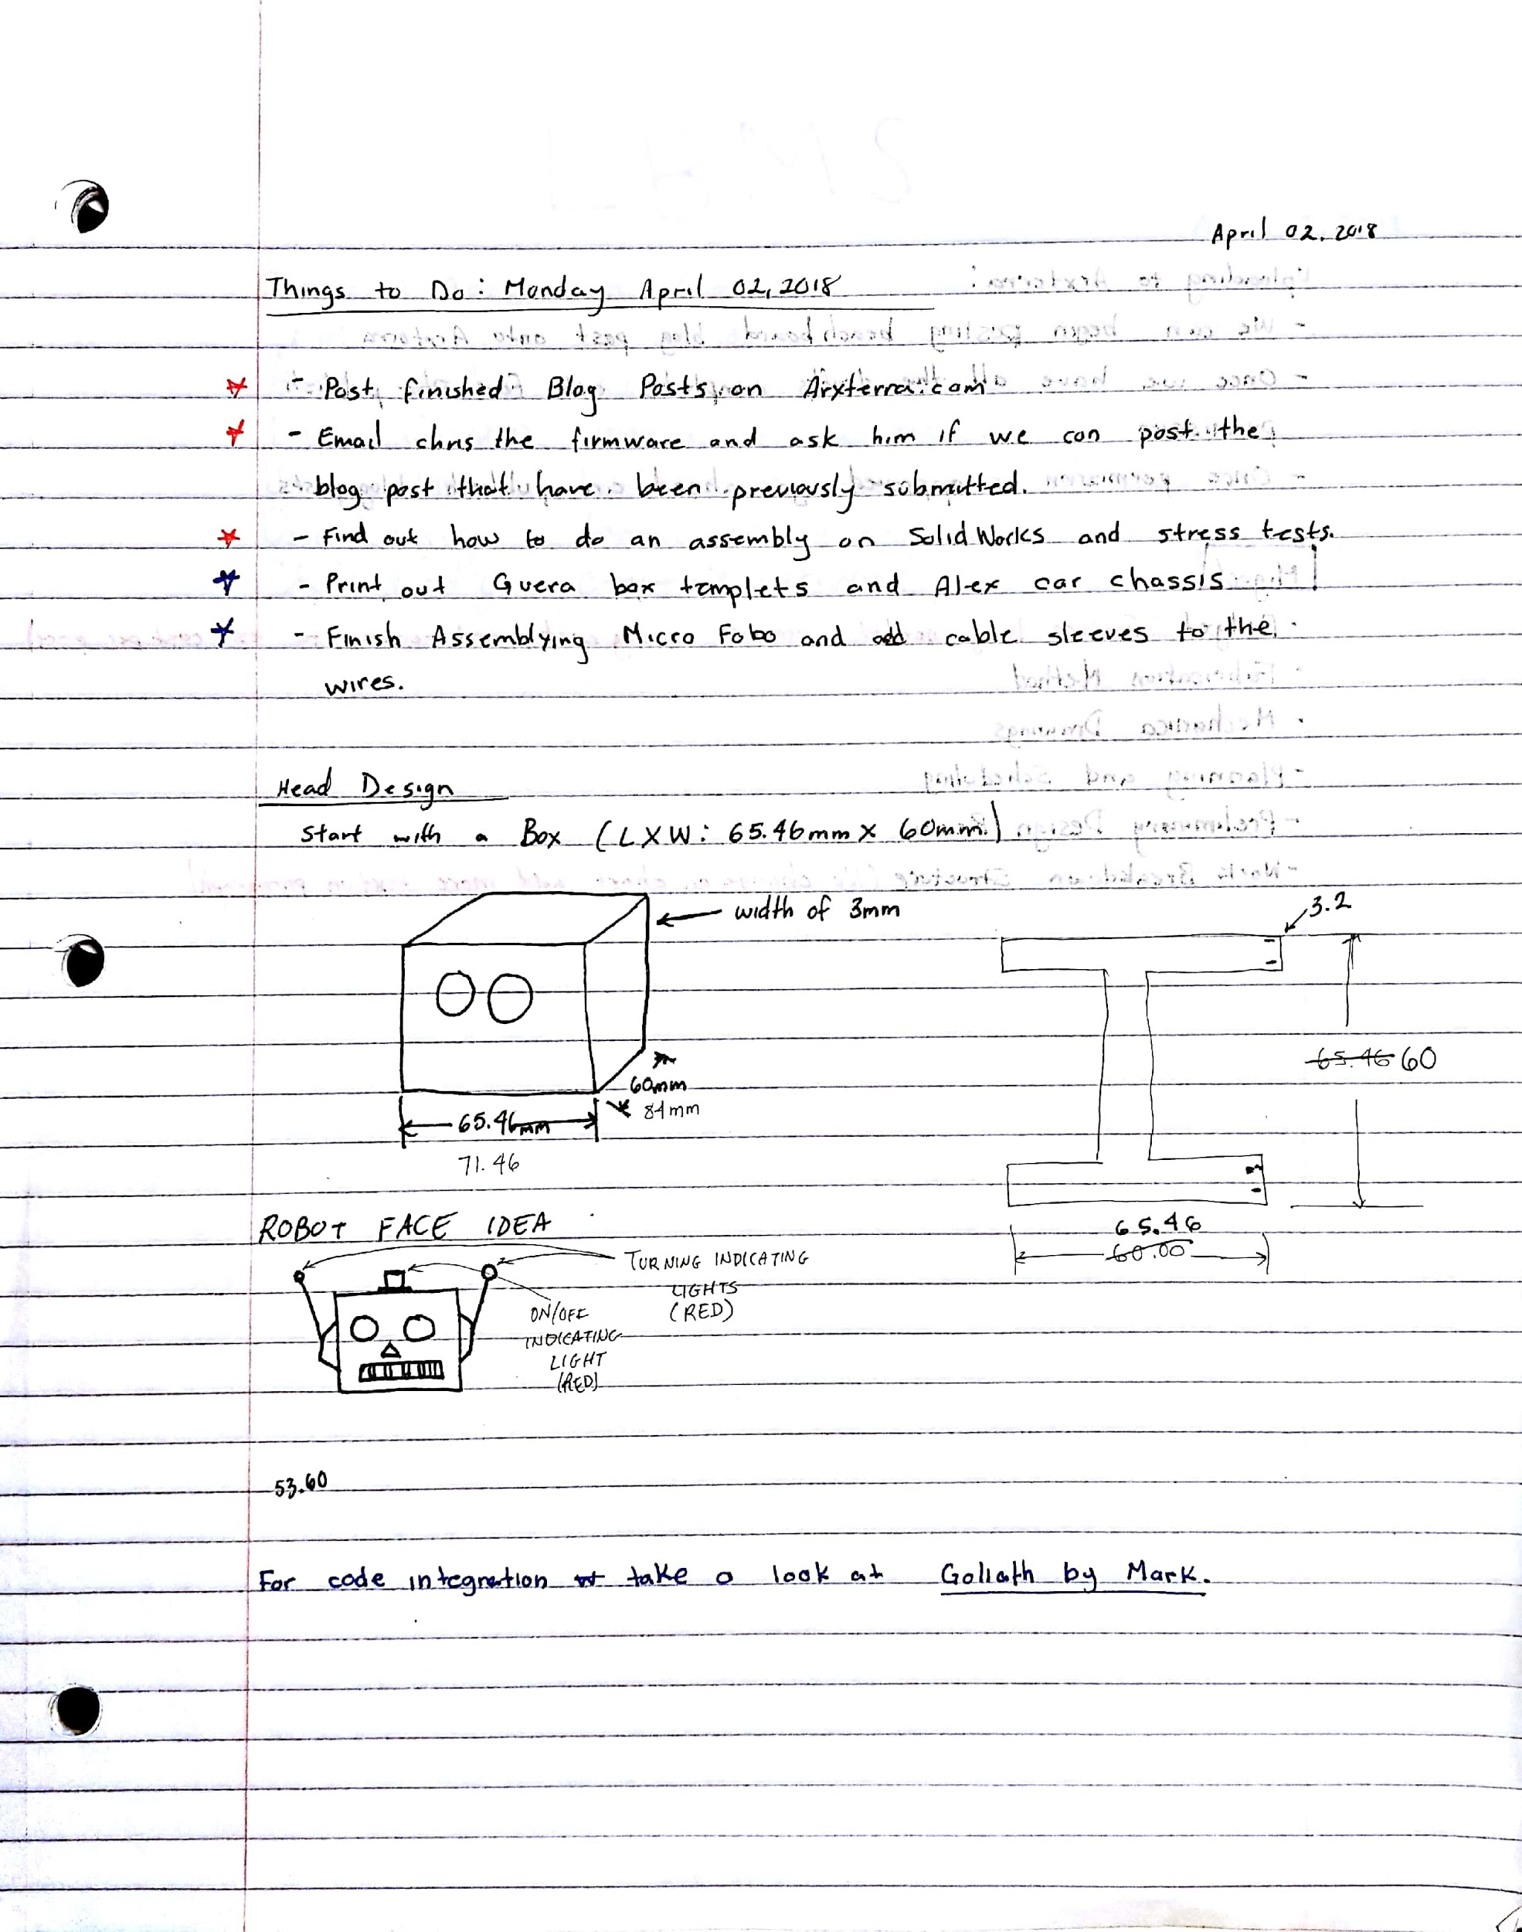
Early Mechanical Designs cont.

Slide 21
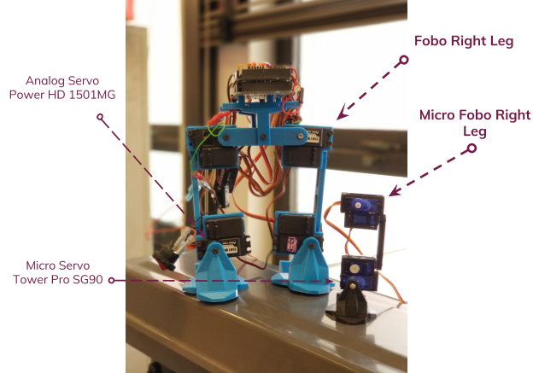
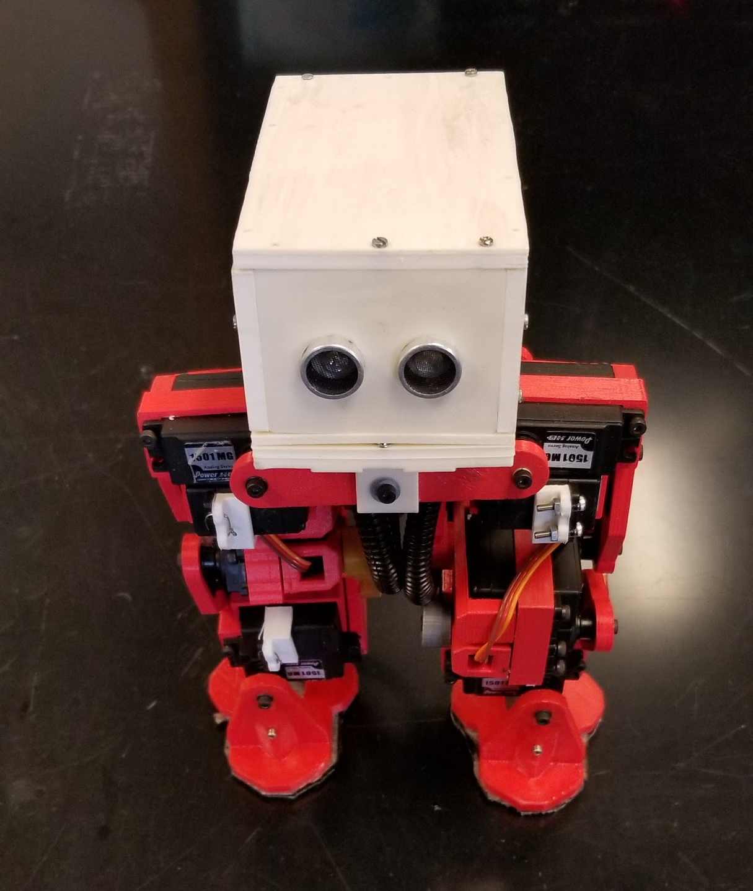
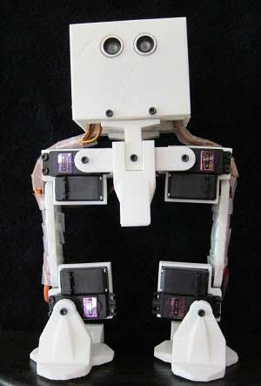
Mechanical Design Improvements
Original Models
Micro FOBO
Photo Credit: Stuart Dixon (Original Models: Right Picture)

Slide 22
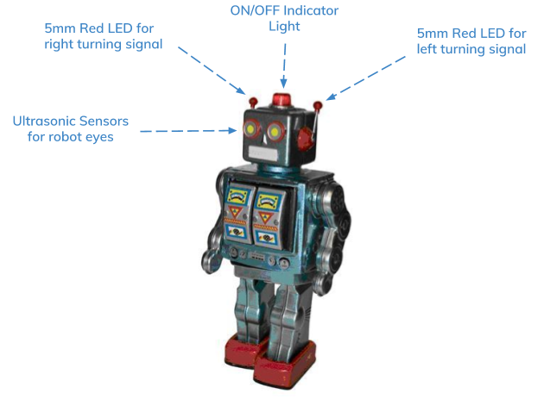
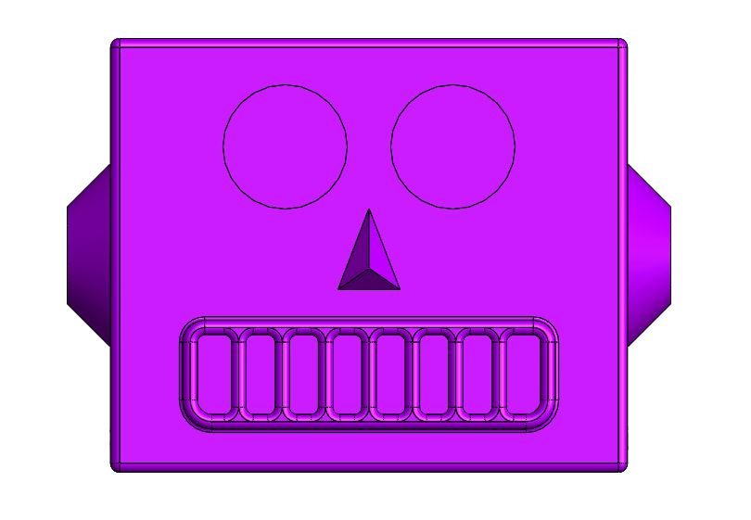
Mechanical Design Improvements
Micro FOBO Functional Toy Face

Slide 23
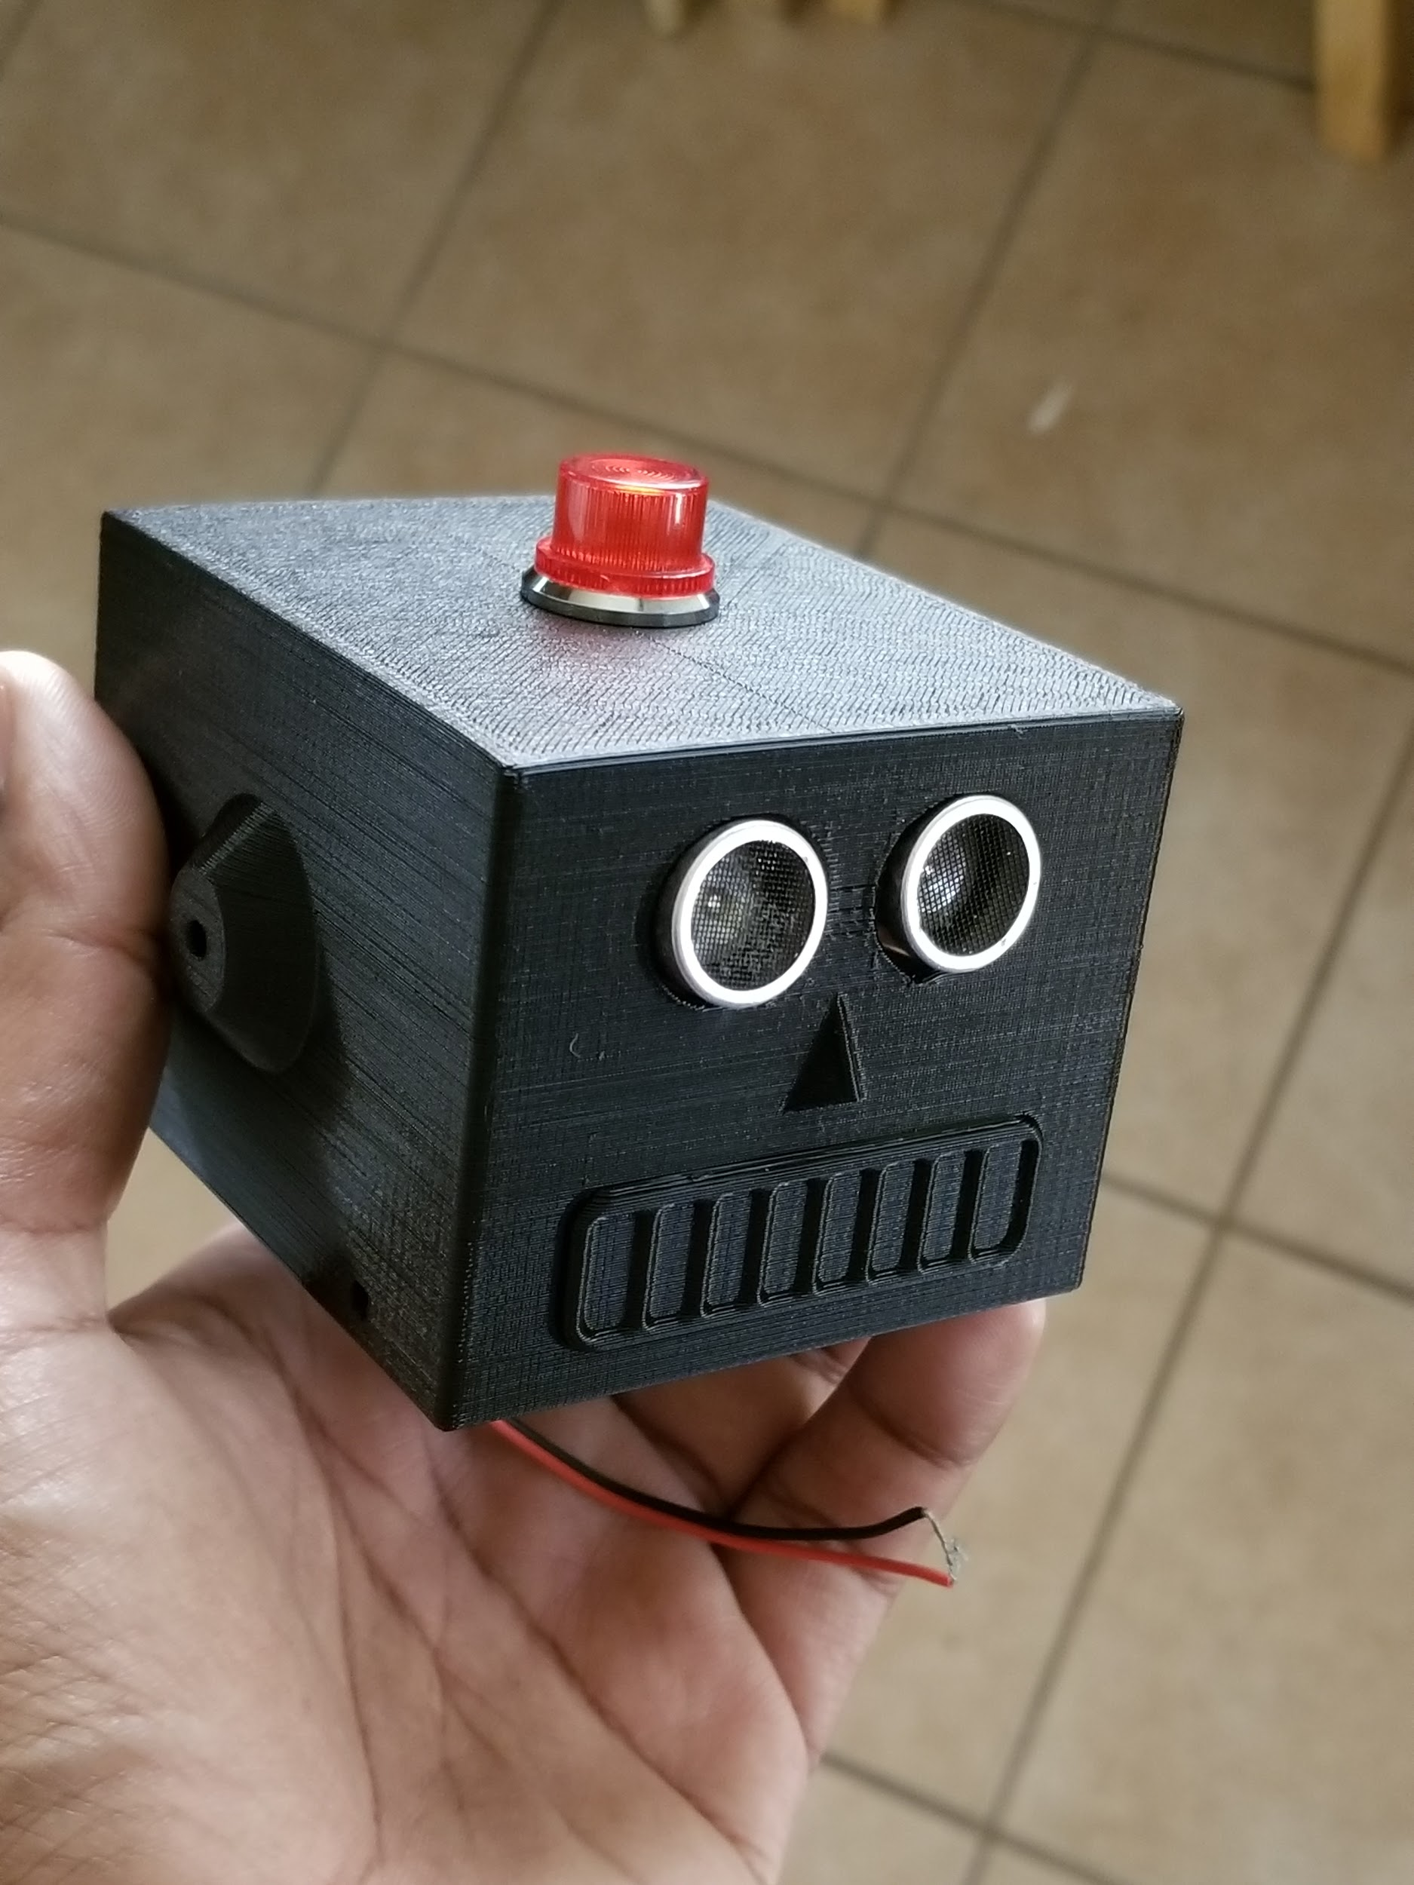
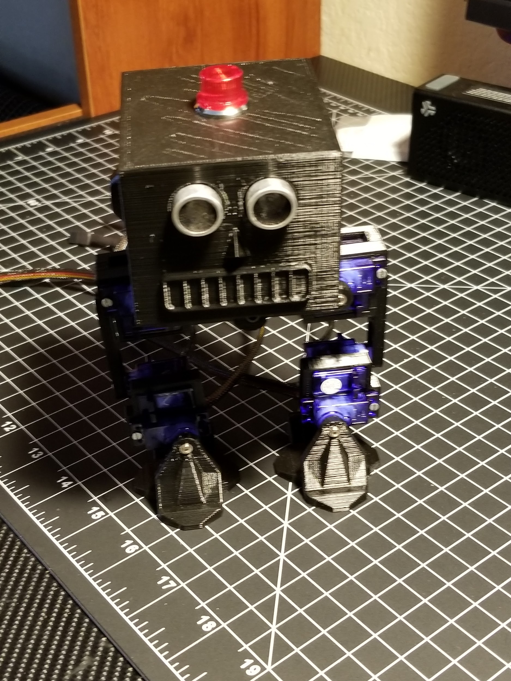
Mechanical Design Improvements

Slide 24
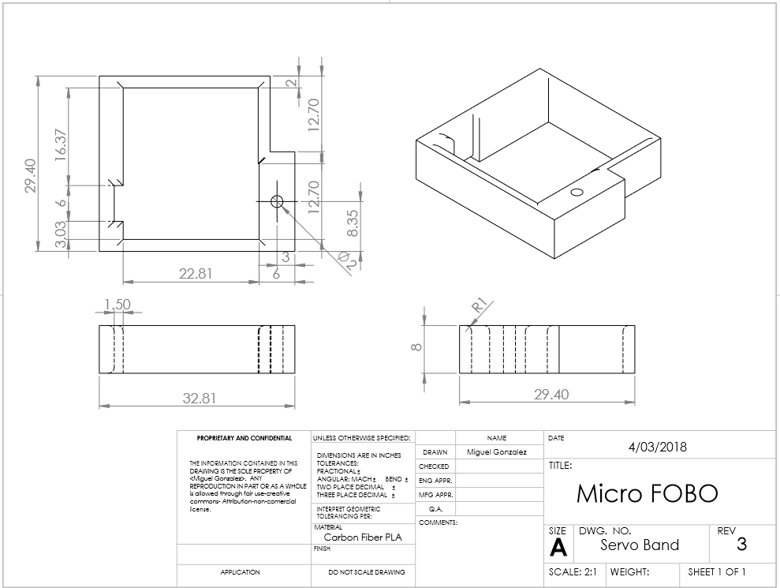
Mechanical Design Improvements

Slide 25
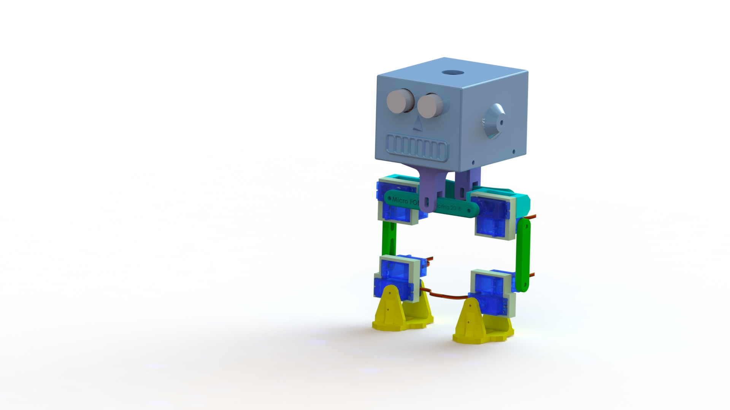
Mechanical Design
0
Servo Hip
1
Foot
2
Servo Band
3
Servo Bracket
4
Servo Wrap
5
Bearing Frame
6
Body Riser
7
Electronics Frame
8
Head

Slide 26
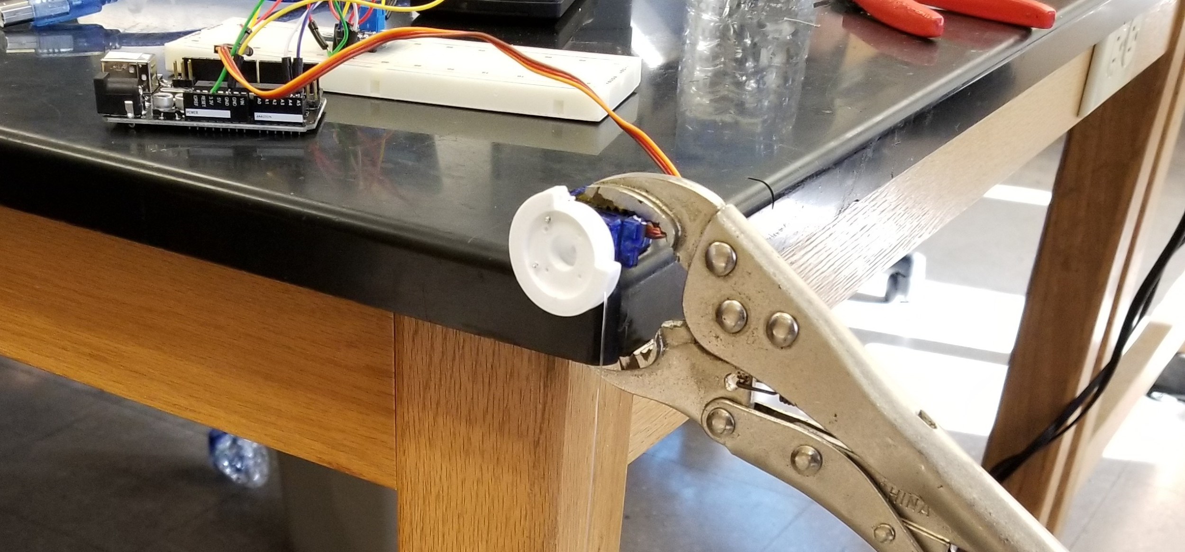
Micro Servo Electronic Design
Plastic geared SG90 & Metal geared MG90 micro servos were tested.
Output current and load stress were tested to see which micro servo would be the best fit for Micro Fobo.
A 3-D pulley attached to different loads along with the INA219 Current sensor were used
Operated at 5V & 3.3V.

Slide 27
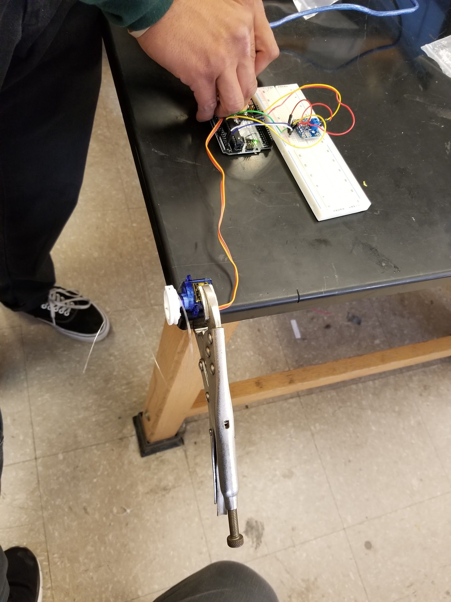
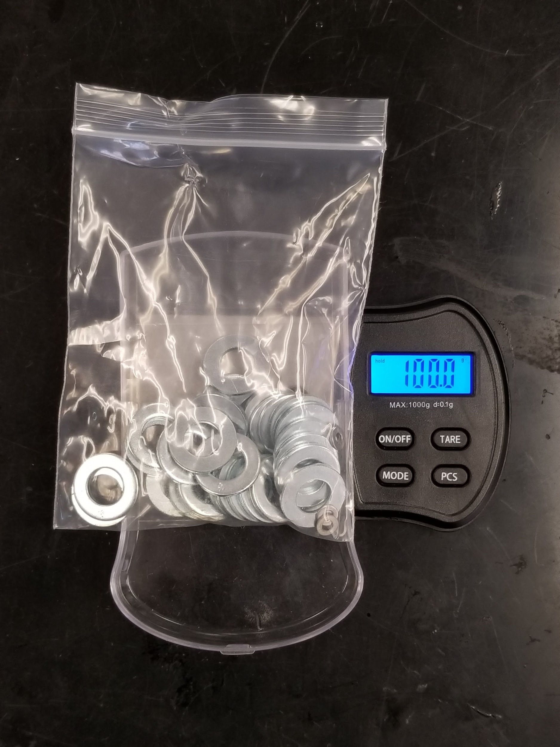
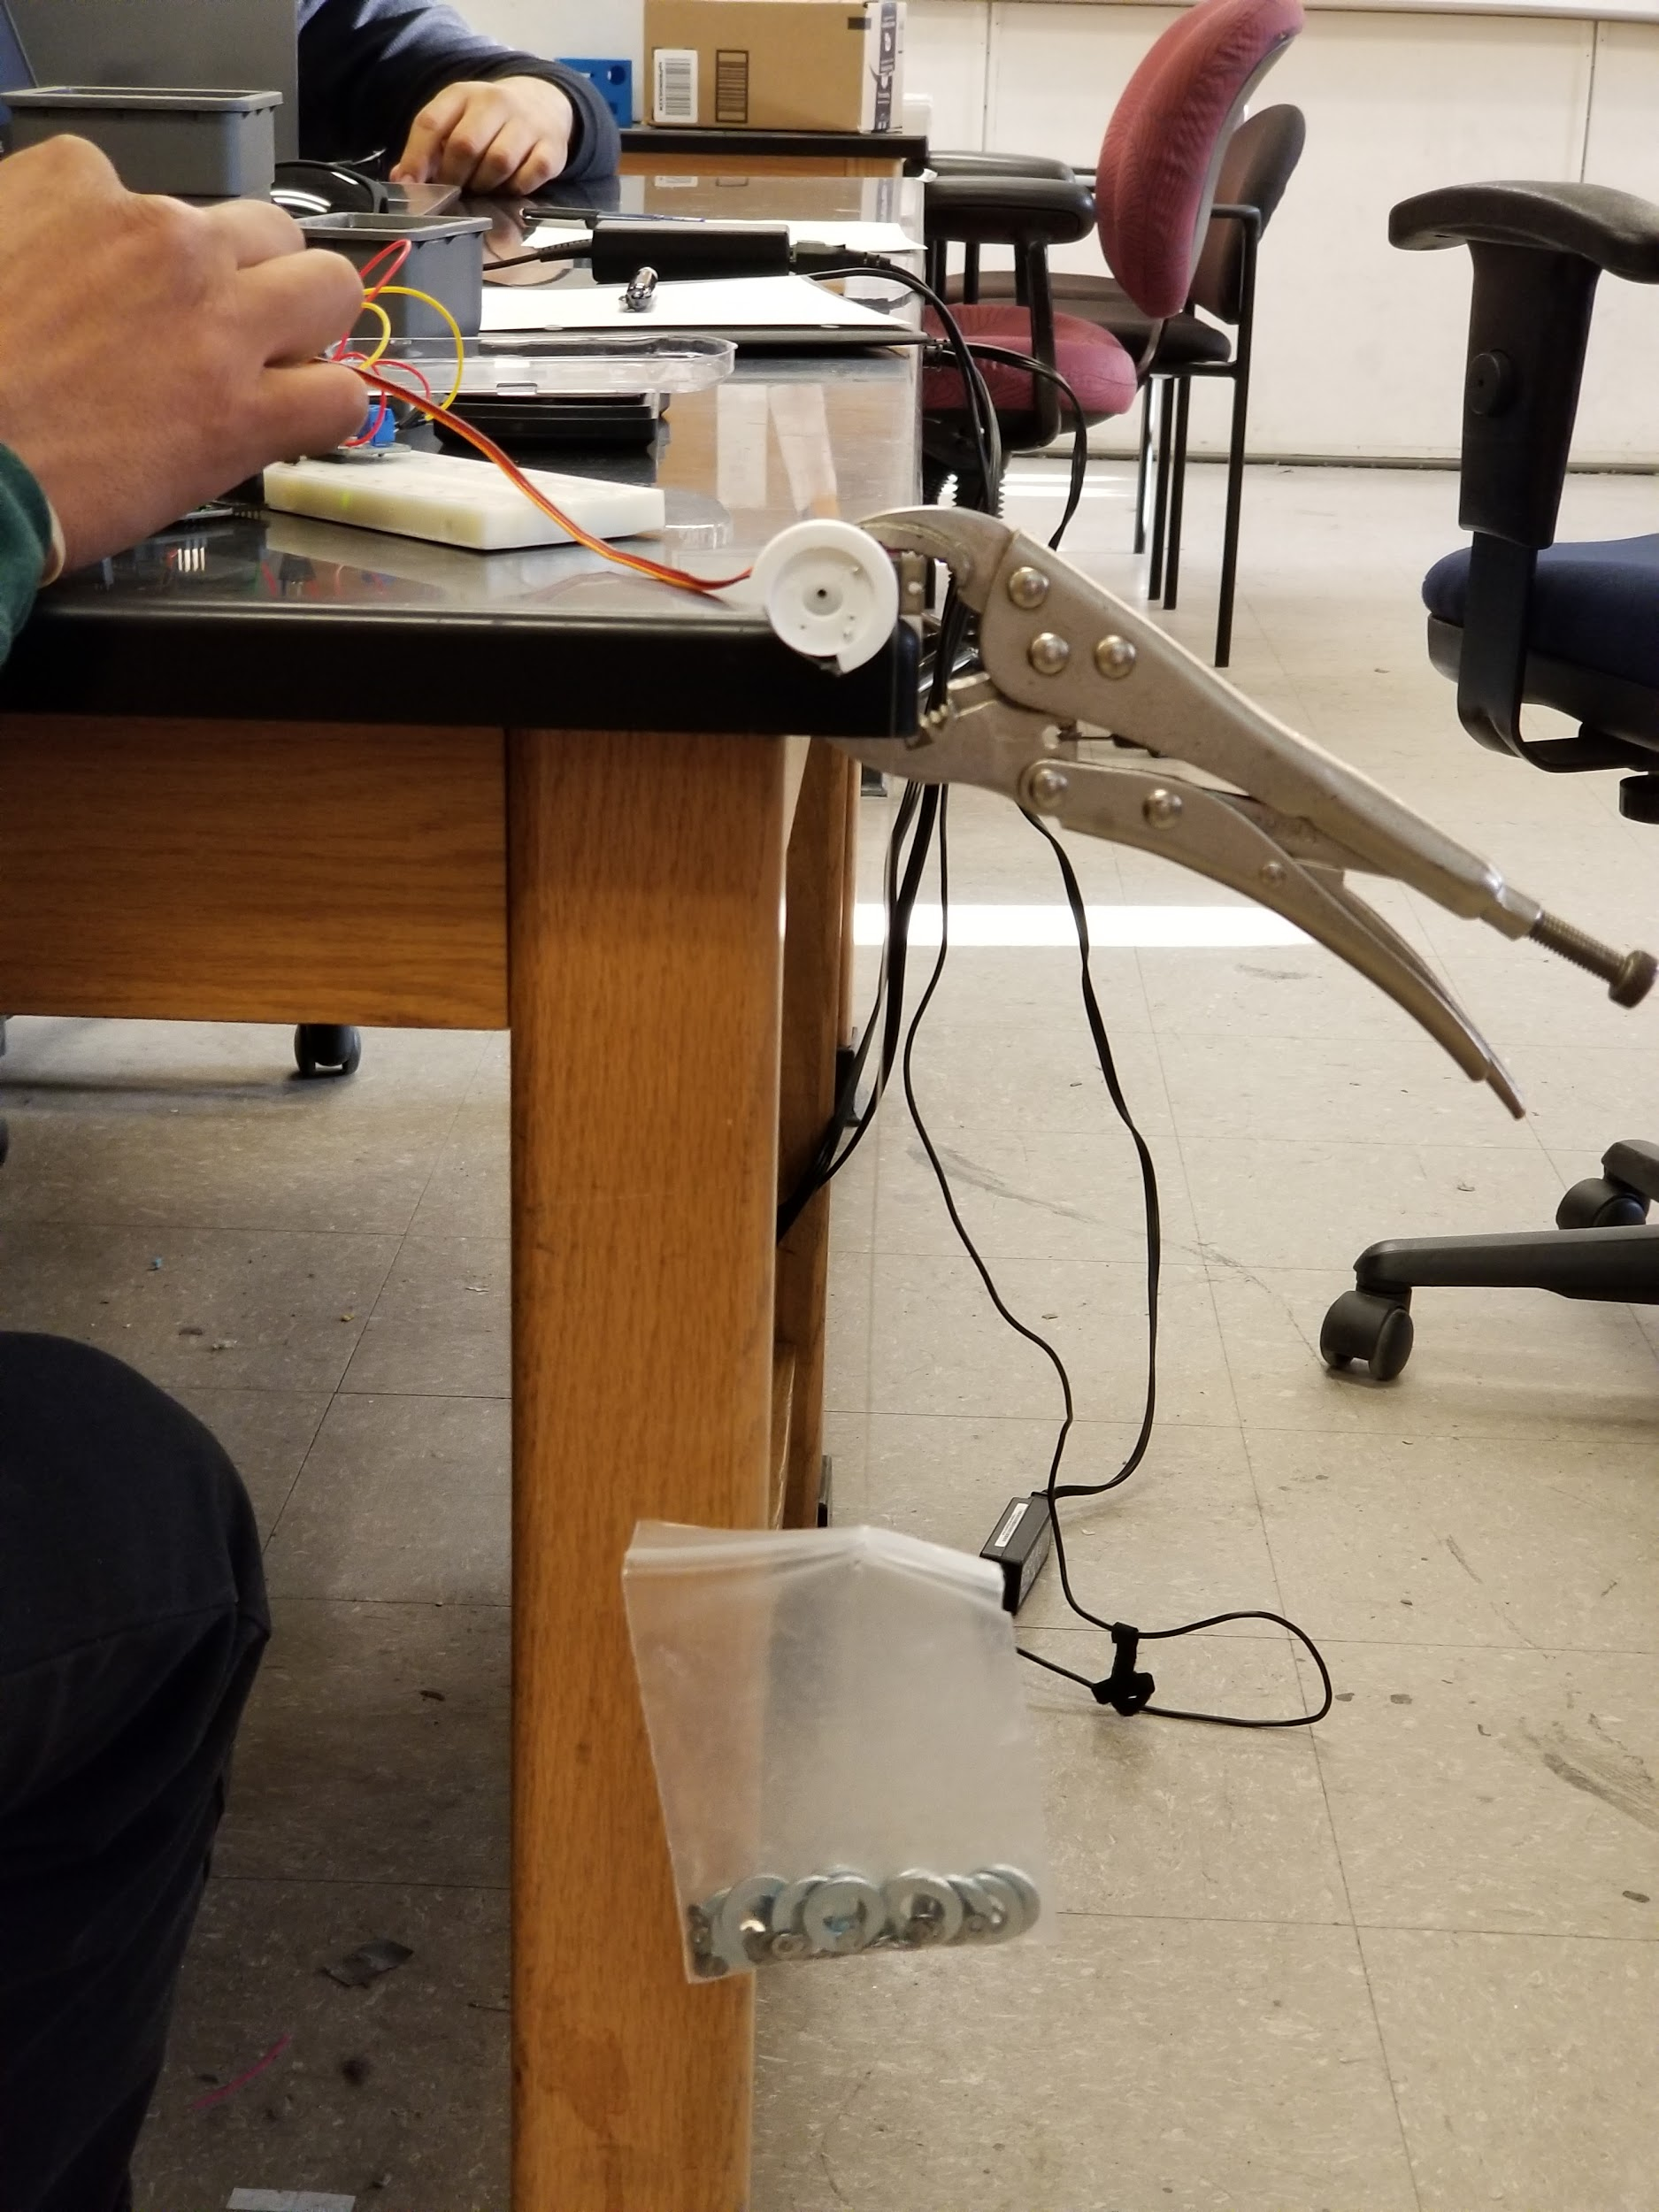
Actual testing

Slide 28
At 3.3 V
SG90 Plastic Geared
Load (grams) | Current (mA) | Power (W)
50 | 104.9 | .327
100 | 164.8 | .510
200 | 266.3 | .809
MG90 Metal Geared
Load (grams) | Current (mA) | Power (W)
50 | 144 | .459
100 | 331 | 1.09
200 | Stalled | Stalled

Slide 29
At 5 V
SG90 Plastic Geared
Load (grams) | Current (mA) | Power (W)
50 | 142.60 | 0.705
100 | 204 | 1.0098
200 | 440.6 | 2.17
MG90 Metal Geared
Load (grams) | Current (mA) | Power (W)
50 | 344.7 | 1.7028
100 | 462 | 2.28
200 | 493.6 | 2.438

Slide 30
Results
SG90 Plastic Geared will be used for Micro Fobo
Uses less Current
Operates at 3.3V/5V
Unlike MG90 micro servo, it doesn not stall at 3.3V @ 200g load
Satisfies customer requirement

Slide 31
Battery trade-off Study
Nominal Capacity >2350mAH | Nominal Voltage =3.6 V | Weight <45g | Max Voltage = 4.2 V
Samsung 25R (18650) | ✔ | ✔ | ✔ | ✔
Lithium Ion Battery 2P (523450) | ✖ | ✔ | ✔ | ✔
EBL Li-Ion(14500) | ✖ | ✔ | ✔ | ✔

Slide 32
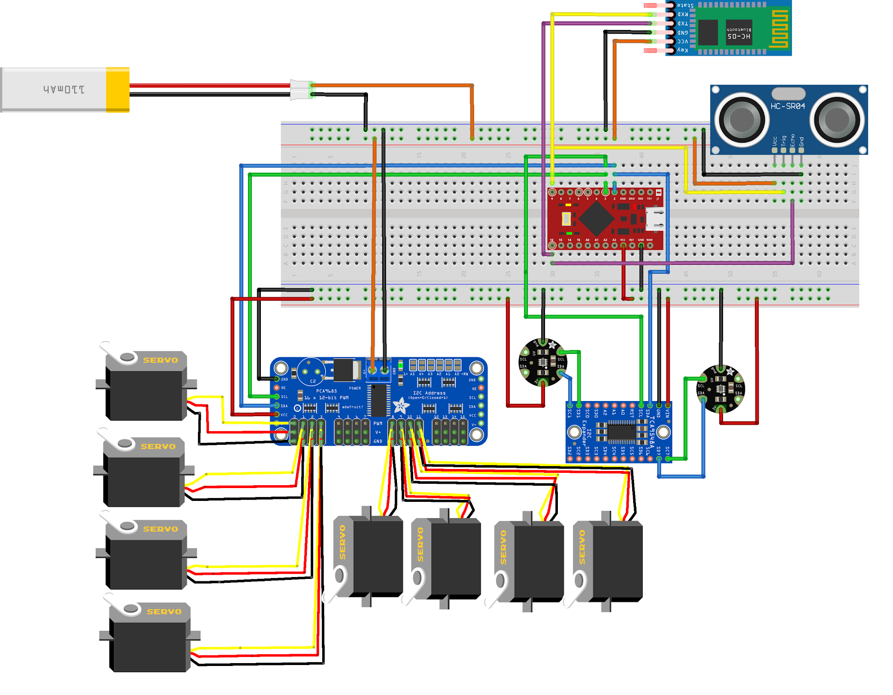
Fritzing Diagram

Slide 33
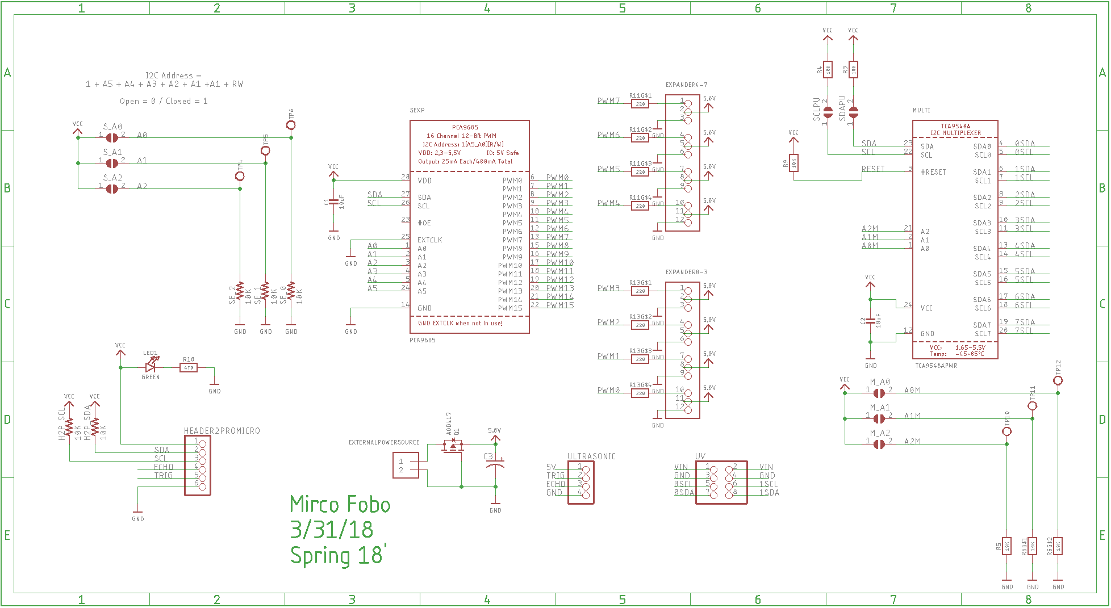
PCB Schematic

Slide 34
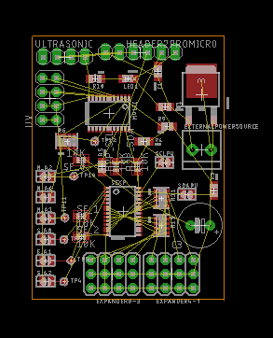
PCB layout
34.29mm x 48.26mm
Fits well within Micro Fobos head
60mm x 78mm

Slide 35
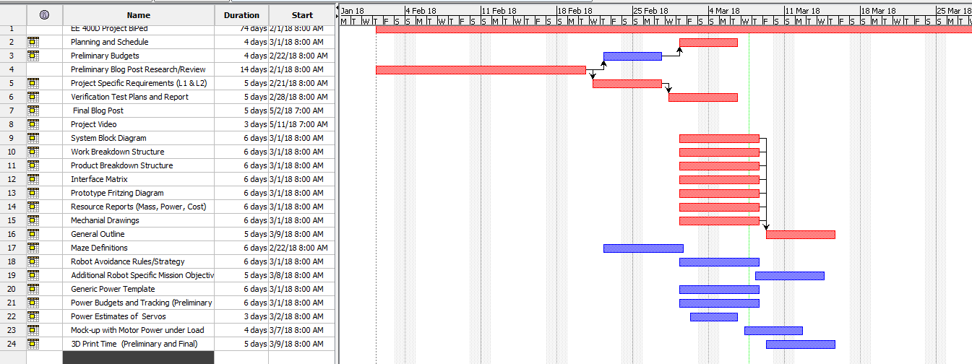
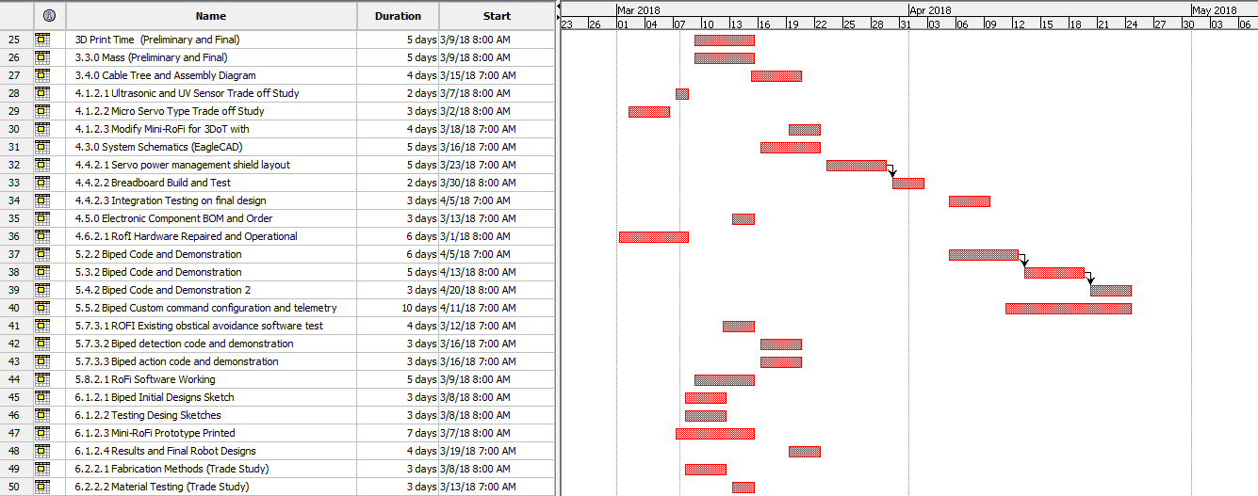
Schedule
Project Schedule

Slide 36
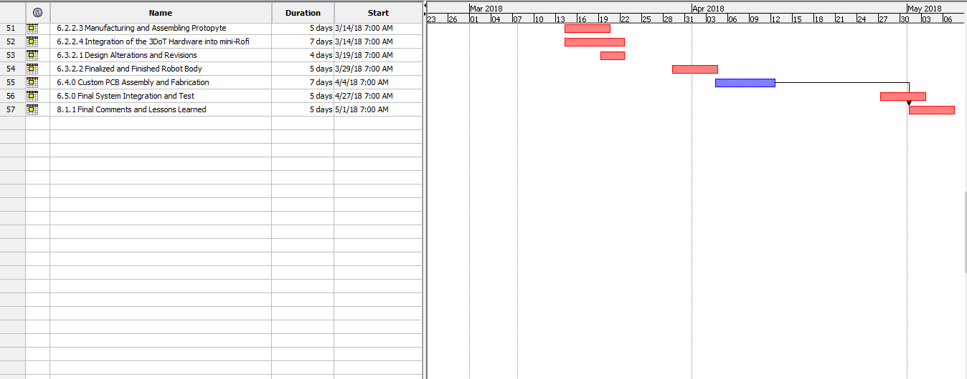
Project Schedule cont..

Slide 37
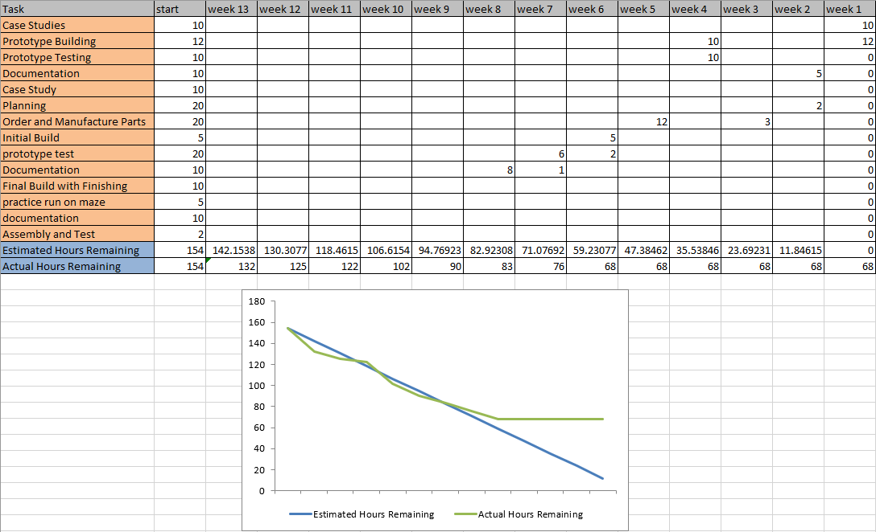
Burn Down

Slide 38
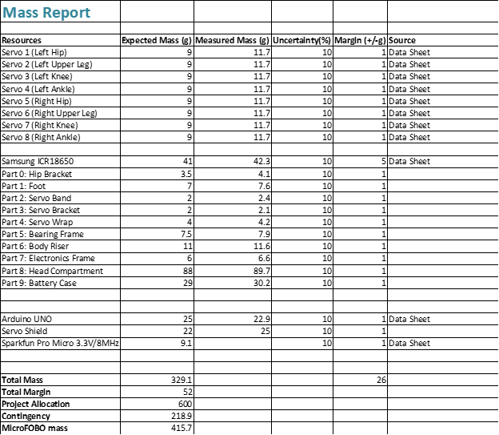
Mass Allocation

Slide 39
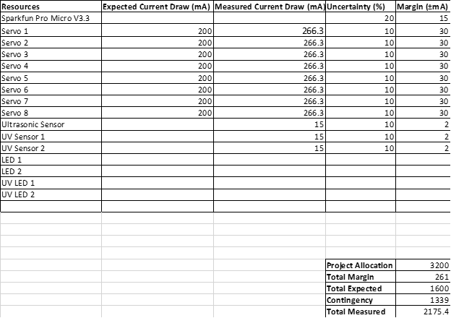
Power Allocation

Slide 40
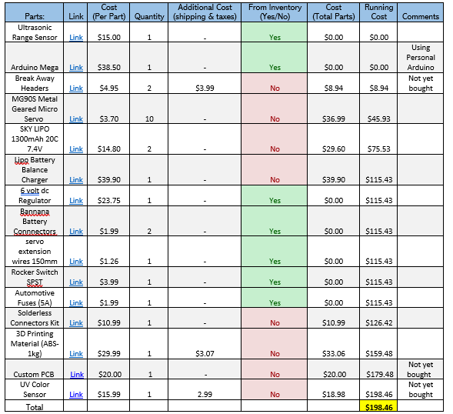

Slide 41
Appendix
Sources:
FOBO Website: http://www.projectbiped.com/prototypes/fobo
Photo Credit:
Omar Mouline (3DoT Board) https://www.arxterra.com/spring-2016-3dot-board-assembly/
Stuart Dixon (Original FOBO) http://www.projectbiped.com/prototypes/fobo/photos
Toy Tin Robot https://www.cpsc.gov/Recalls/2007/schylling-associates-recalls-collectable-toy-robot-due-to-violation-of-lead-paint
Eduardo De La Cruz (Maze pg5)

